Slide 1
HOW TO VISUALISE
PAEDIATRIC CARDIAC SURGERY
FOR THE PUBLIC
R. Poruban
Children´s Heart Centre, University Hospital Motol, Prague

Slide 2
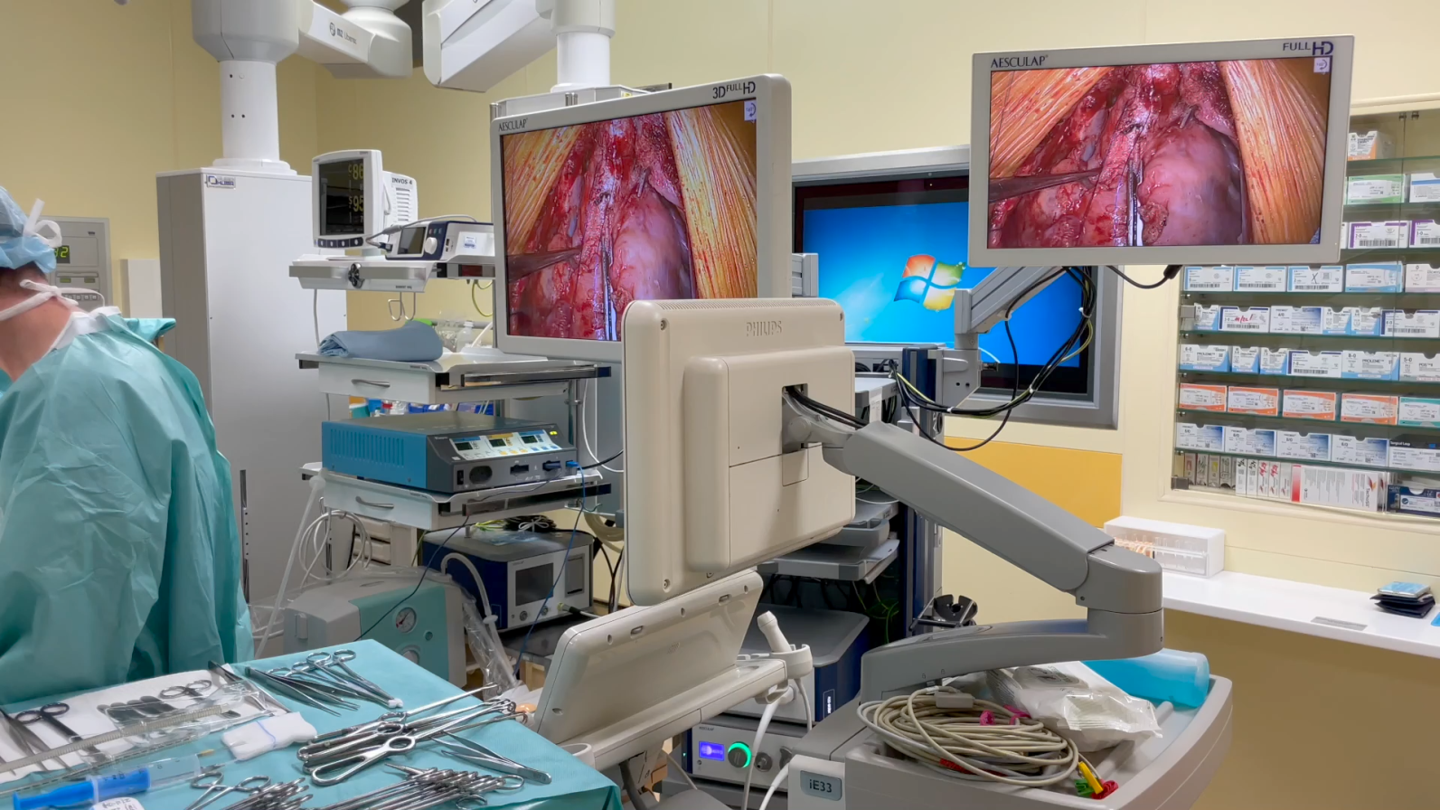
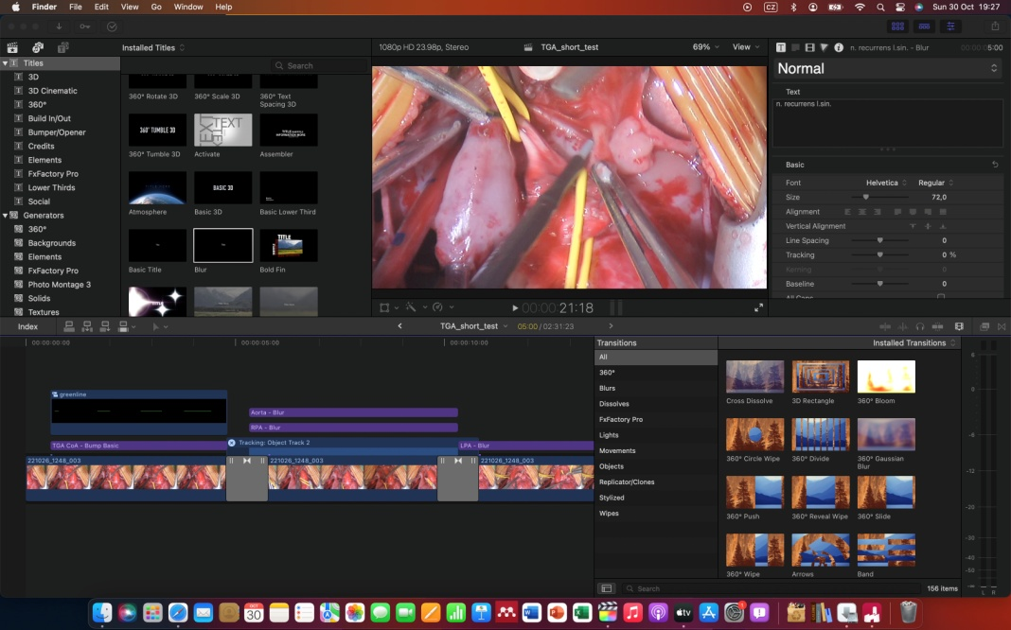
What we do…
Recording videos on a regular basis
Using HD 3CCD thoracoscopic camera
Sharing online on local network
Discussing surgical findings next day with processed surgical video

Slide 3
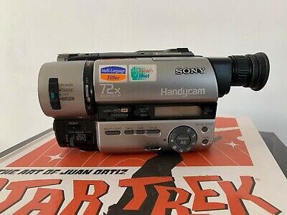
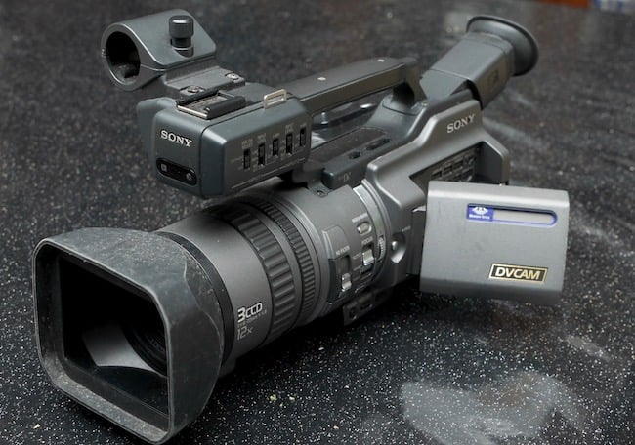
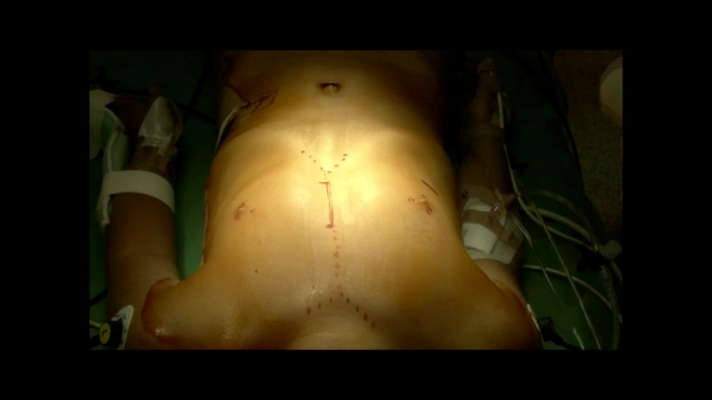
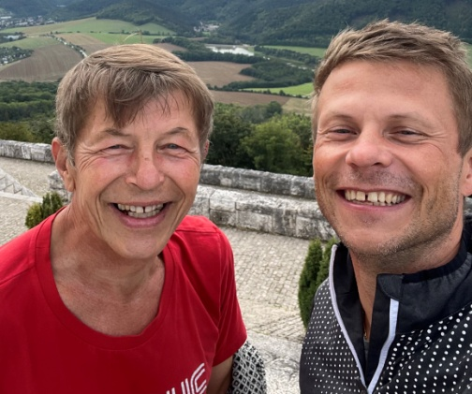
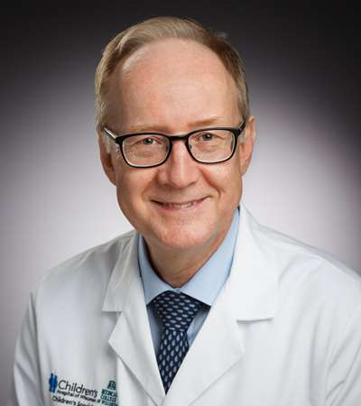
History
Video recording:
  Video8 / Hi8 formats (VHS C)
  High definition (HD), 4K (UHD)
Video formats
  Digital 8, miniDV, DVD, flash memory, HardDisk
1997 start recording videos
2007 Sankt Augustin – thoracoscopic camera

Slide 4
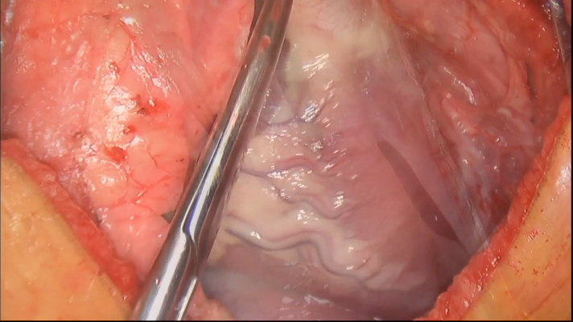
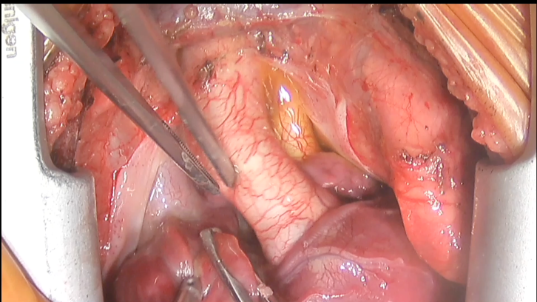
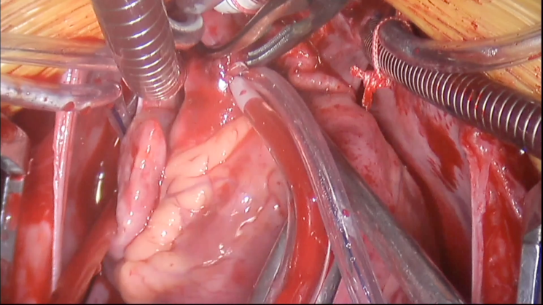
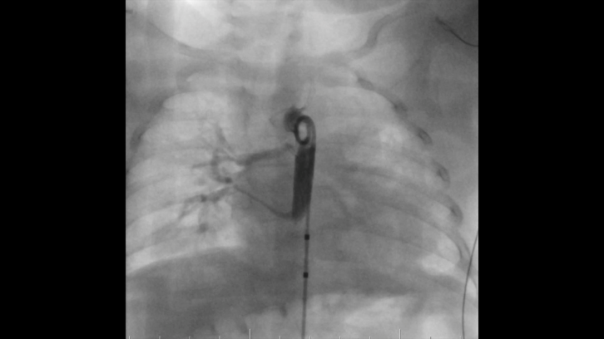
GOALS – Why do we record videos?
Presentations and lectures
Education
Documentation of the exact procedure
Visualization for professionals
  Complexity of the surgery
  Building trust

Slide 5
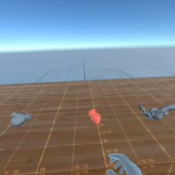
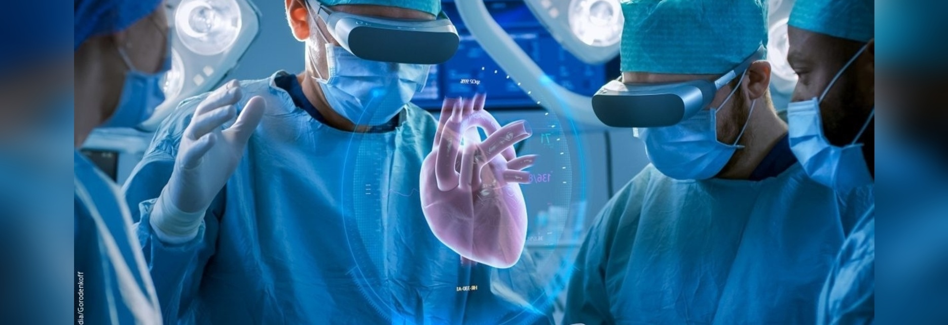
Future of visualization
Virtual reality of surgical planning
Experimental learning
Virtual surgery trainig

Slide 6
Why to share surgical videos?
Visualization for the professionals
  Complexity of the surgery
  Building trust
Clips
Figures
Anatomic landmarks
Arrows and signs

Slide 7
Not everything could be shared… and problems
Sound
Dedicated professionals
Hardware
Digital storage

Slide 8
Conclusion
Important
Self education and education
Teaching

