Slide 1




CzeCh CardiovasCular
Diuretic Use in Heart Failure
Wilfried Mullens MD, PhD
Ziekenhuis Oost-Limburg, Genk
University Hasselt, Belgium
Fellow and Board Member of Heart Failure Association

Slide 2
Disclosures
Speekers fee from Medtronic, Abbott, Novartis, Vifor Pharma, Astra Zenica, Boehringer Ingelheim, Pfizer, Novo Nordisk
Heart failure specialist who should have been a nephrologist….

Slide 3

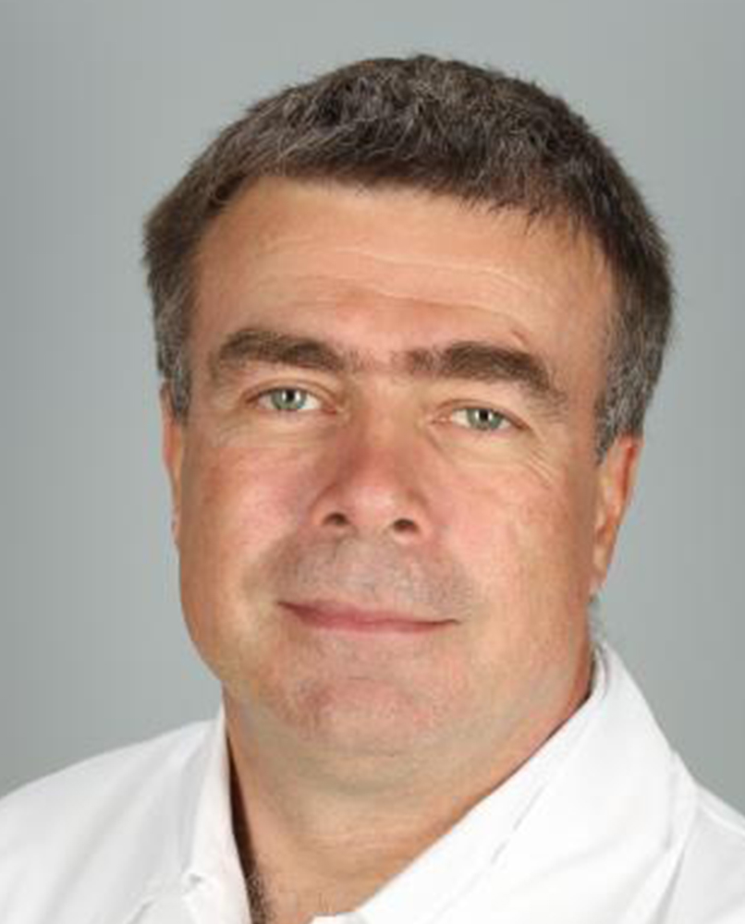


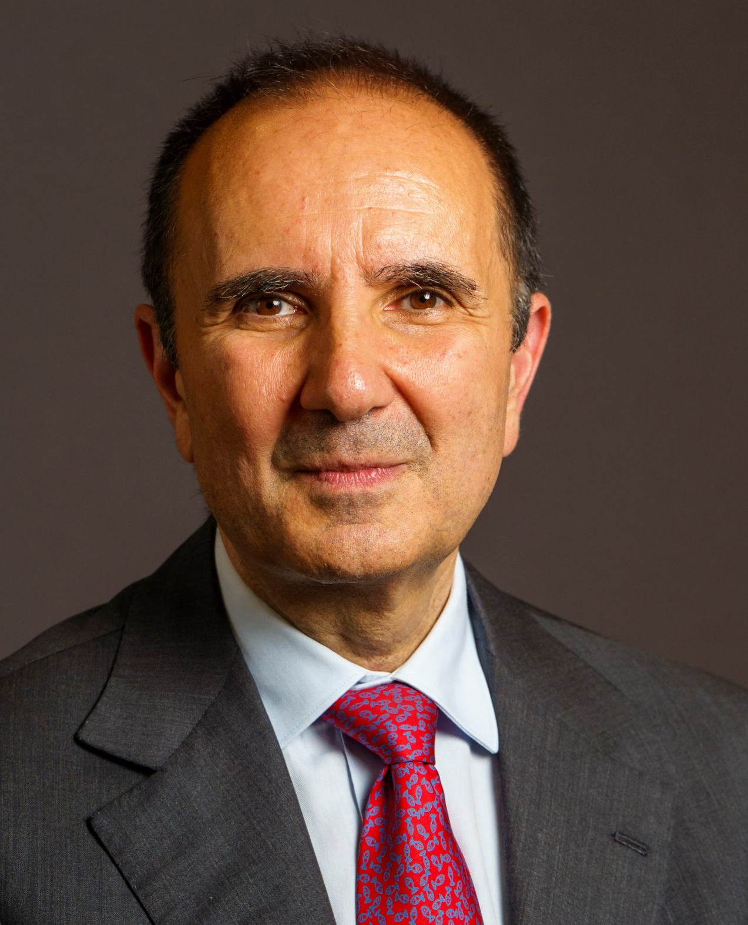
Ales Linhart
Heart Failure 2023
Local Host
Wilfried Mullens
Heart Failure 2023
Congress Chairperson
Marco Metra
President-Elect
Giuseppe Rosano
President
Largest international HF congress (Onsite + Online)
Close collaboration with the Czech Cardiac – HF society
Leading-edge science
Late-breaking science
Update of HF guidelines
Large visibility of the abstracts and clinical cases
EACCME Accreditation
Networking opportunities & Interaction
Interactive room for Experts on the Spot - Cased-based and How-to sessions
Open rooms dedicated to oral abstracts presentations + meet the trialist
Networking events
Opportunities for the Young community
Travel grants for Young and abstract presenters
Ask-your question sessions
Career café…

Slide 4
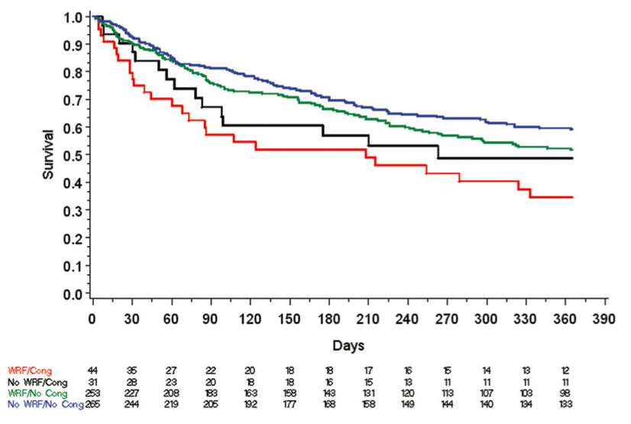
Underappreciated risk for hospitalization / death
linked to residual congestion in HFpnts
Ambulatory: 20% risk at 2 years
Recently Hospitalized: 60% risk at 1 year
No congestion @ discharge
Ongoing congestion @ discharge
McMurray, Packer et al NEJM 2014
Metra M et al. Circ Heart Fail. 2012;5:54-62

Slide 5

McDonagh T et al. Eur Heart J 2021

Slide 6
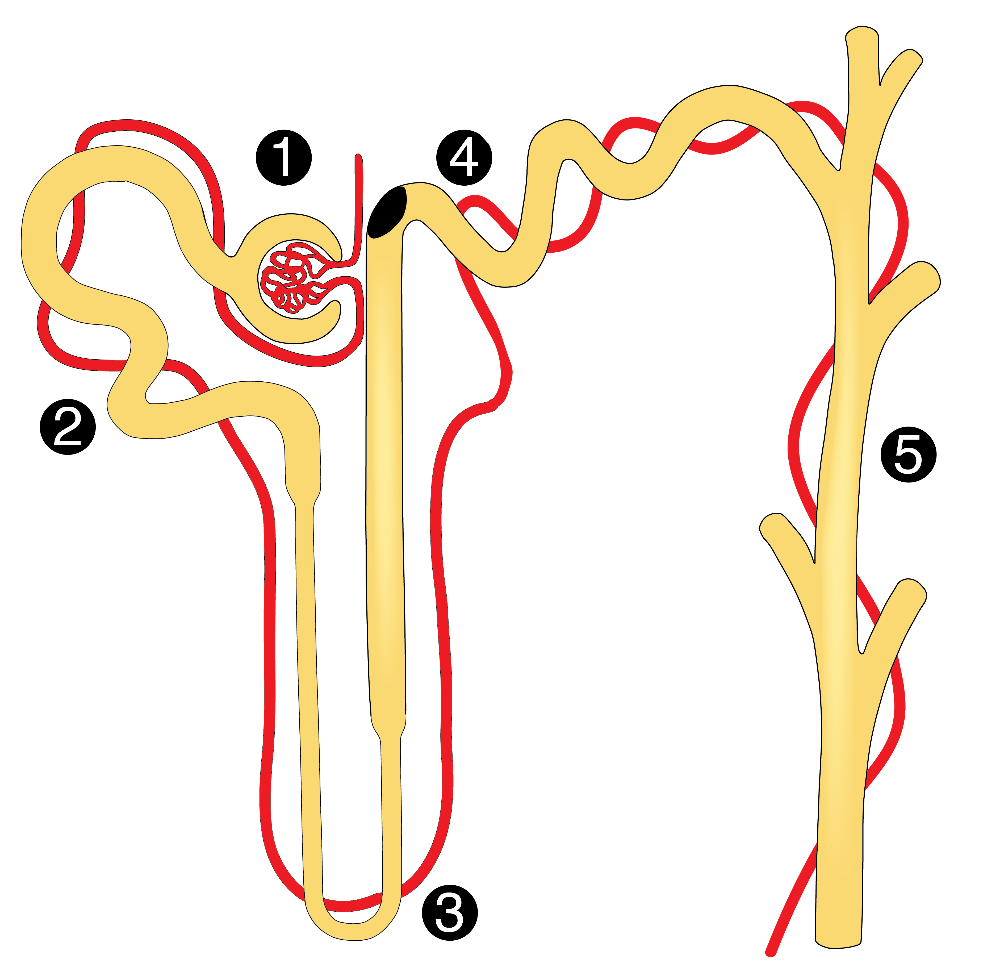
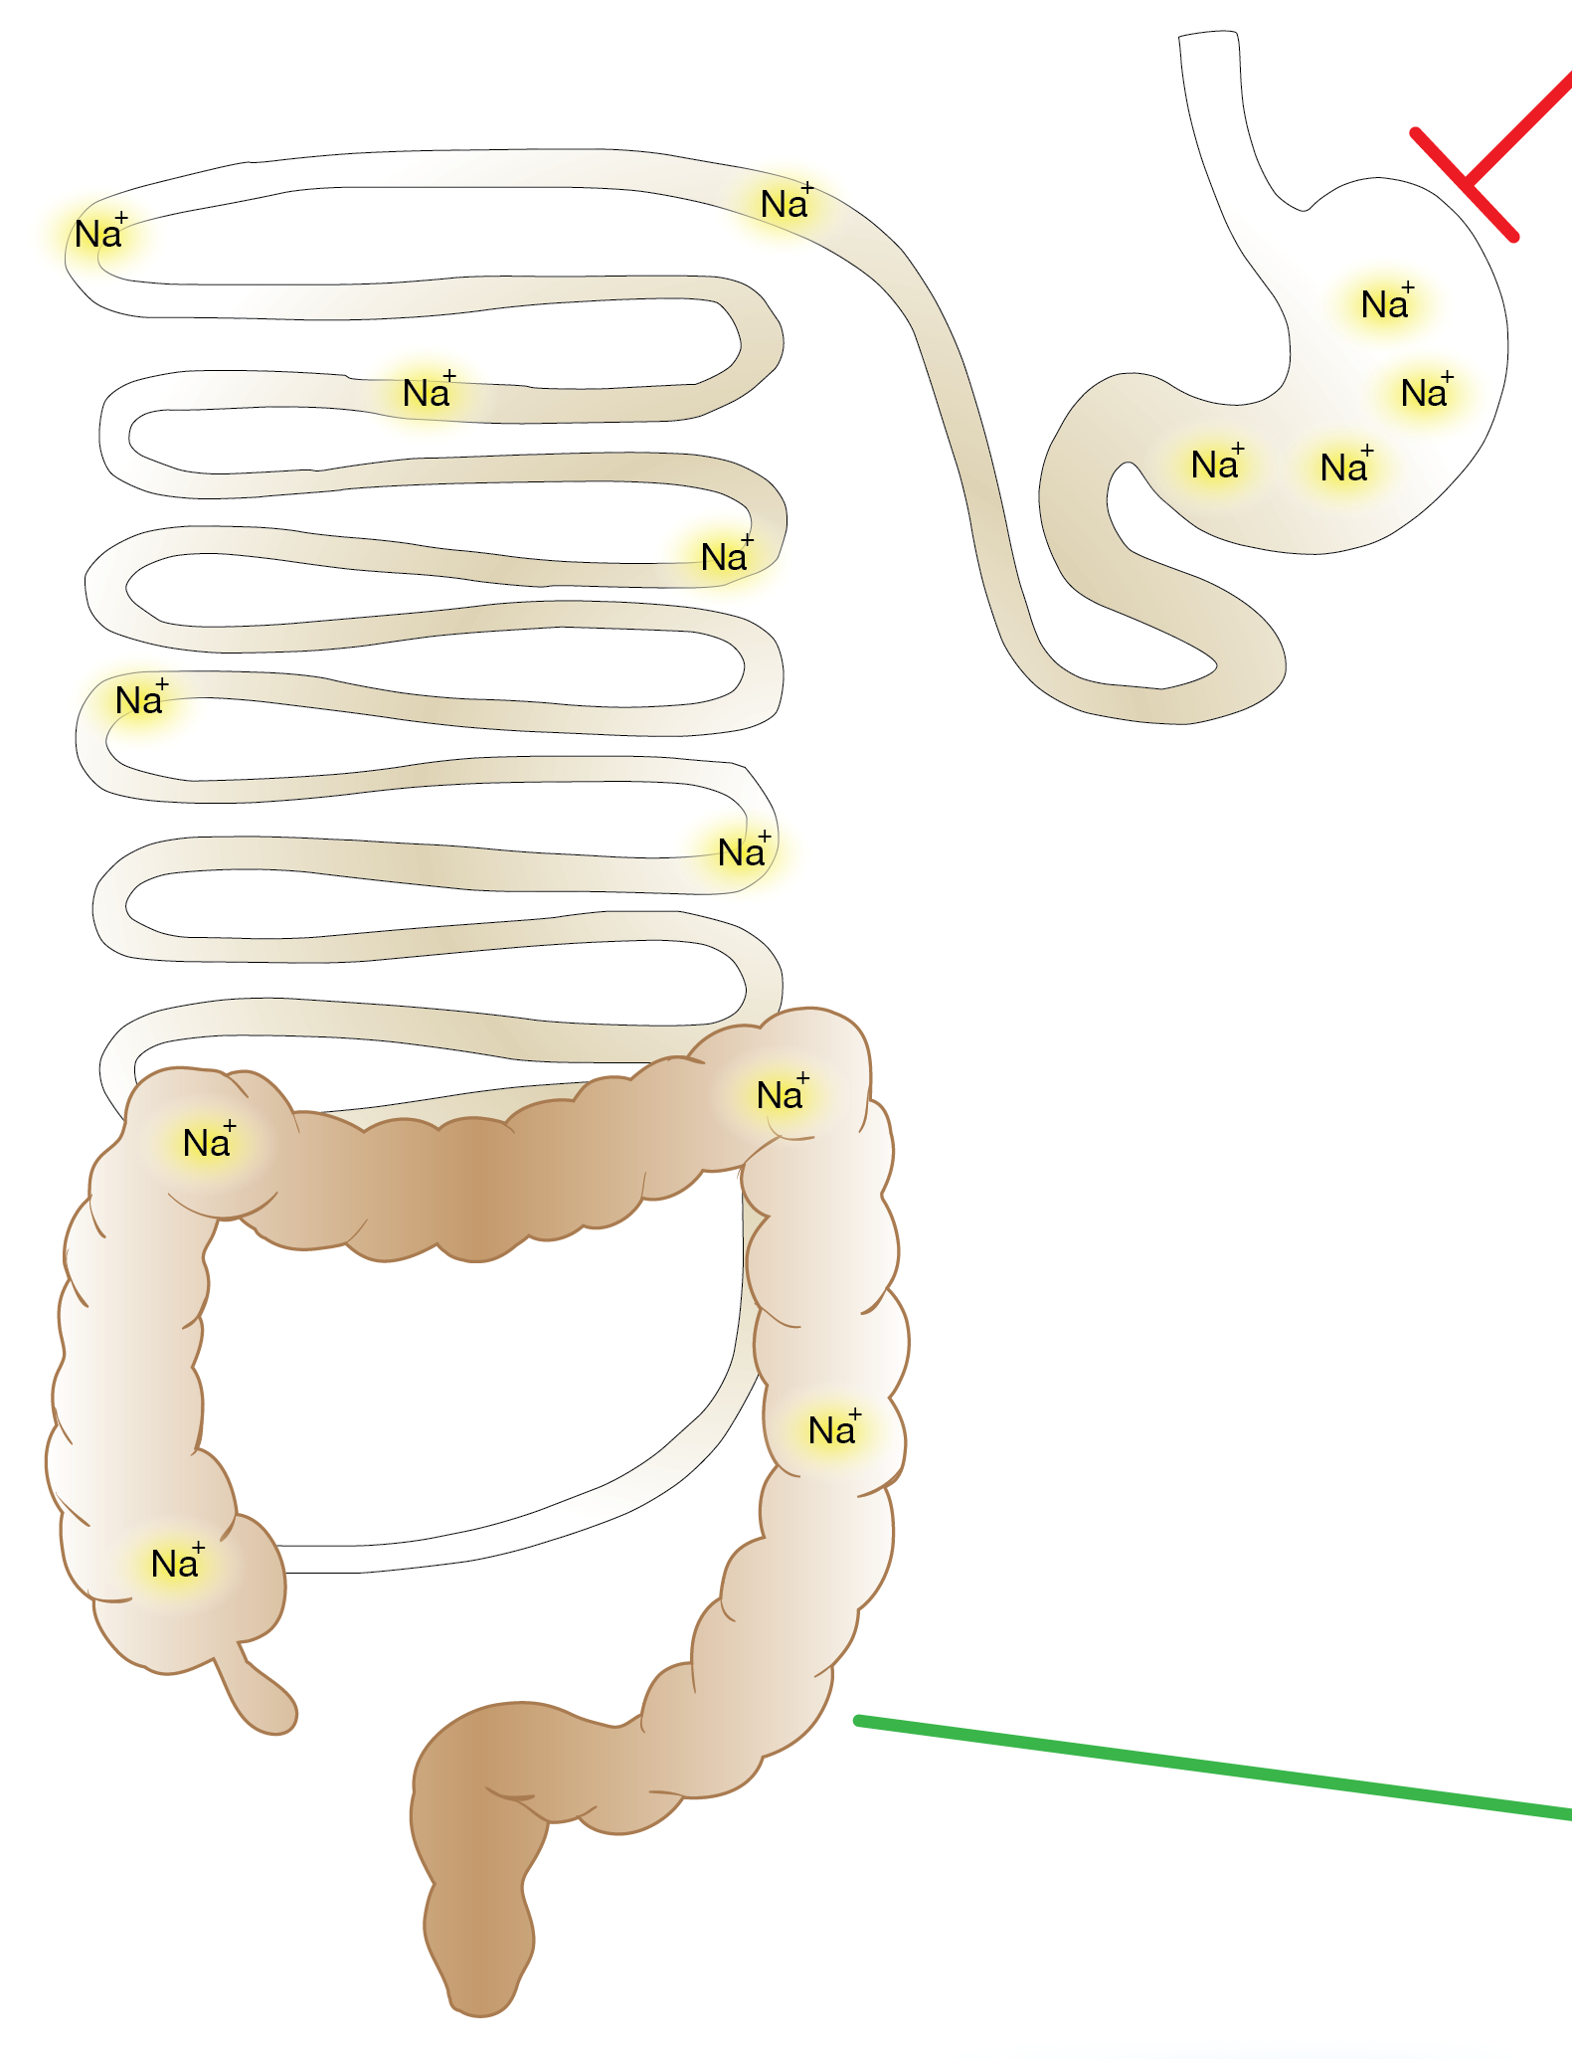

Humans have RAAS++++ so, almost impossible to loose sodium
100% Na absorption
Increased RAAS activity
Mullens W et al. Eur Heart J, 2017;38:1872-1882

Slide 7
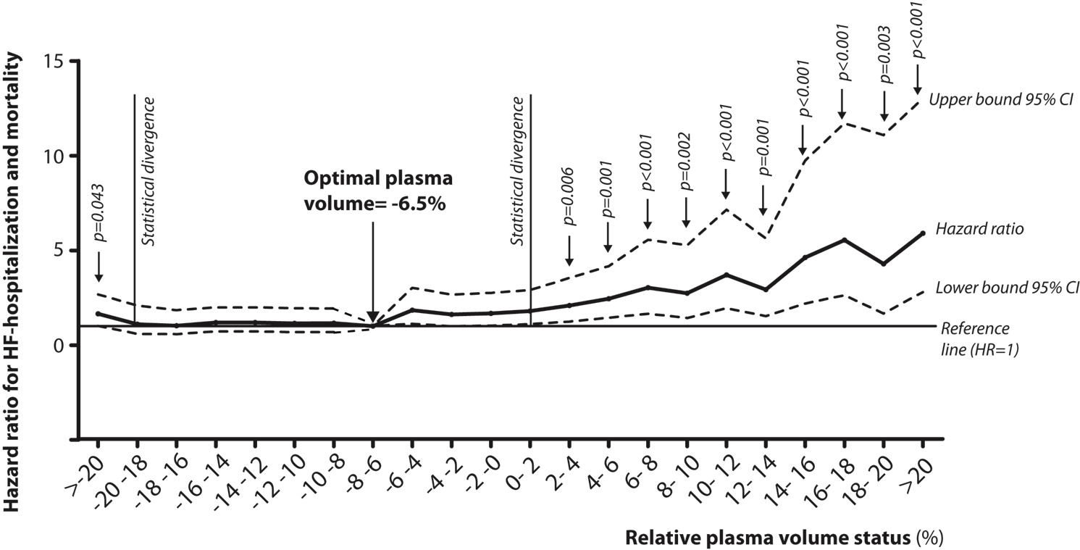
Optimal plasma volume in relation to outcome
Martens P, Mullens W et al. J Card Fail, 2019;25:240-248

Slide 8
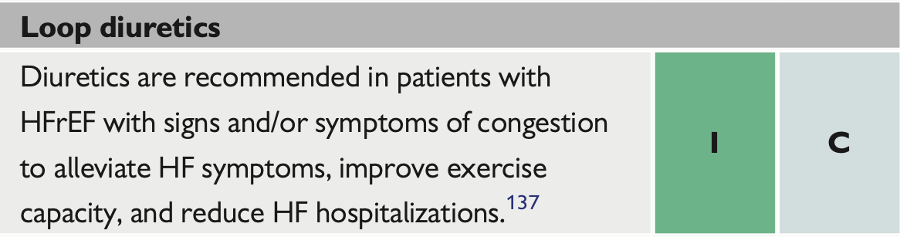
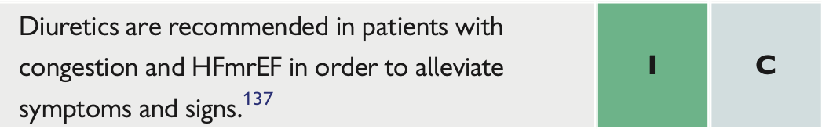
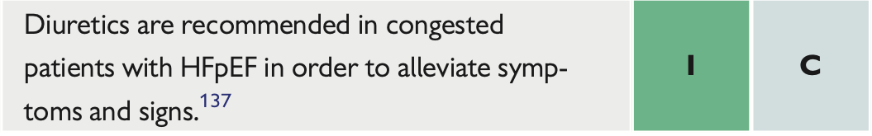
Loop diuretics only class I therapy for congestion in all HF subgroups
McDonagh T et al. Eur Heart J 2021

Slide 9
The Diuretic Optimization Strategies Evaluation Study (DOSE)
Low (=home dose) vs high (x2.5 home dose) - continuous vs bolus every 12 h
Felker M et al. NEJM 2011; 364:797-805

Slide 10
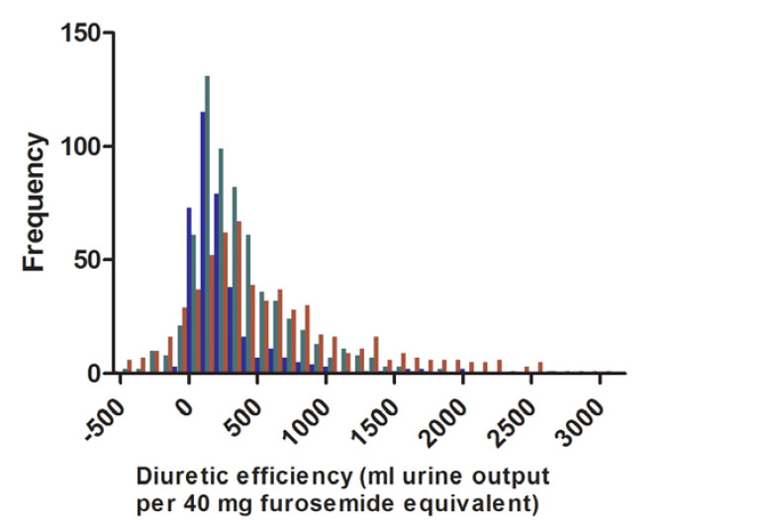
’Diuretic resistance’ is omnipresent in HF patients
Normal diuretic response
Testani J et al. Circ Heart Fail 2014.

Slide 11
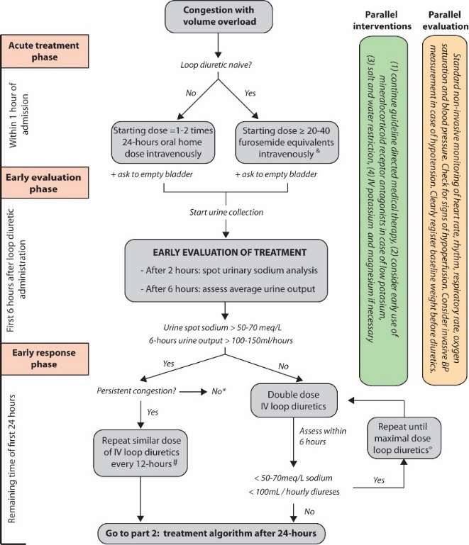
Five most important rules
Door to diuretic time
Early evaluation (within HOURS) of the diuretic effect
Appropriate dosing according to natriuresis/diuresis
Only stop when the patient is ‘dry’
Continue guideline-directed medical therapy
Incorporated
Mullens W, Eur J Heart Fail 2019; 21:137-155.

Slide 12
Thiazides, know how to use them
Metolazone
High dose loop diuretics
Work distal in nephron (poor diuretic effect)
Might counterbalance distal hypertrophy with chronic use of high dose LD
Also work in low eGFR states
Slow GI absorption (need to be given hours before LD)
Protein bound like loop diuretics
Long half life
Mullens W, Eur J Heart Fail 2019; 21:137-155.
Brisco-Bacik, J Card Fail 2017 abstract supplement S56.

Slide 13
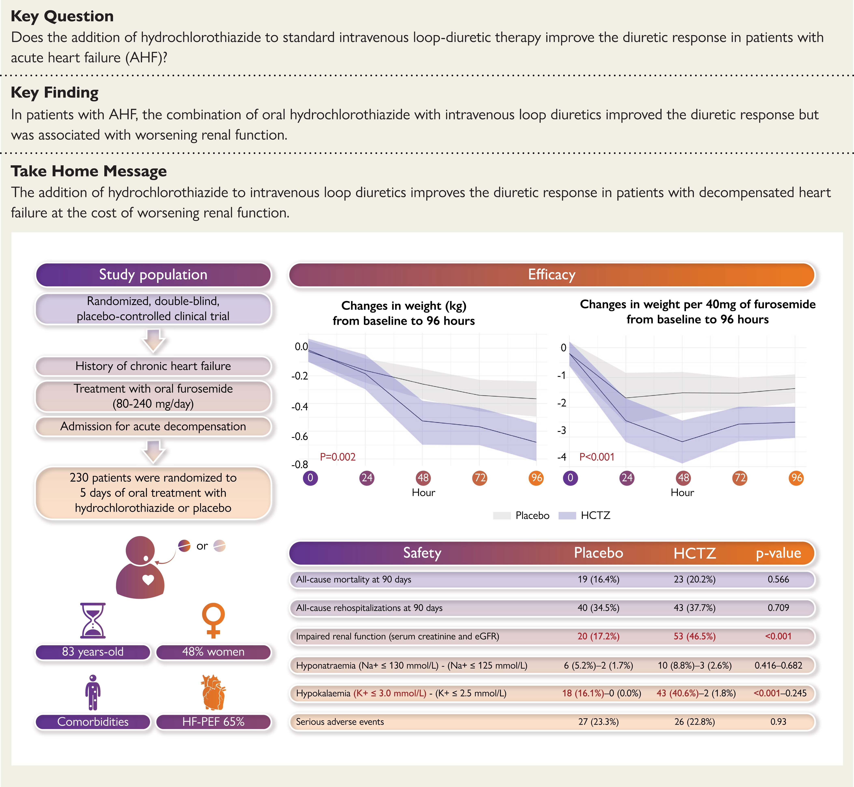
CLOROTIC: 25 mg hydrocholorothiazide vs placebo in ADHF
Trullas JC et al. Eur Heart J 2022 in press.

Slide 14
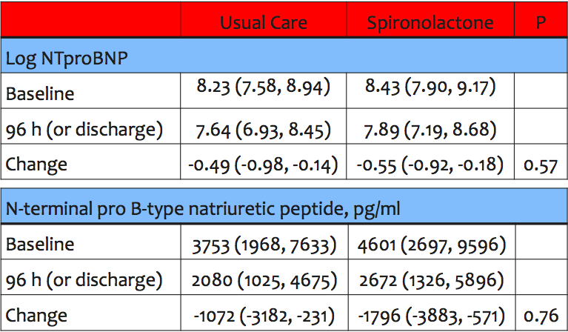
High dose spiro for advanced decompensated heart failure
ATHENA trial
Butler J et al. JAMA Cardiol. 2017;2:950-958

Slide 15
HF induces a state of increased proximal renal sodium reabsorption, but loop diuretics, thiazides, MRA work distal at loop of Henle
Mullens W et al. J Am Coll Card 2009;53:589-96.
Mullens W et al. Eur J Heart Fail 2019; 21:137-155

Slide 16
Acetazolamide might improve loop diuretic efficiency
Mullens W et al. Eur Heart J 2017
Verbrugge F et al. Acta Cardiol 2015 + Eur J Heart Fail 2019

Slide 17
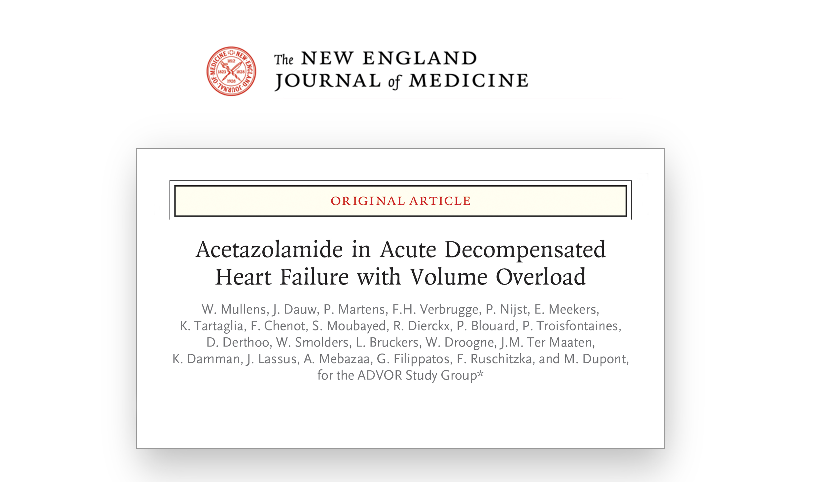


Slide 18
Methods: trial procedures
Mullens W et al. Eur J Heart Fail. 2018;20:1591-1600

Slide 19
Methods: primary end point
Primary end point:
Successful decongestion defined as congestion score ≤1 within 3 days after randomization without an indication for escalation of decongestive therapy
=
Mullens W et al. Eur J Heart Fail. 2018;20:1591-1600

Slide 20
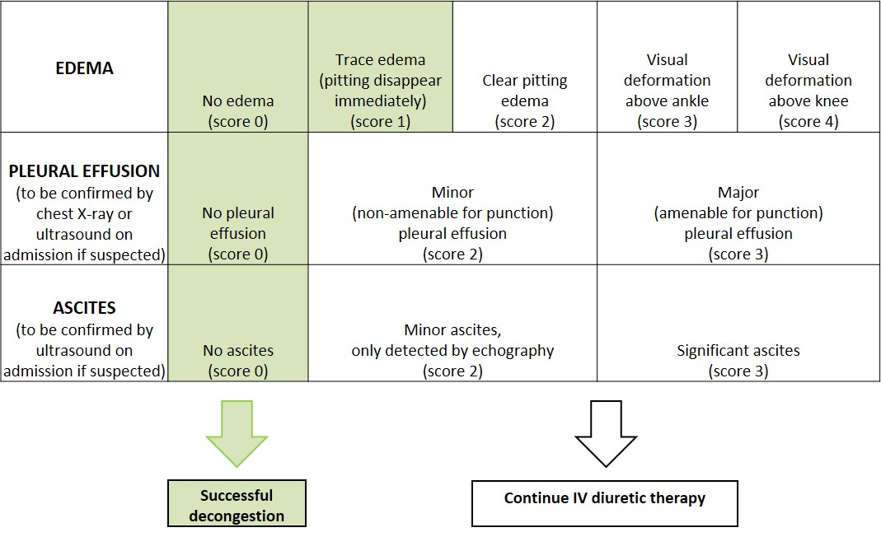
Methods: congestion score
Mullens W et al. Eur J Heart Fail. 2018;20:1591-1600

Slide 21
Results: baseline characteristics (1/2)
Mullens W et al. N Eng J Med 2022.

Slide 22
Results: baseline characteristics (2/2)
Mullens W et al. N Eng J Med 2022.

Slide 23
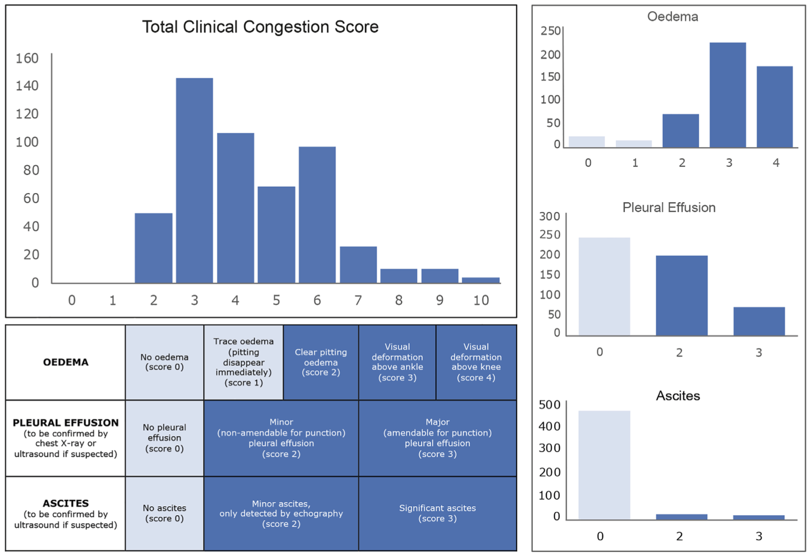
Baseline characteristics: congestion score
Mullens W et al. Eur J Heart Fail. 2022;online before print

Slide 24
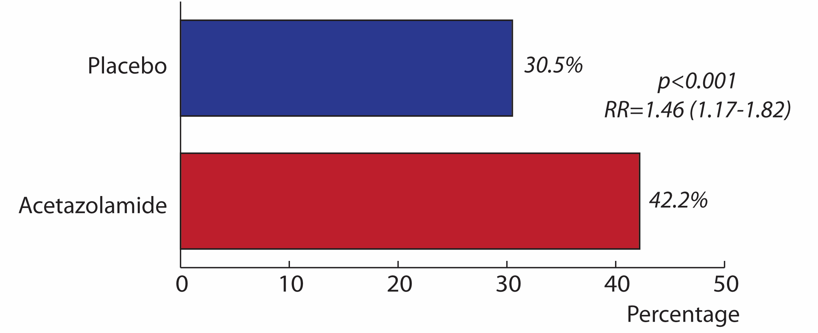
Results: primary end point (successful decongestion within 3 days)
RR = 1.46 (1.17-1.82)
p = 0.0009
NNT = 8.5
Mullens W et al. N Eng J Med 2022.

Slide 25
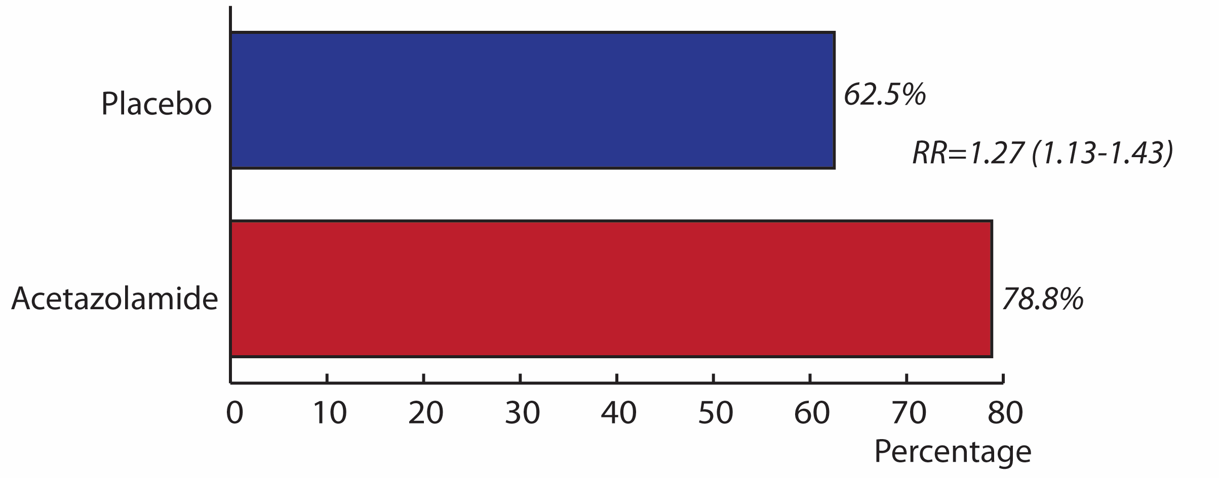
Results: successful decongestion at discharge
RR 1.27 (1.13-1.43)
p = 0.0001
NNT = 6
Mullens W et al. N Eng J Med 2022.

Slide 26
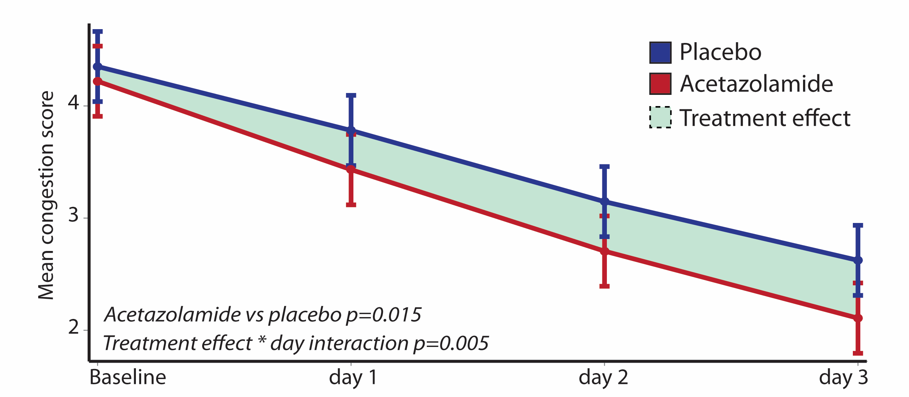
Results: effect of acetazolamide on congestion score
Mullens W et al. N Eng J Med 2022.

Slide 27
Results: effect of acetazolamide on diuresis and natriuresis
Mullens W et al. N Eng J Med 2022.

Slide 28
Results: secondary end points
Mullens W et al. N Eng J Med 2022.

Slide 29
Results: safety end points
(Acetazolamide has been used > 70 years)
Mullens W et al. N Eng J Med 2022.

Slide 30
Acetazolamide equally effective accross all LVEF ranges
Martens P et al Circulation, in press 2022
AHA scientific sessions, Chicago - LBCT, 2022.

Slide 31
Acetazolamide increases natriuresis which has important prognostic implications (all-cause mortality + HFH)
Verbrugge F et al. In Review
AHA scientific sessions, Chicago - LBCT, 2022

Slide 32
Conclusions
ADVOR was the largest diuretic trial in ADHF ever performed with a very important clinical end point of decongestion (= Class I recommendation).
The addition of acetazolamide was associated with 46% higher incidence of decongestion.
The benefit was generally consistent across all prespecified subgroups.
Patients treated with acetazolamide:
  more diuresis and natriuresis
  shorter hospital stay
  more likely to be discharged without residual volume overload (NNT 6)
There was no higher incidence of adverse events with acetazolamide treatment.
ADVOR supports utilization of acetazolamide as it is a cheap, off-patent, easy-to-use, safe and very effective drug to improve decongestion.
Mullens W et al. N Eng J Med 2022.

Slide 33
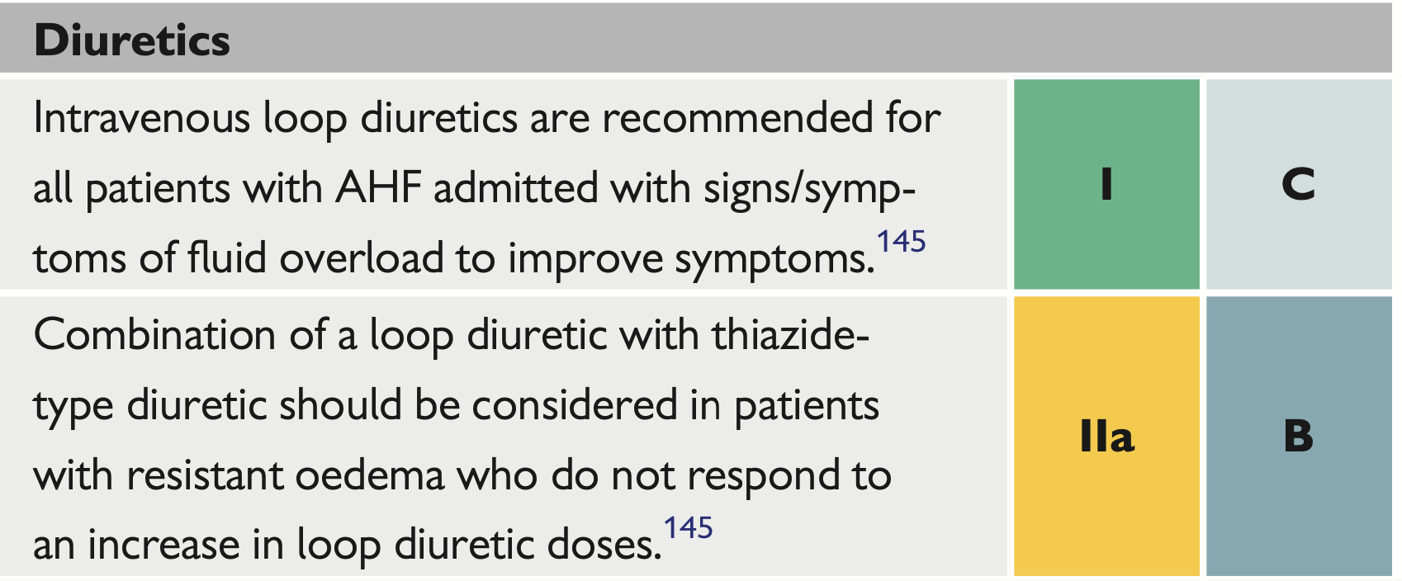
Impact on guidelines ?
New in 2023 update ?????
McDonagh T et al. Eur Heart J 2021

Slide 34
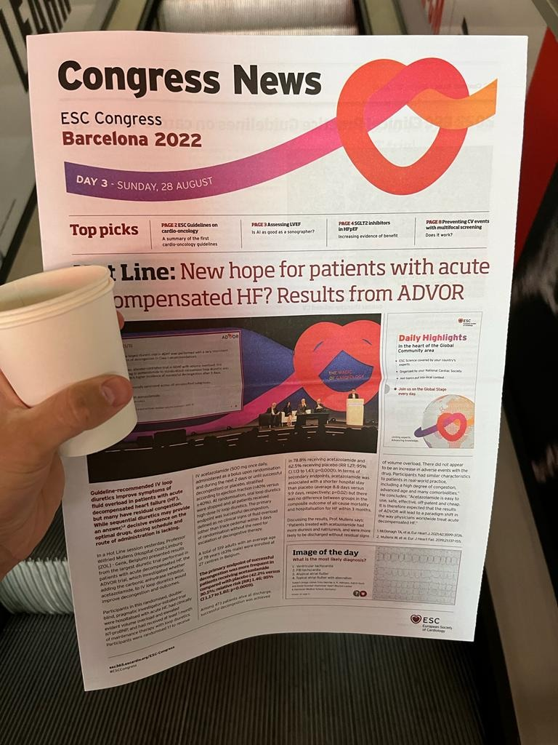
“door to combo-diuretic time”

