Slide 1

Plicní hypertenze – diagnostika
Martin Hutyra
1. interní klinika - kardiologická, Lékařská fakulta a Fakultní nemocnice Olomouc

Slide 2
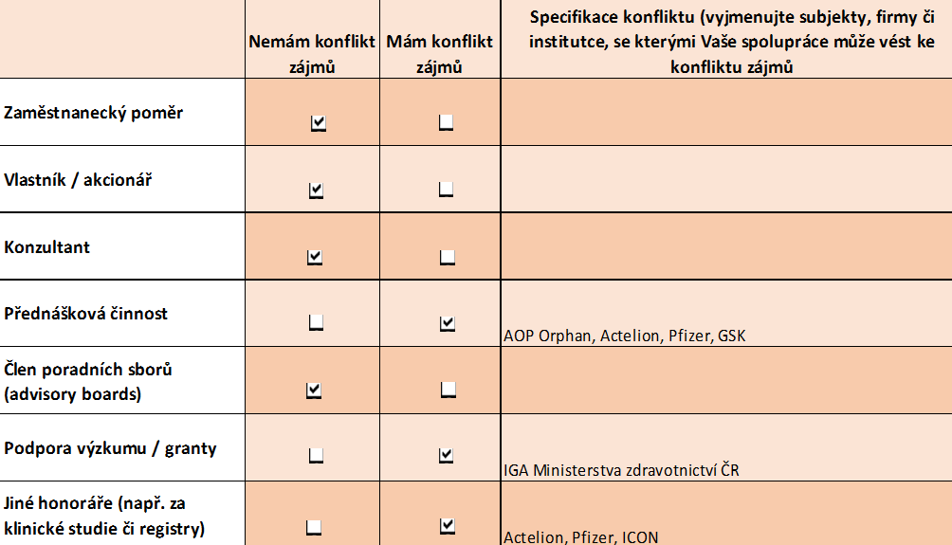

Slide 3
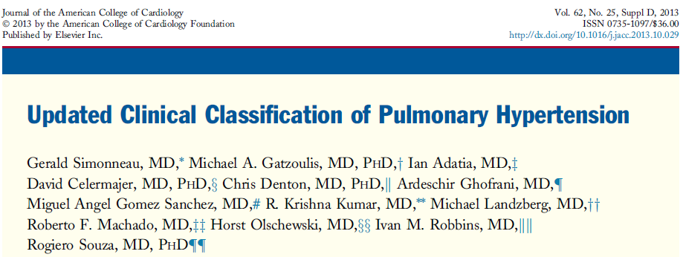
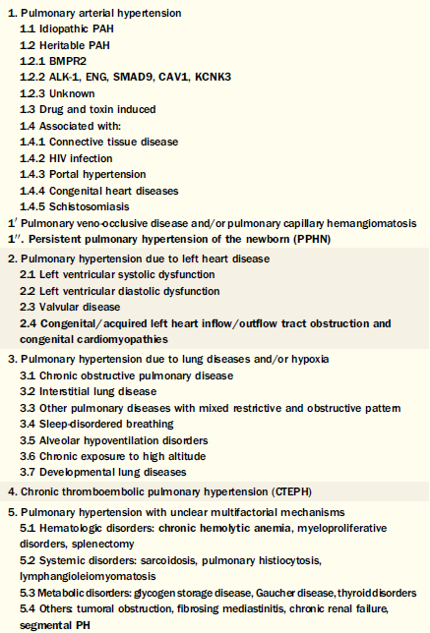
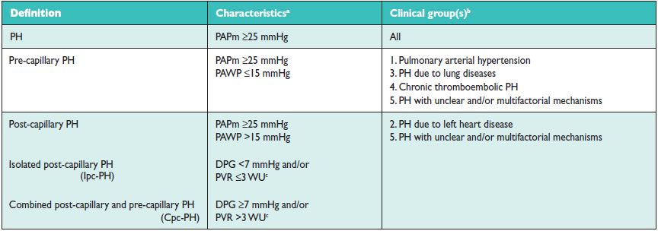
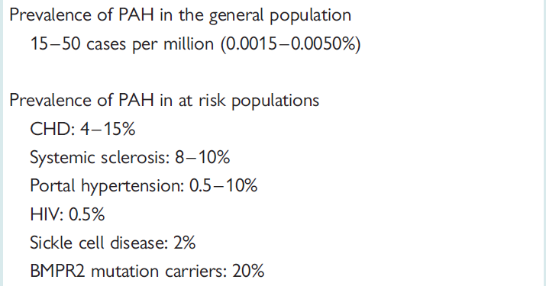
Plicní hypertenze -
klasifikace a epidemiologie
PAH prevalence and incidence are in the range of 15–60 subjects per million population and 5–10 cases per million/year

Slide 4

Hemodynamická definice plicní hypertenze
MPAP
≥20/25 mmHg
Definice PH
MPAP
≥20/25 mmHg
Definice PAH
PAWP
≤15 mmHg
PVR >3 WU
PAP: pulmonary arterial pressure; PAWP: pulmonary artery wedge pressure; PVR: pulmonary vascular resistance
Hoeper MM, et al. J Am Coll Cardiol 2013; 62:D42-50.
6th World Symposium on Pulmonary Hypertension, Nice, February 27 to March 1, 2018

Slide 5
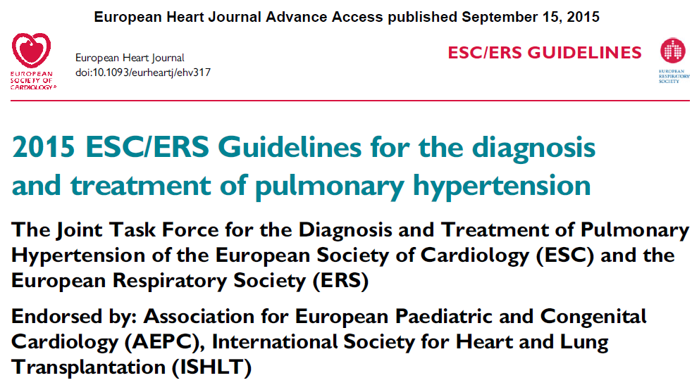
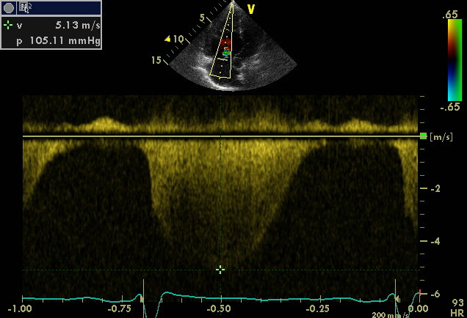
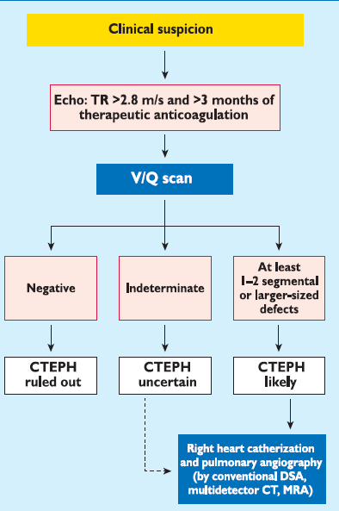
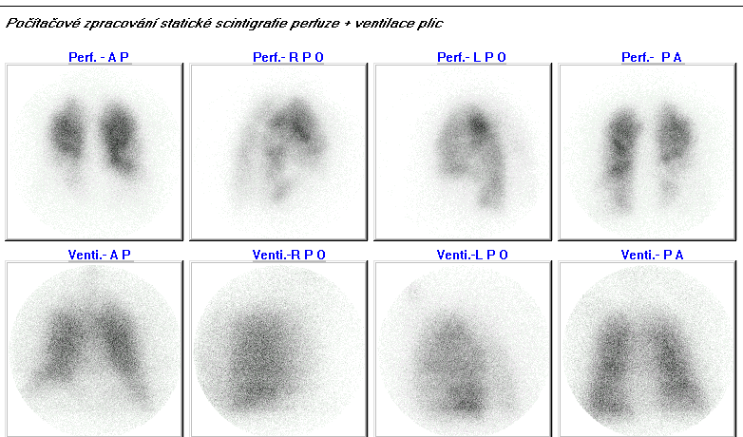
Screening plicní hypertenze
Notes:
PSK

Slide 6
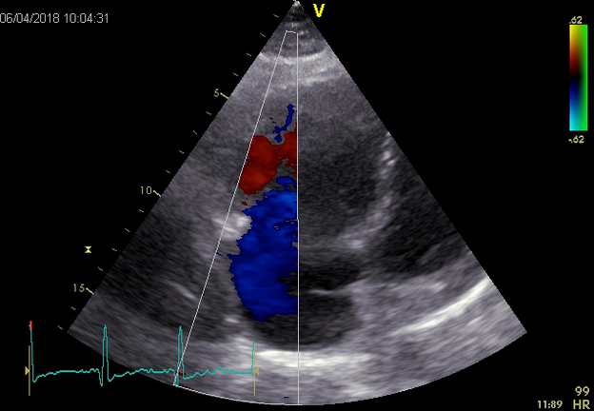
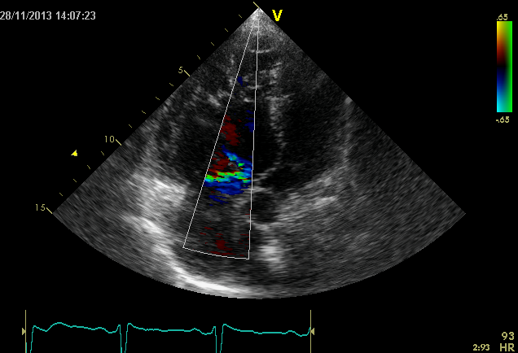
Echokardiografie – klíčový screeningový nástroj

Slide 7
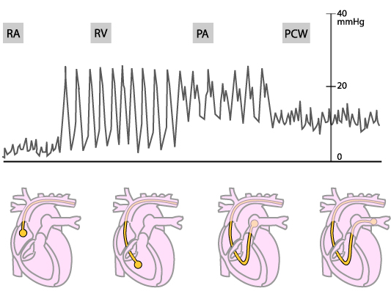
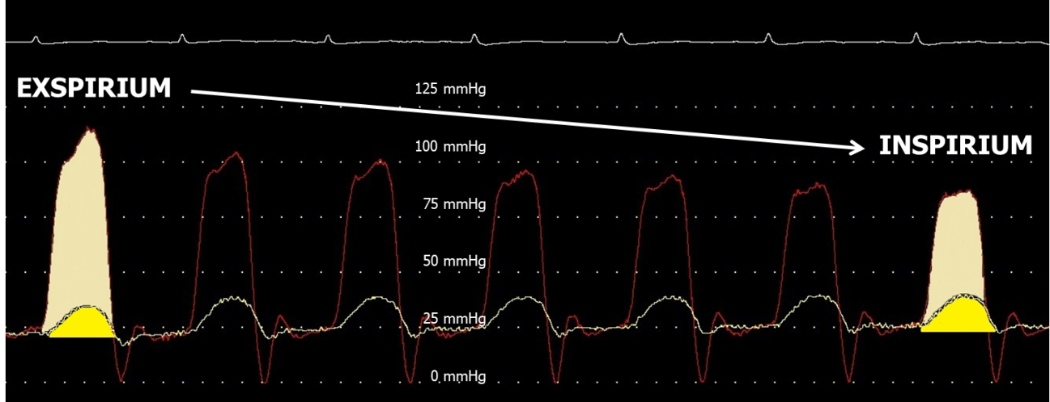

Pravostranná katetrizace – „zlatý standard“
ESC guidelines. Eur Heart J 2009;30:2493-2537
Jansa P. Chronicka plicni hypertenze. Cor Vasa 2011;53(3)

Slide 8

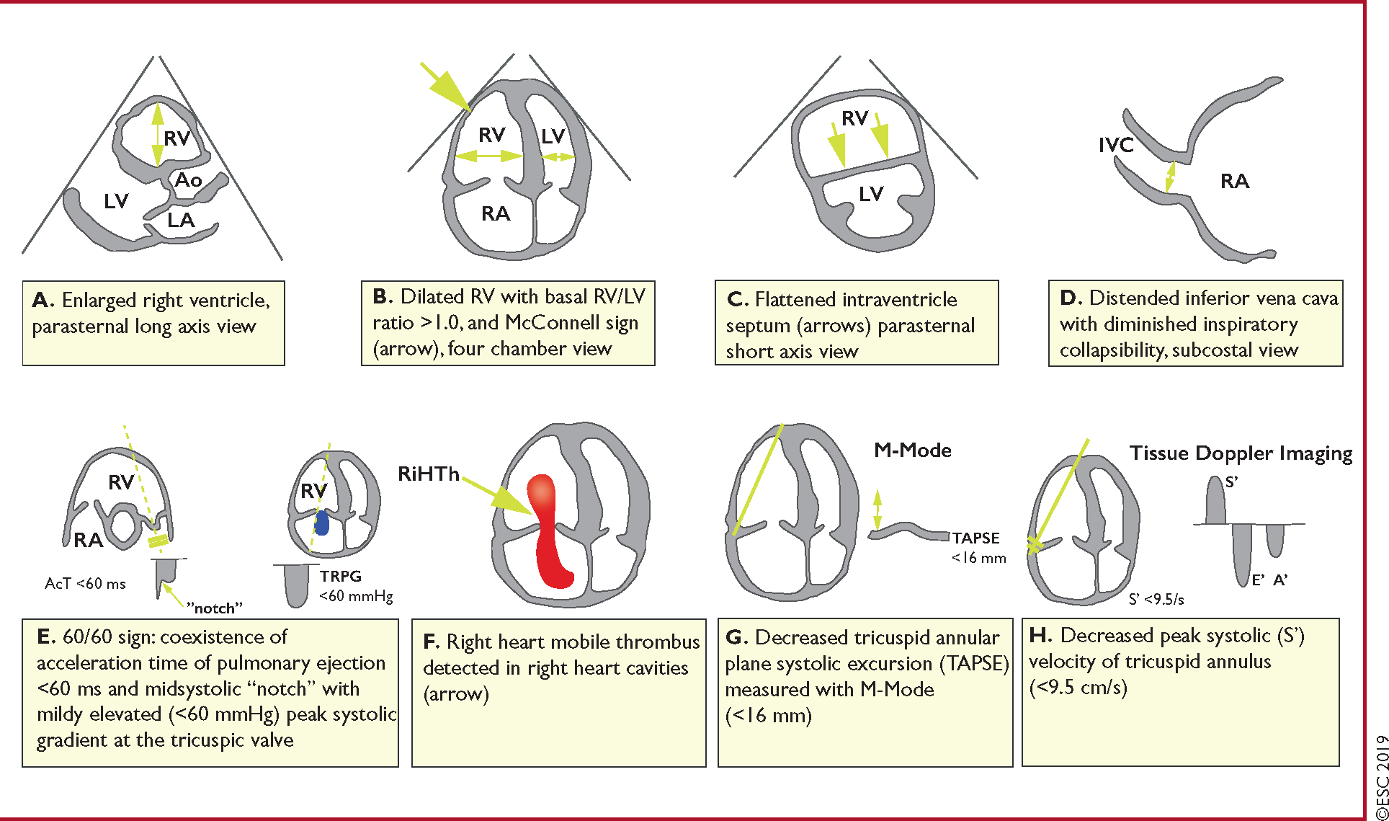
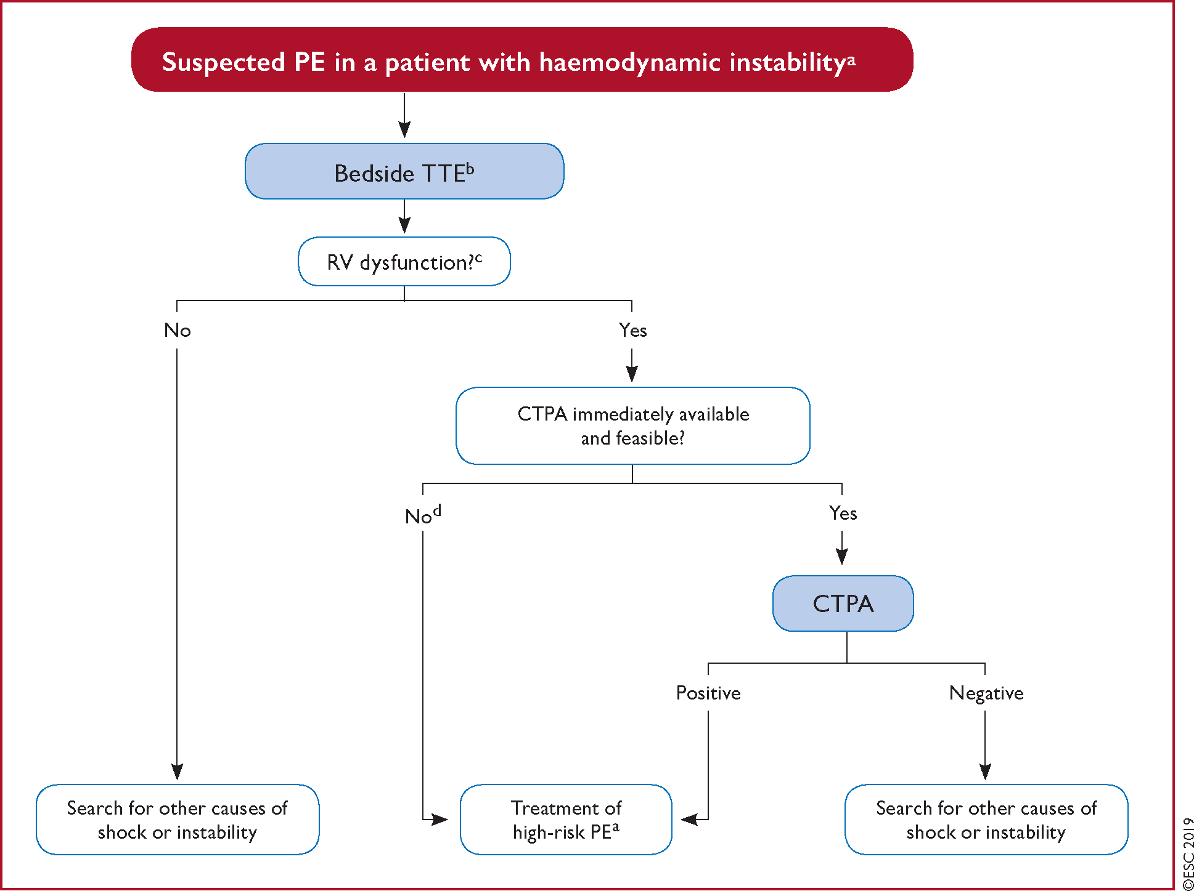
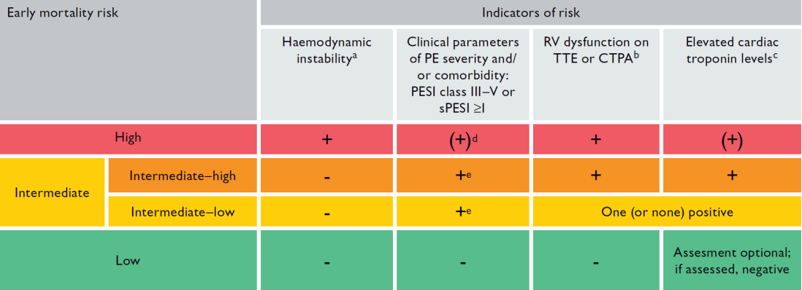
Plicní embolie
Echocardiographic criteria of RV dysfunction include RV dilation and/or an increased end-diastolic RV–LV diameter ratio (in most studies, the reported threshold value was 0.9 or 1.0); hypokinesia of the free RV wall; increased velocity of the TR jet; or combinations of the above.

Slide 9
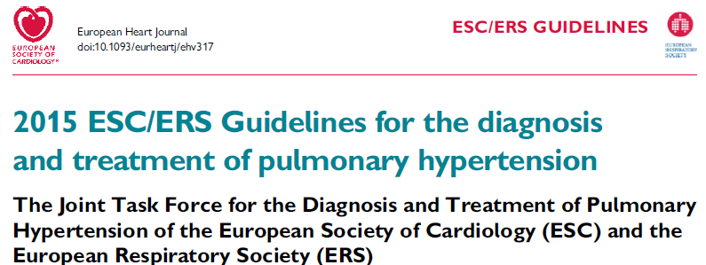
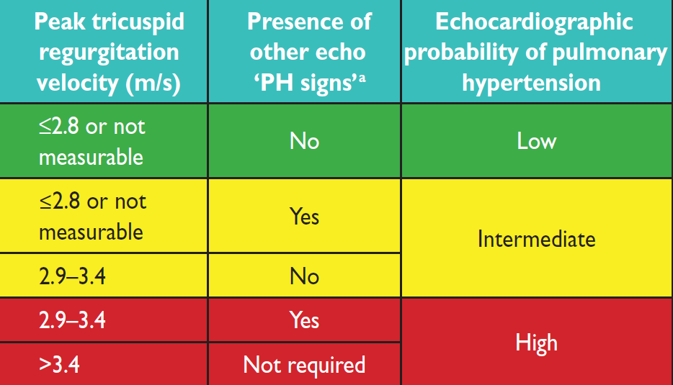
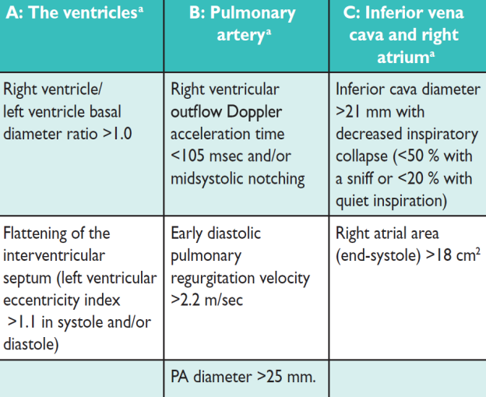
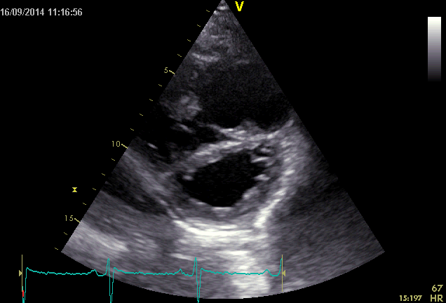
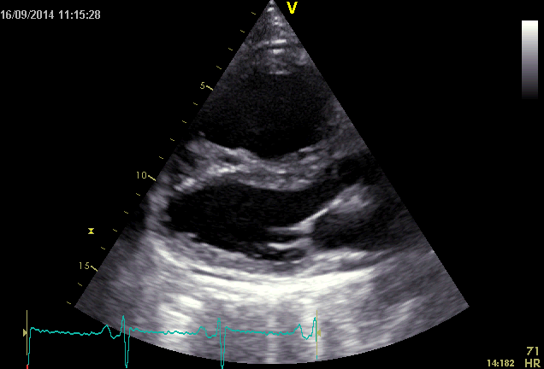
PAH/CTEPH

Slide 10
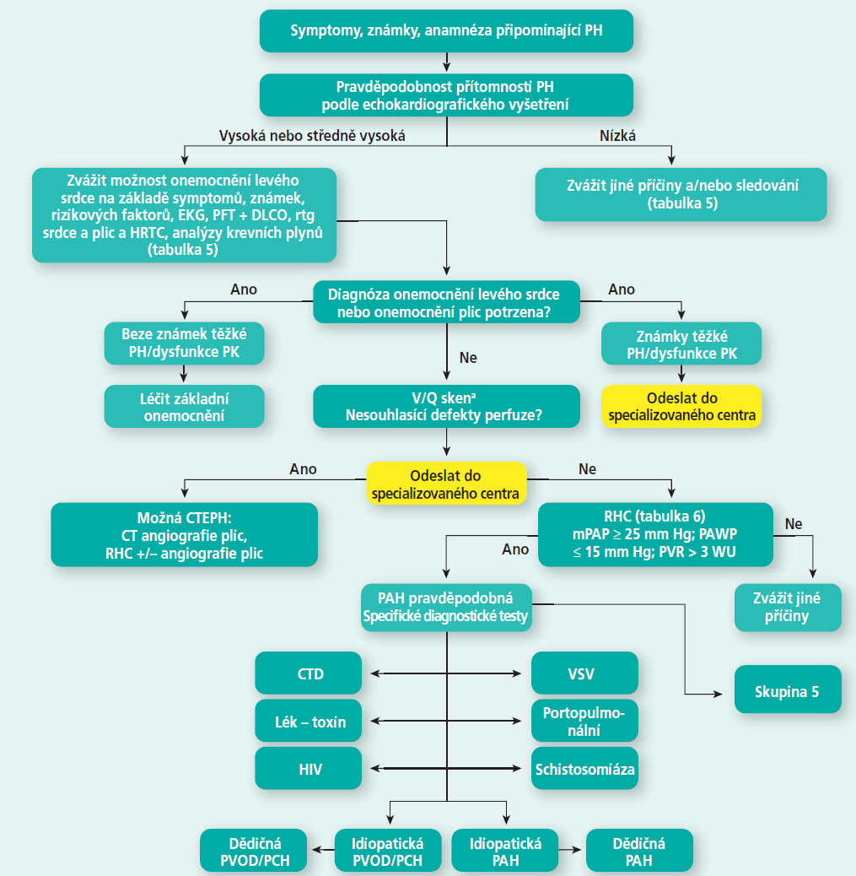
M. Aschermann, et al., 2015 ESC/ERS Guidelines for the diagnosis and treatment of pulmonary hypertension. Summary document prepared by the Czech Society of Cardiology, Cor et Vasa 58 (2016) e129–e152

Slide 11
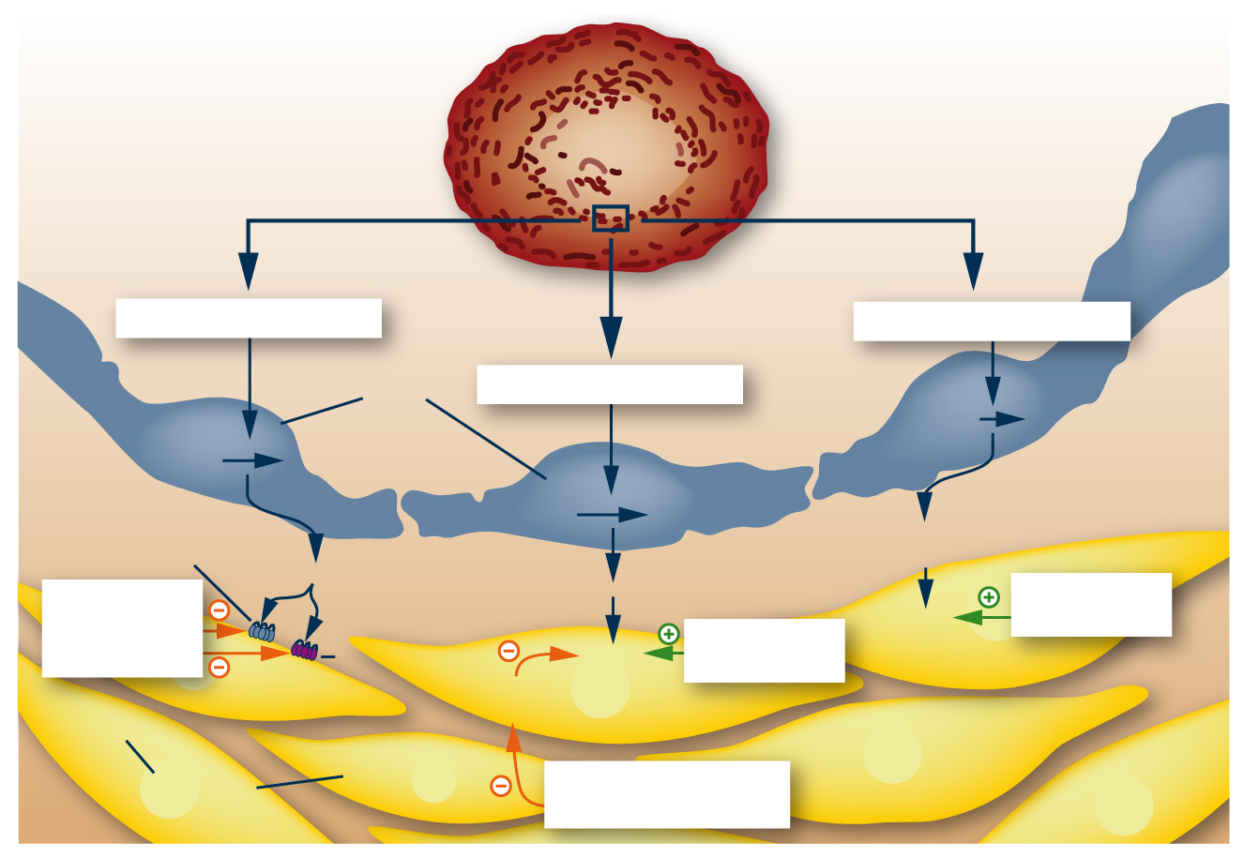
Specifická farmakoterapie – cíle
Endotelinová cesta
Prostacyklinová cesta
Endotelové
buňky
Lumen
cévy
Cesta oxidu dusnatého
Arachidonic acid
Prostaglandin I₂
Pre-proendothelin
Proendothelin
Endotelin. receptor A
L-arginine
L-citrulline
Prostacyclin
(prostaglandin I₂)
Endotelin-1
Nitric oxide
Deriováty
prostacyclinu
Antagonisté endotelin. receptoru
cAMP
Endotelin. receptor B
cGMP
Exogenní NO
Phosphodiesterase type 5
Vasodilatace a
antiproliferace
Vasodilatace a antiproliferace
Vasodilatace a
antiproliferace
Buňky hladké svaloviny
Inhibitor
fosfodiesterázy 5
Humbert; NEJM (2004)
Notes:
Three of the most relevant pathways to our specific understanding of PAH and its treatment are the endothelin, nitric oxide and the prostacyclin pathways.
Humbert. NEJM 200

Slide 12
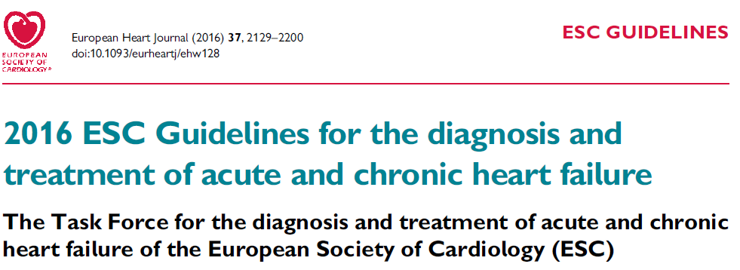
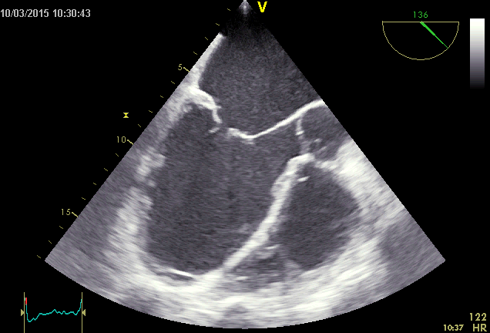
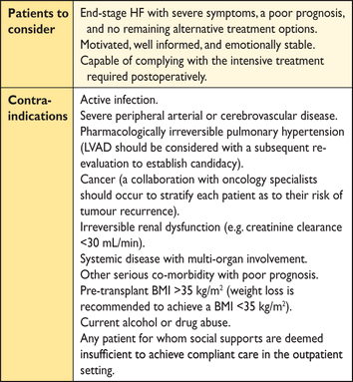
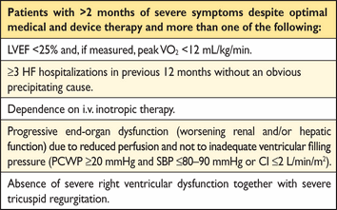
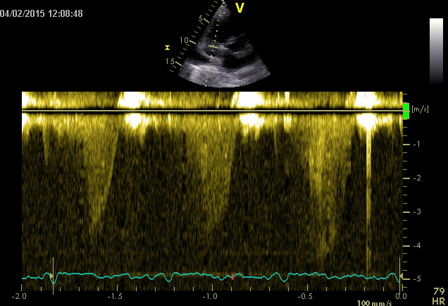
Srdeční selhání
HTx
LVAD

Slide 13

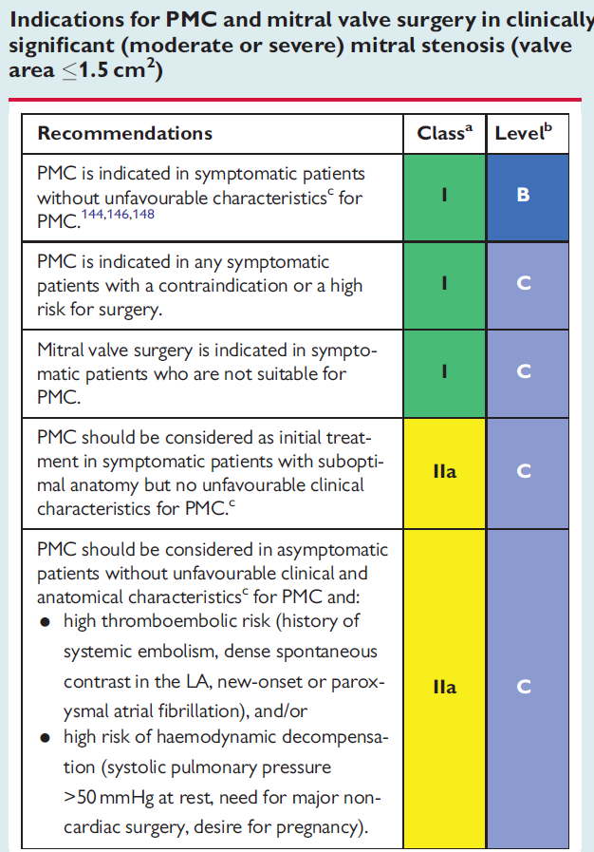
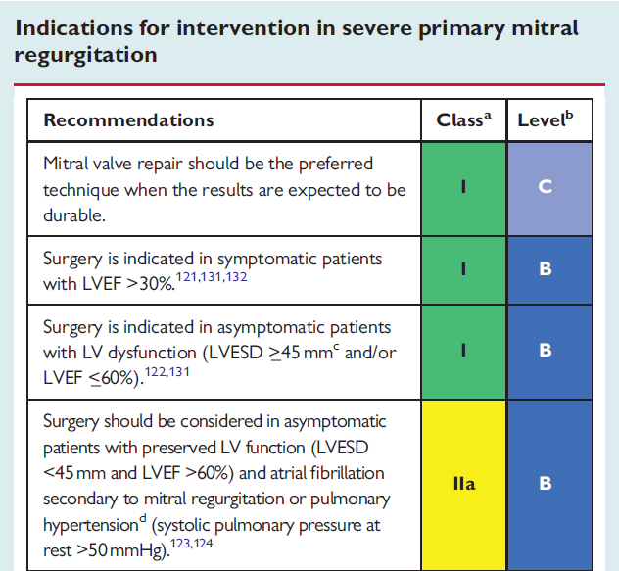
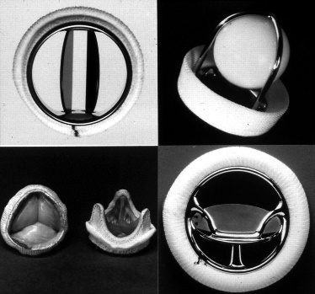
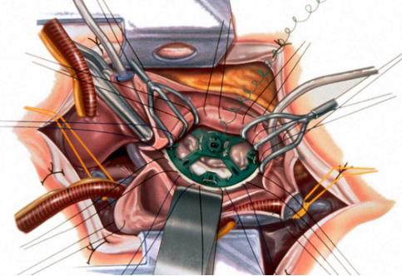
Chlopenní vady

Slide 14
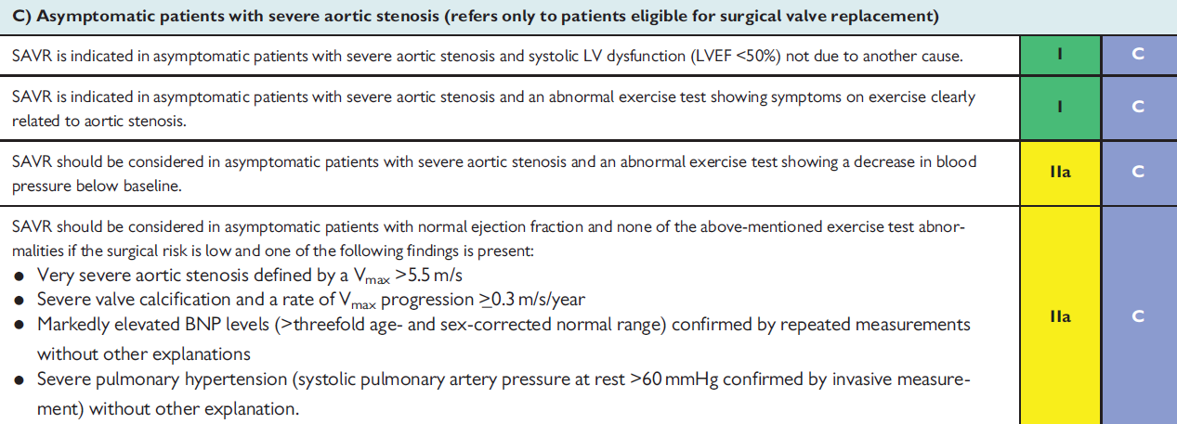
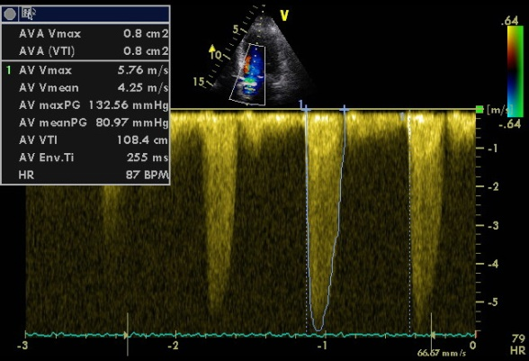
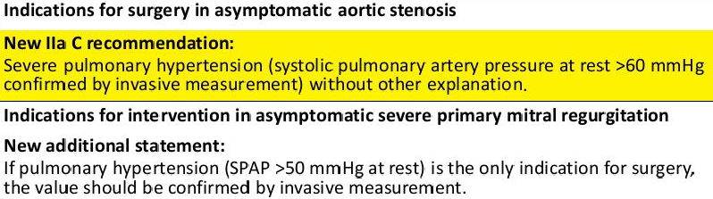

Slide 15
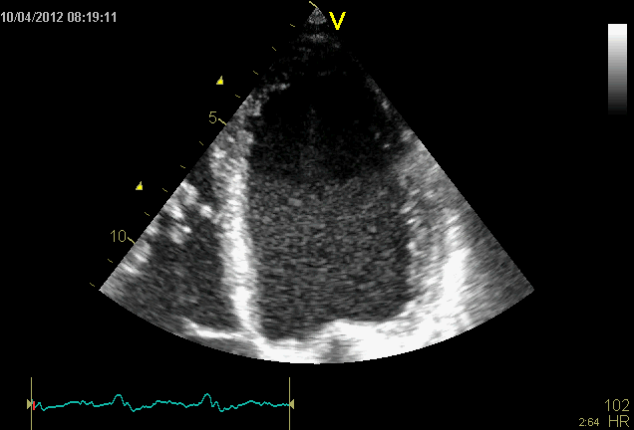
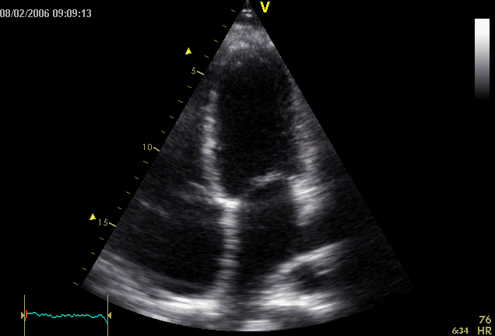
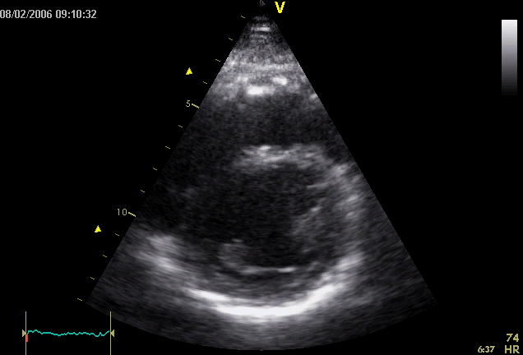
ECHOKARDIOGRAFICKÉ FENOTYPY
Lang RM, Badano LP, Mor-Avi V, et al. Recommendations for cardiac chamber quantification by echocardiography in adults: an update from the American Society of Echocardiography and the European Association of Cardiovascular Imaging. J Am Soc Echocardiogr. 2015;28(1):1.

Slide 16
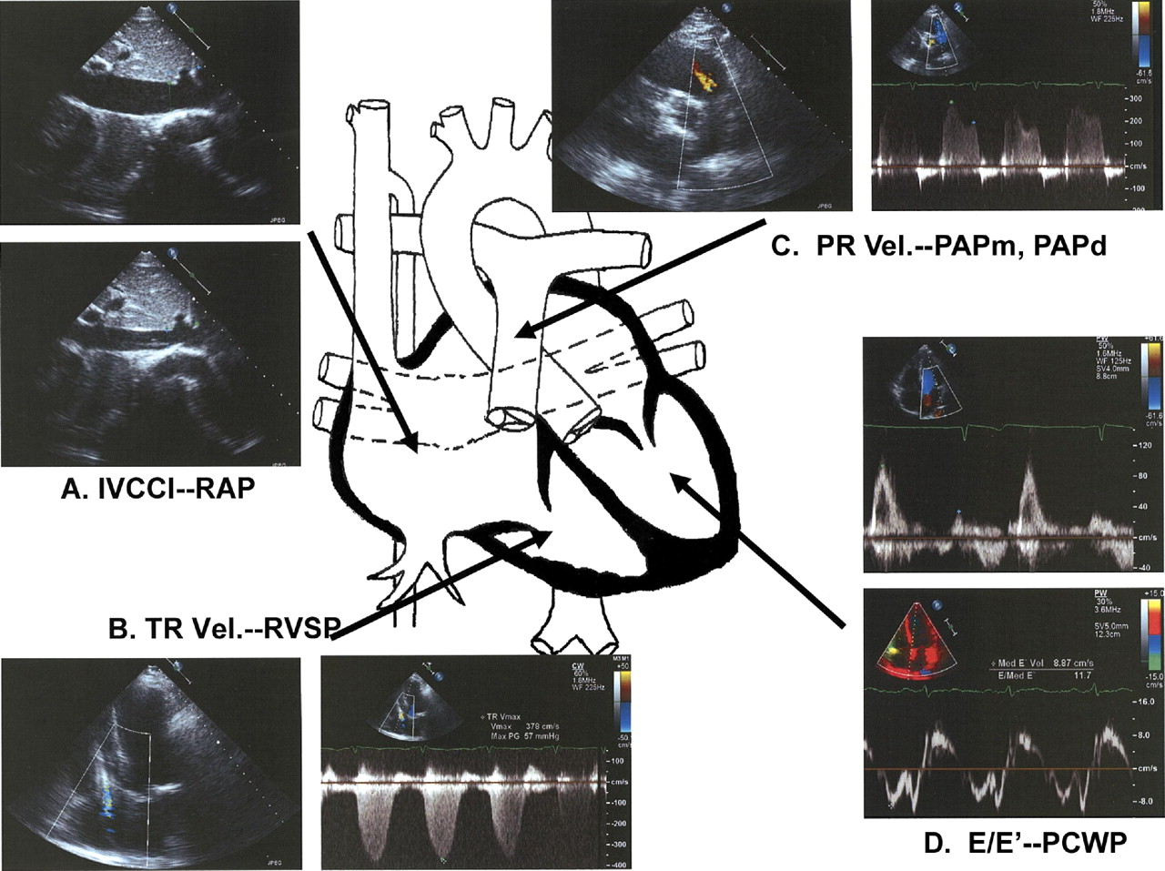
Maximální gradient regurgitace na pulmonální chlopni (PR) predikuje střední tlak v plicnici (MAP) . Endiastolický gradient pulmonální regurgitace predikuje diastolický tlak v plicnici (DAP) .
Dolní dutá žíla (IVC) , její rozměr a stupeň inspiračního kolapsu predikují tlak v pravé síni (RAP resp. CVT):
IVC <1.2 cm a kolaps 100% = RAP 0 mmHg
IVC 1.2-1.7 cm s >50% kolapsem = RAP 0-5 mmHg
IVC >1.7 cm s >50% kolapsem = RAP 6-10 mmHg; <50% kolapsem = RAP 10-15 mmHg
IVC >1.7 cm s 0% kolapsem = RAP >15 mmHg
Vrcholová systolická rychlost jetu trikuspidální regurgitace (TR) predikuje systolický tlak v plicnici (SAP):
Poměr vrcholové systolické rychlosti časného mitrálního toku (E)/časná diastolická rychlost mitrálního anulu Em (E/Em) <8 nebo >15 přesně predikuje PCWP <15 mmHg resp. >15 mm Hg.
Kirkpatrick JN et al. Echocardiography in Heart Failure: Applications, Utility, and New Horizons. J Am Coll Cardiol 2007;50:381–96

Slide 17
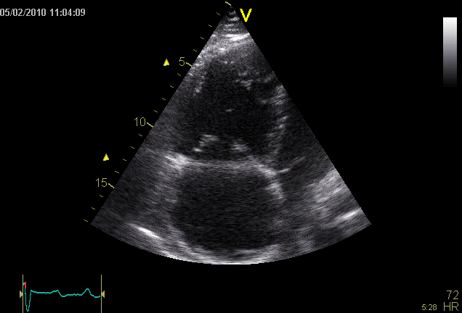
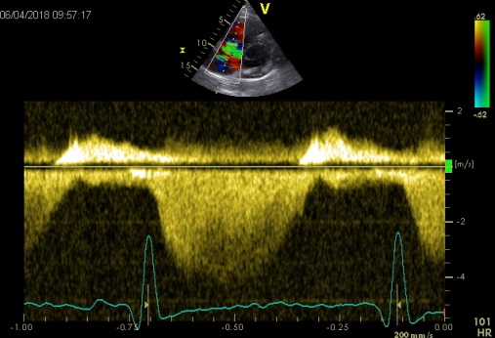
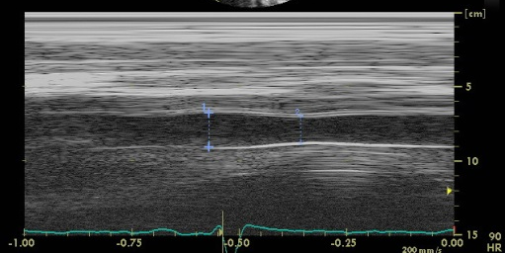
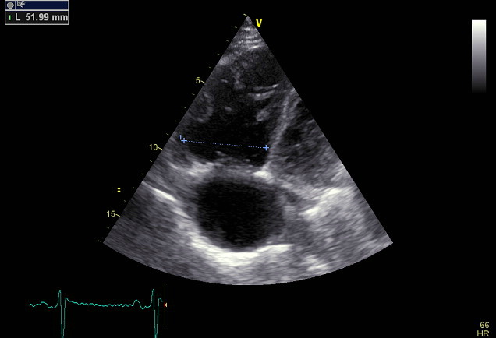
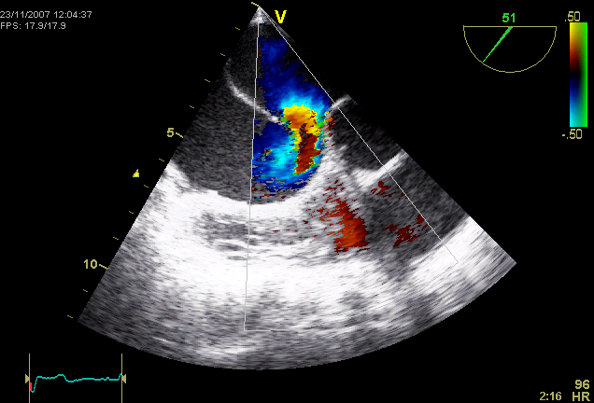
1. PRAVOSTRANNÝ FENOTYP

Slide 18
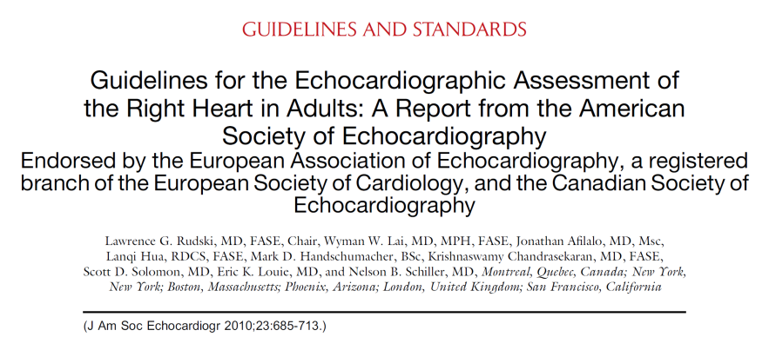
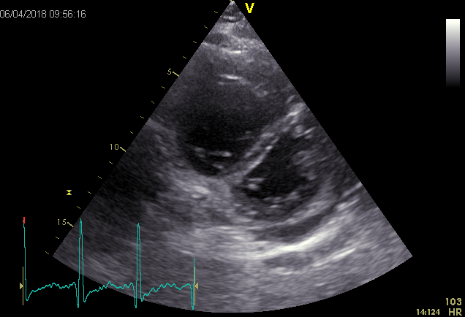
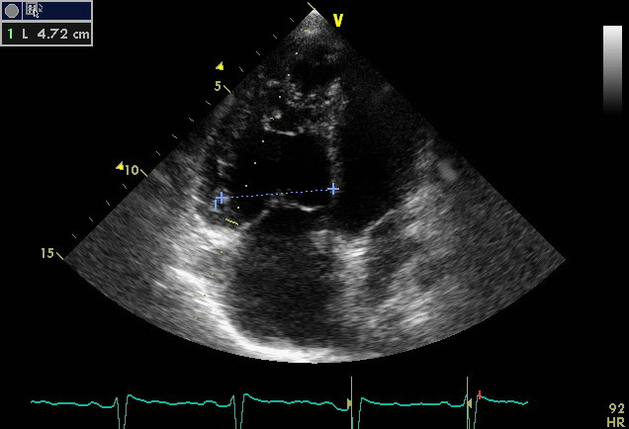
Geometrie, morfologie a funkce PK
Visual assessment of ventricular septal curvature looking for a D-shaped pattern in systole and diastole should be used to help in the diagnosis of RV volume and/or pressure overload.
Although a D-shaped septum is not diagnostic in RV overload, with its presence, additional emphasis should be placed on the confirmation, as well as determination, of the etiology and severity of right-sided pressure and/or volume overload.

Slide 19

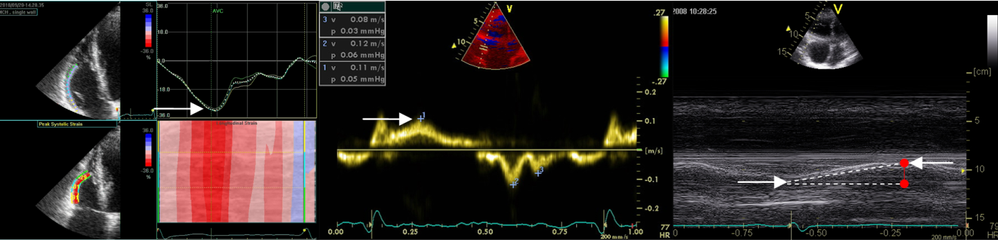
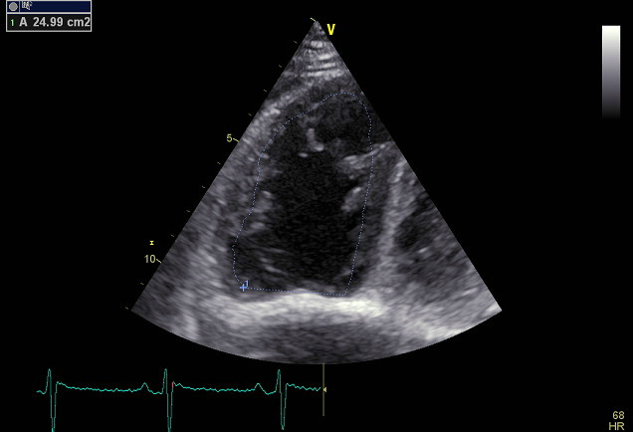
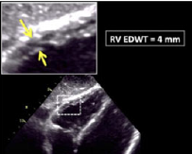



Lang RM, Badano LP, Mor-Avi V, et al. Recommendations for cardiac chamber quantification by echocardiography in adults: an update from the American Society of Echocardiography and the European Association of Cardiovascular Imaging. J Am Soc Echocardiogr. 2015;28(1):1.

Slide 20




Index excentricity
D-shaped LV cavity in systole suggests RV pressure overload, in diastole suggests RV volume overload.
LV Eccentricity Index = D2/D1
Lang RM, Badano LP, Mor-Avi V, et al. Recommendations for cardiac chamber quantification by echocardiography in adults: an update from the American Society of Echocardiography and the European Association of Cardiovascular Imaging. J Am Soc Echocardiogr. 2015;28(1):1.

Slide 21






The most common cause for RV pressure overload is pulmonary hypertension, leading to RV hypertrophy and dilatation. As the adaptive remodeling with concentric hypertrophy transitions in maladaptive remodeling with eccentric hypertrophy and dyssynchrony, the filling pressures increase, leading to decompensation. Fibrotic changes in the RV are lesser than the LV, most patients with PH recover function after LTx.
RV volume overload is associated with RV dilatation and hypertrophy with diastolic leftward shift of the septum affecting the LV function due to geometric changes. RV tolerates volume overload better and RV contractility remains preserved. Chronic volume overload leads to RV systolic dysfunction and increases morbi/mortality.
Sanz J, Sánchez-Quintana D, Bossone E, Bogaard HJ, Naeije R. Anatomy, Function, and Dysfunction of the Right Ventricle: JACC State-of-the-Art Review. J Am Coll Cardiol 2019;73:1463-1482.

Slide 22









Up to 50% of patients with acute myocardial infarction at postmortem show RV involvement. RV injury is more common in inferior infarcts, but also seen in anterior infarcts. After the acute ischemic event, the RV function tends to recover.
In arrhythmogenic RV cardiomyopathy, newer studies show preferential involvement of the RV basal inferior and anterior segments in early disease with the LV basal inferolateral segment. Microstructural abnormalities precede the electrical phase of the disease, challenging the conventional notion of electrical disease preceding structural disease.
In other nonischemic cardiomyopathies, RV dysfunction (EF ≤45%) is present in 35-40% of patients. RV scarring is usually absent.
In hypertrophic cardiomyopathy, RV myocardial disarray and hypertrophy are seen in up to 30% of patients.
In cardiac amyloidosis, increased RV wall thickness and late enhancement are common. RV dysfunction is related to RV amyloid deposition and LV involvement.
In acute myocarditis, approximately 20% of patients have RV free wall involvement and RV involvement signals worse outcomes.
In patients with proven extracardiac sarcoidosis, 15-20% show RV free wall or interventricular septum involvement. RV involvement is associated with a higher risk for mortality from ventricular tachyarrhythmias.
Sanz J, Sánchez-Quintana D, Bossone E, Bogaard HJ, Naeije R. Anatomy, Function, and Dysfunction of the Right Ventricle: JACC State-of-the-Art Review. J Am Coll Cardiol 2019;73:1463-1482.

Slide 23


Odhad tlaku v pravé síni
IVC diameter ≤2.1 cm that collapses >50% with a sniff suggests normal RA pressure of 3 mmHg (range, 0-5 mm Hg).
IVC diameter 2.1 cm that collapses <50% with a sniff suggests high RA pressure of 15 mmHg (range, 10-20 mm Hg).
IVC diameter and collapse do not fit this paradigm, an intermediate value of 8 mm Hg (range, 5-10 mm Hg) may be used.
TV E/E_{T} >6 suggests high RA pressure

Slide 24




W.H. Wilson Tang, and Takeshi Kitai JCHF 2016;4:683-686

Slide 25

Odhad systolického tlaku v AP
The normal cutoff value for invasively measured mean PA pressure is 25 mmHg. In the echolab, SPAP is more commonly measured and reported. RVSP can be determined from peak TR jet velocity, using Bernoulli equation and combining this value with an estimate of the RA pressure: RVSP = 4V² + RAP.
In cases in which RVSP is elevated, obstruction at RVOT or PV should be excluded, especially in patients with congenital heart disease.
Normal resting values are usually defined as a peak TR gradient of 2.8-2.9 m/s or a peak systolic pressure of 35/36 mm Hg, assuming an RA pressure of 3-5 mm Hg. This value may increase with age and increasing BSA.

Slide 26





Micah R. Fisher et al. Am J Respir Crit Care 2009, Med Vol 179. pp 615–621,

Slide 27

Odhad diastolického tlaku v AP
PADP can be estimated from the velocity of the end-diastolic pulmonary regurgitant jet using the modified Bernoulli equation: [PADP = 4 (end-diastolic pulmonary regurgitant velocity)2 + RA pressure].

Slide 28


Odhad středního tlaku v AP
Standard formula mean PA pressure = 1/3(SPAP) + 2/3(PADP).
Mean PA pressure may also be estimated by using PAT measured by pulsed Doppler of the pulmonary artery in systole, whereby mean PAP = 79 x (0.45 AT). In patients with PAT <120 ms, the formula for mean PAP is 90 x (0.62 AT) performed better.
The mean PA pressure can be estimated as 4 x (early PR velocity) 2+ estimated RAP.
An additional recently described method adds estimated RA pressure to the velocity-time integral of the TR jet to calculate a mean systolic pressure.

Slide 29



Srovnání metod
J Am Soc Echocardiogr 2018;31:89-98.

Slide 30

Srovnání přesnosti
PAPm = TR Pmean + RAP
PAPm = 0.61 x PAPsys + 2
PAT ≥120 ms: PAPm = 79 (0.45 x PAT)
PAT <120 ms: PAPm = 90 (0.62 x PAT)
TR Vmax: sensitivity 0.81; specificity 0.53
PAPm: sensitivity 0.87; specificity 0.67
J Am Soc Echocardiogr 2018;31:89-98.

Slide 31




2. LEVOSTRANNÝ FENOTYP

Slide 32



PAWP – LAP - LVED

Slide 33







Odhad PAWP – LAP - LVED
Snížená EF LK
Normální EF LK

Slide 34




Dif. dg.
Am Soc Echocardiogr 2015;28:108-15.

Slide 35





Slide 36

ZÁVĚRY
Echokardiografie zůstává zobrazovací metodou volby při podezření na plicní hypertenzi a obecně při diferenciální diagnostice dušnosti
Vzhledem k významné diferenci mezi katetrizačním měřením tlaků a echokardiografického odhadu je nutné považovat echo za screeningovou neinvazivní hemodynamickou metodu.
U většiny nemocných lze, ale charakterizovat určitý typický echokardiografický fenotyp, který následně určí další diagnostický postup (prekapilární vs. postkapilární PH)
Tam, kde to není jednoznačně možné je nutné využít invazivní měření event. s podporou provokačních testů (inspirační manévry, tekutinová výzva)
Lang RM, Badano LP, Mor-Avi V, et al. Recommendations for cardiac chamber quantification by echocardiography in adults: an update from the American Society of Echocardiography and the European Association of Cardiovascular Imaging. J Am Soc Echocardiogr. 2015;28(1):1.
Haddad F, Hunt SA, Rosenthal DN., et al. Right Ventricular Function in Cardiovascular. Disease, Part I. Anatomy, Physiology, Aging, and Functional Assessment of the Right Ventricle. Circulation. 2008;117:1436-1448.

