Slide 1

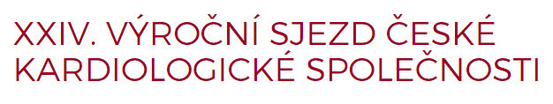
Treatment of hypertension in pregnancy:
a single-center 4-year retrospective study
Pokorna V, Pazmanova T, Kaluzay J, Bodikova S, Pontuch P
4th Department of Internal Medicine
Faculty of Medicine, Comenius University, St. Cyril and Methodius Hospital
University Hospital Bratislava, Slovakia

Slide 2
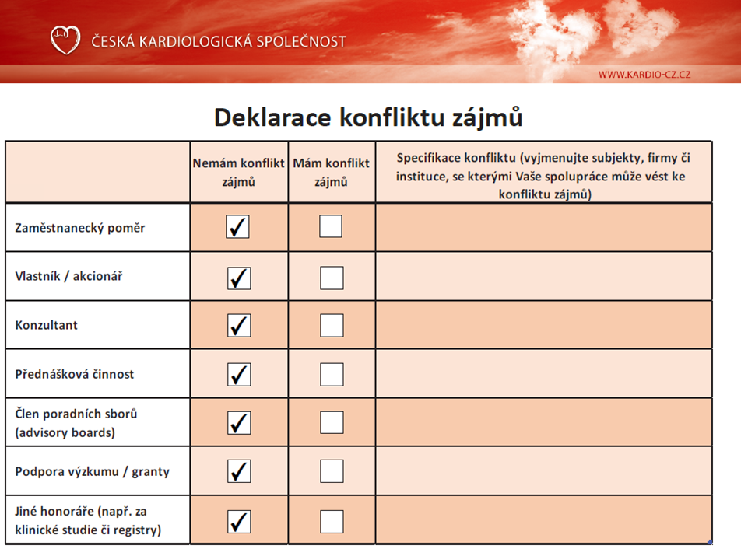

Slide 3
Aims
Treatment of hypertension in pregnancy
To evaluate the treatment in women with hypertension in pregnancy
To evaluate the relationship between
    studied parameters
        age
        DM
        quantitative proteinuria
        serum uric acid
and the treatment.

Slide 4
Patients and methods
Treatment of hypertension in pregnancy
June 2011 – June 2015
St. Cyril and Methodius Hospital
308 pregnant women
(339 fetuses, 335 born alive, 84% per Caesarean section)
median age 32 (min 18, max 46) years
16% with DM
treatment until the day of delivery
proteinuria and uric acid - the highest ante-partum value

Slide 5
Type of hypertension
Treatment of hypertension in pregnancy

Slide 6
Diabetes mellitus
Treatment of hypertension in pregnancy

Slide 7
Proteinuria and uric acid
Treatment of hypertension in pregnancy
Proteinuria
  median 580 mg/24 h
  IQR 210-1935 mg/24 h
  min 0.06 g/24h max 20.04 g/ 24h
Serum uric acid
  median 344.2 µmol/l (ULN 340 µmol/l)
  IQR 288.8-401.85 µmol/l
  min 194 µmol/l max 633 µmol/l

Slide 8
Number of antihypertensives
Treatment of hypertension in pregnancy

Slide 9
Types of antihypertensives
Treatment of hypertension in pregnancy

Slide 10
Types of antihypertensives
Treatment of hypertension in pregnancy
There was only sporadic use of other drugs:
isosorbide dinitrate (i.v., 4 pts)
bisoprolol (2 pts)
nitrendipine (2 pts)
atenolol (1 pts)
felodipine (1 pts)

Slide 11
Doses of antihypertensives
Treatment of hypertension in pregnancy
 | median dose | maximum dose
methyldopa | 2000 mg | 2250 mg
isradipine | 5 mg | 10 mg
i.v. urapidil | - | -
oral urapidil | 60 mg | 360 mg
metoprolol | 50 mg | 125 mg
amlodipine | 10 mg | 15 mg
verapamil | 120 mg | 360 mg

Slide 12
Conclusions
Treatment of hypertension in pregnancy
The number of drugs needed to control hypertension was increasing with
  growing age (p<0.05)
  increasing proteinuria (p<0.001)
There was no relationship between DM or serum uric acid and the number of drugs needed.

Slide 13
Conclusions
Treatment of hypertension in pregnancy
Most pts were concomitantly treated with
    2 antihypertensives.
Methyldopa, isradipine and urapidil were the most frequently used drugs.
Treatment was consistent with current ESH/ESC guidelines, except for urapidil.

Slide 14
St. Cyril and Methodius Hospital, Bratislava

