Slide 1
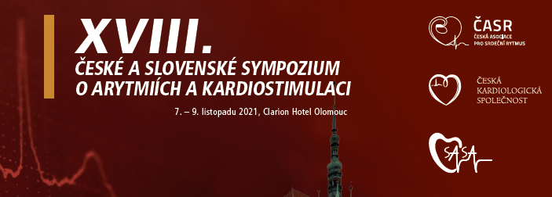
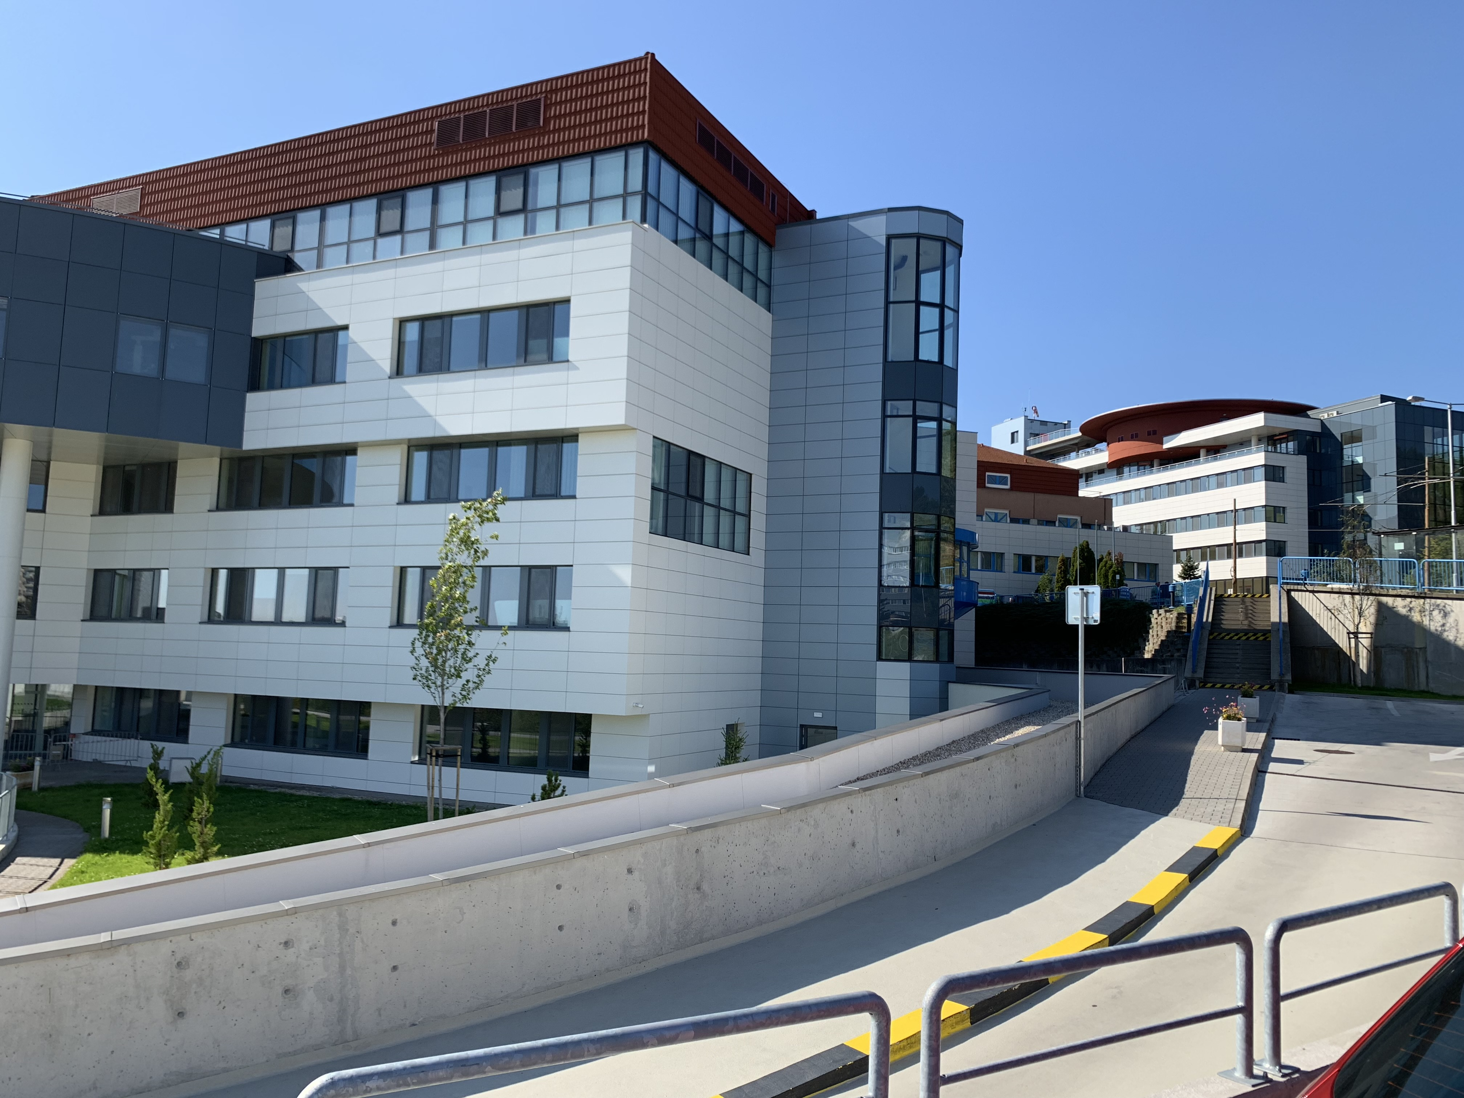
Telemedicína a digitálne technológie v manažmente arytmií
ROBERT HATALA
Klinika kardiológie a angiológie
NÚSCH a.s. a LF SZU Bratislava

Slide 2
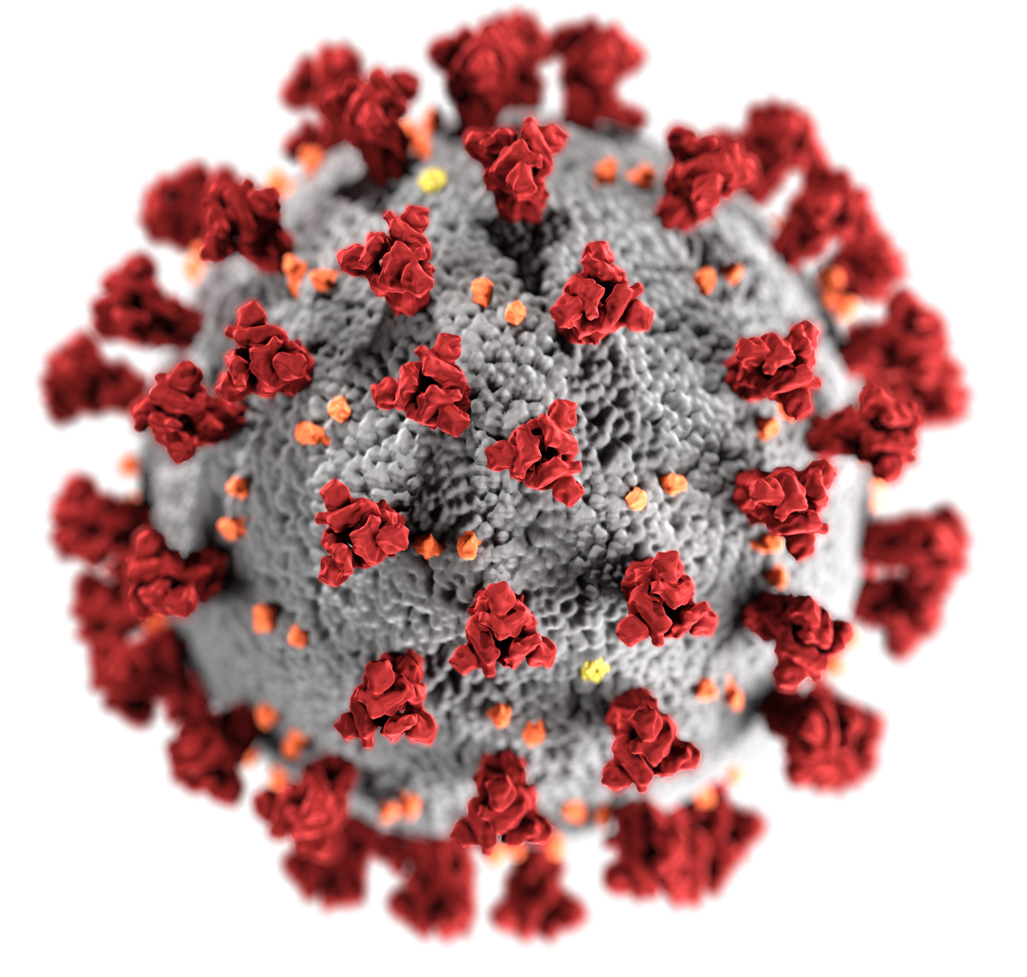
Digitálna medicína katalyzovaná pandémiou
Notes:
Singhal A, Cowie MR. Digital Health: Implications for Heart Failure Management. Card Fail Rev. 2021;7:e08. Published 2021 May 11. doi:10.15420/cfr.2020.28

Slide 3
DIGITÁLNE ZDRAVIE, TELEMEDICÍNA, …..
ČO TO VLASTNE JE?
Termín | Definícia
Digitálne zdravie | Široký „dáždnik“ zastrešujúci e-Zdravie (vrátane m-Zdravia), ako aj nové oblasti ako pokročilé počítačové aplikácie s veľkými dátami, genomiku a umelú inteligenciu.
eZdravie | Využívanie informačných a komunikačných technológií na podporu zdravia a súvisiacich oblastí.
mZdravie | Lekárska a verejno-zdravotnícka prax podporovaná mobilnými zariadeniami ako napr. smartfóny, pacientske domáce monitorovacie jednotky, osobní digitálni asistenti a iné bezdrôtové zariadenia
Telezdravie (telemedicína) | Poskytovanie zdravotnej starostlivosti, pri ktorom sa pacient a poskytovateľ nachádzajú na vzdialených miestach.
Telekonzultácie | Používanie informačných a komunikačných technológií pre konzultácie so vzdialeným pacientom.
Vzdialené monitorovanie | Podskupina technológií v rámci telemedicíny, ktoré uľahčujú monitorovanie a včasný bidirekčný transfer pacientskych údajov medzi pacientom a zdravotníkom.

Slide 4
Digitálne zdravie v čase pandémie
(príklad chronického SZ)
Singhai A, Cowie MR. Card Fail Rev. 2021;7:e08. doi:10.15420/cfr.2020.28
Notes:
Singhal A, Cowie MR. Digital Health: Implications for Heart Failure Management. Card Fail Rev. 2021;7:e08. Published 2021 May 11. doi:10.15420/cfr.2020.28
Abstract
Digital health encompasses the use of information and communications technology and the use of advanced computing sciences in healthcare. This review covers the application of digital health in heart failure patients, focusing on teleconsultation, remote monitoring and apps and wearables, looking at how these technologies can be used to support care and improve outcomes. Interest in and use of these technologies, particularly teleconsultation, have been accelerated by the coronavirus disease 2019 pandemic. Remote monitoring of heart failure patients, to identify those patients at high risk of hospitalisation and to support clinical stability, has been studied with mixed results. Remote monitoring of pulmonary artery pressure has a consistent effect on reducing hospitalisation rates for patients with moderately severe symptoms and multiparameter monitoring shows promise for the future. Wearable devices and apps are increasingly used by patients for health and lifestyle support. Some wearable technologies have shown promise in AF detection, and others may be useful in supporting self-care and guiding prognosis, but more evidence is required to guide their optimal use. Support for patients and clinicians wishing to use these technologies is important, along with consideration of data validity and privacy and appropriate recording of decision-making.
Keywords: COVID-19; Digital health; apps; cardiology; e-health; heart failure; m-health; machine learning; telemedicine; wearable

Slide 5
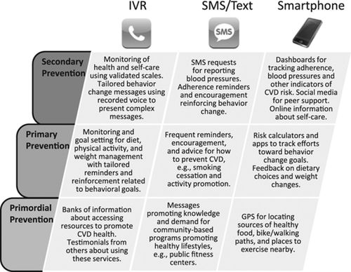
John D. Piette. Circulation. Mobile Health Devices as Tools for Worldwide Cardiovascular Risk Reduction and Disease Management, Volume: 132, Issue: 21, Pages: 2012-2027, DOI: (10.1161/CIRCULATIONAHA.114.008723)

Slide 6
Tarakji KG et al. Circ Arrhythm Electrophysiol. 2020;13(11):e007953. doi:10.1161/CIRCEP.120.007953
Notes:
Tarakji KG, Silva J, Chen LY, et al. Digital Health and the Care of the Patient With Arrhythmia: What Every Electrophysiologist Needs to Know. Circ Arrhythm Electrophysiol. 2020;13(11):e007953. doi:10.1161/CIRCEP.120.007953
Abstract
The field of cardiac electrophysiology has been on the cutting edge of advanced digital technologies for many years. More recently, medical device development through traditional clinical trials has been supplemented by direct to consumer products with advancement of wearables and health care apps. The rapid growth of innovation along with the mega-data generated has created challenges and opportunities. This review summarizes the regulatory landscape, applications to clinical practice, opportunities for virtual clinical trials, the use of artificial intelligence to streamline and interpret data, and integration into the electronic medical records and medical practice. Preparation of the new generation of physicians, guidance and promotion by professional societies, and advancement of research in the interpretation and application of big data and the impact of digital technologies on health outcomes will help to advance the adoption and the future of digital health care.

Slide 7
Nositeľné a implantovateľné technológie
Tarakji KG et al. Circ Arrhythm Electrophysiol. 2020;13(11):e007953. doi:10.1161/CIRCEP.120.007953
Notes:
Tarakji KG, Silva J, Chen LY, et al. Digital Health and the Care of the Patient With Arrhythmia: What Every Electrophysiologist Needs to Know. Circ Arrhythm Electrophysiol. 2020;13(11):e007953. doi:10.1161/CIRCEP.120.007953
Abstract
The field of cardiac electrophysiology has been on the cutting edge of advanced digital technologies for many years. More recently, medical device development through traditional clinical trials has been supplemented by direct to consumer products with advancement of wearables and health care apps. The rapid growth of innovation along with the mega-data generated has created challenges and opportunities. This review summarizes the regulatory landscape, applications to clinical practice, opportunities for virtual clinical trials, the use of artificial intelligence to streamline and interpret data, and integration into the electronic medical records and medical practice. Preparation of the new generation of physicians, guidance and promotion by professional societies, and advancement of research in the interpretation and application of big data and the impact of digital technologies on health outcomes will help to advance the adoption and the future of digital health care.

Slide 8
Snímanie EKG prenosným EKG monitorom
Varmna N et al. Europace. 2021;23(2):313. doi:10.1093/europace/euaa187
Notes:
Varma N, Marrouche NF, Aguinaga L, et al. HRS/EHRA/APHRS/LAHRS/ACC/AHA worldwide practice update for telehealth and arrhythmia monitoring during and after a pandemic. Europace. 2021;23(2):313. doi:10.1093/europace/euaa187

Slide 9
2405 pacientov, FU 1 rok
Absolútne zníženie celkovej mortality - 1,9% (RR=0,62)
1078 pacientov, FU 1 rok
Absolútne zníženie celkovej mortality - 5,6% (RR=0,64)
Notes:
Hindricks G, Varma N, Kacet S, et al. Daily remote monitoring of implantable cardioverter-defibrillators: insights from the pooled patient-level data from three randomized controlled trials (IN-TIME, ECOST, TRUST). Eur Heart J. 2017;38(22):1749-1755. doi:10.1093/eurheartj/ehx015
Abstract
Aims: Remote monitoring of implantable cardioverter-defibrillators may improve clinical outcome. A recent meta-analysis of three randomized controlled trials (TRUST, ECOST, IN-TIME) using a specific remote monitoring system with daily transmissions [Biotronik Home Monitoring (HM)] demonstrated improved survival. We performed a patient-level analysis to verify this result with appropriate time-to-event statistics and to investigate further clinical endpoints.
Methods and results: Individual data of the TRUST, ECOST, and IN-TIME patients were pooled to calculate absolute risks of endpoints at 1-year follow-up for HM vs. conventional follow-up. All-cause mortality analysis involved all three trials (2405 patients). Other endpoints involved two trials, ECOST and IN-TIME (1078 patients), in which an independent blinded endpoint committee adjudicated the underlying causes of hospitalizations and deaths. The absolute risk of death at 1 year was reduced by 1.9% in the HM group (95% CI: 0.1-3.8%; P = 0.037), equivalent to a risk ratio of 0.62. Also the combined endpoint of all-cause mortality or hospitalization for worsening heart failure (WHF) was significantly reduced (by 5.6%; P = 0.007; risk ratio 0.64). The composite endpoint of all-cause mortality or cardiovascular (CV) hospitalization tended to be reduced by a similar degree (4.1%; P = 0.13; risk ratio 0.85) but without statistical significance.
Conclusion: In a pooled analysis of the three trials, HM reduced all-cause mortality and the composite endpoint of all-cause mortality or WHF hospitalization. The similar magnitudes of absolute risk reductions for WHF and CV endpoints suggest that the benefit of HM is driven by the prevention of heart failure exacerbation.

Slide 10
Using of myMerlinPulse™
Mobile App

Slide 11
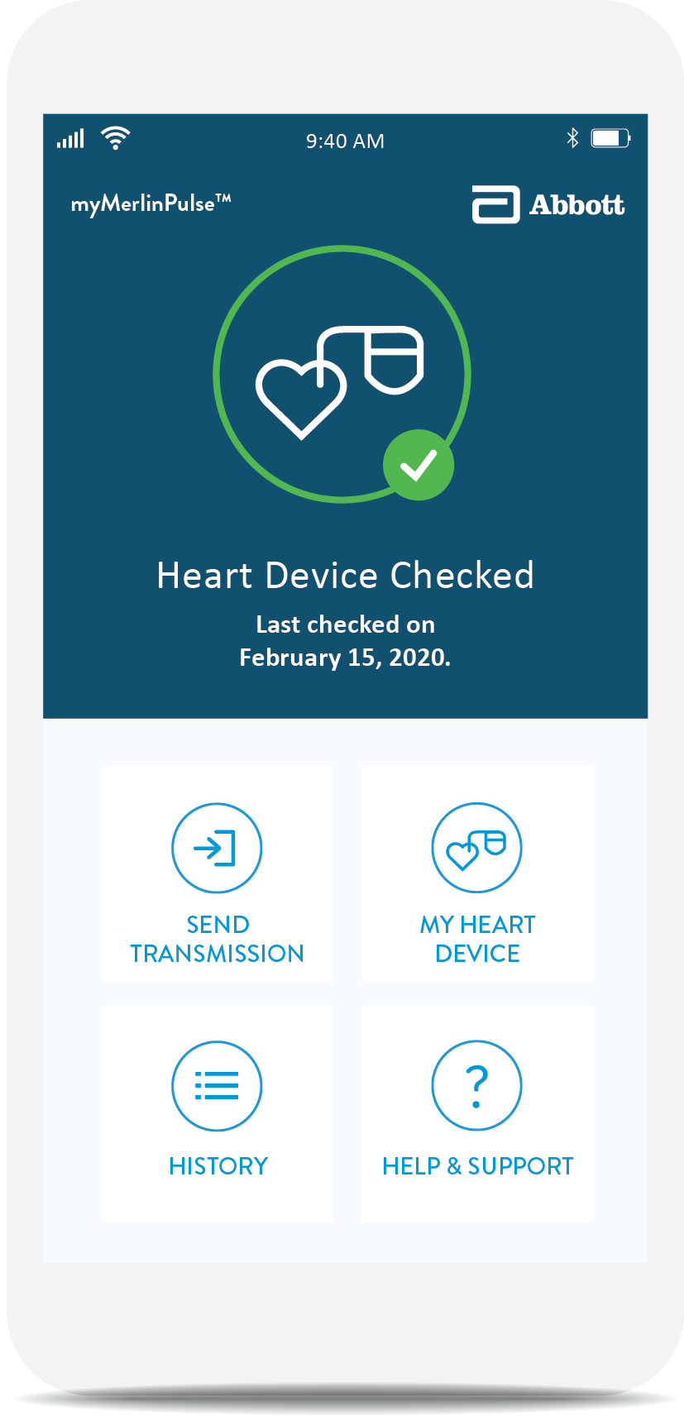
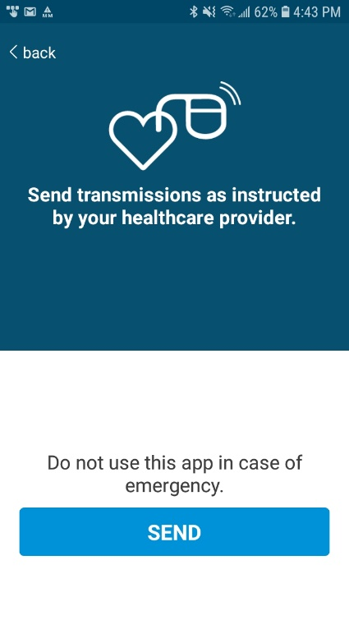
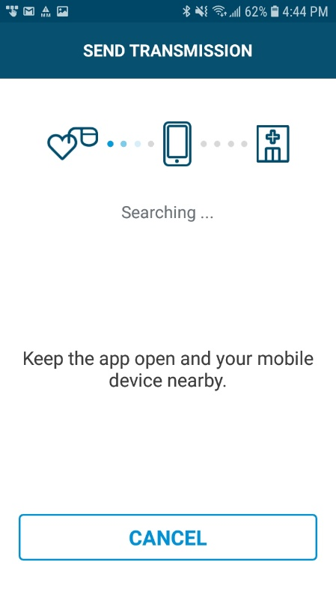
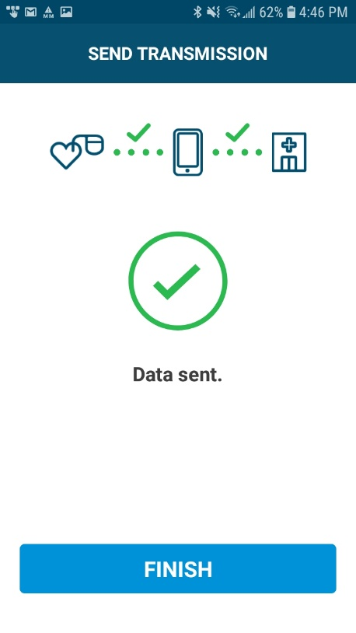
SEND TRANSMISSION
PATIENT CAN SEND DEVICE DATA WHEN INSTRUCTED BY THEIR HCP
The App can store UP TO 5 encrypted sessions locally.
The Send Transmission feature can be deactivated via Merlin.netTM PCN.
11
Notes:
The App can store up to 5 encrypted sessions locally until a data or WiFi connection is re-established. Once uploaded successfully, data is deleted from the app.

Slide 12
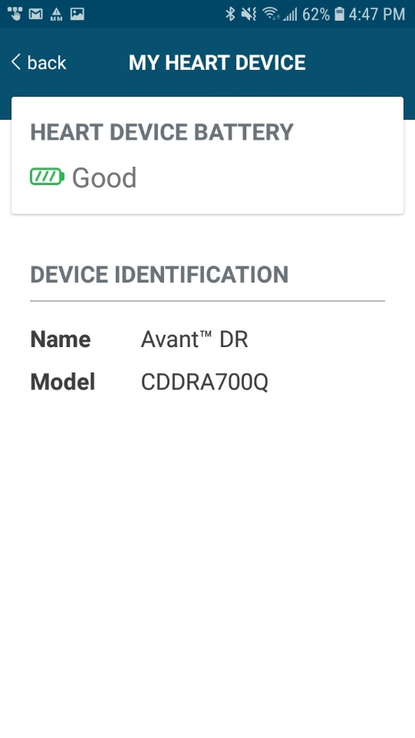
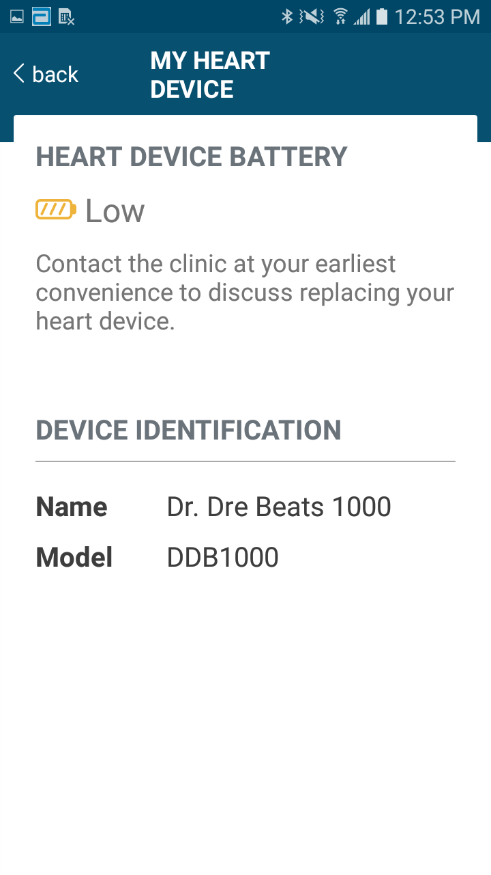
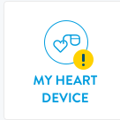
MY HEART DEVICE
PATIENT CAN VIEW THEIR DEVICE MODEL AND BATTERY STATUS
Battery Status is INDICATED AS “LOW” once the device reaches ERI:
Yellow alert symbol on home page
Patient Notification sent through the app
GallantTM DR
CDDRA500Q
GallantTM DR
CDDRA500Q
12
Notes:
A yellow alert symbol will appear on the home page to alert the patient, and a notification will be sent through the app.

Slide 13
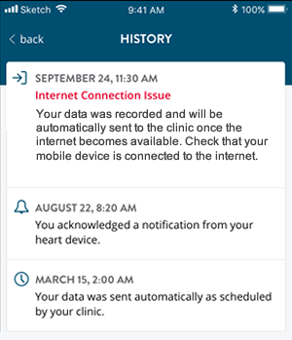



HISTORY
PATIENT CAN VIEW A LOG OF TRANSMISSIONS AND ALERTS
Indicates a MANUAL OR ALERT TRANSMISSION was sent
If there is a connection issue during sending, a red alert message will appear.
Indicates a PATIENT NOTIFIER was sent to the app.
Indicates a SCHEDULED
TRANSMISSION was sent automatically.
13
Notes:
.

Slide 14
Merlin@Home vs. myMerlinPulse™ Mobile App
Faster and easier pairing (less than one minute)
Less hardware, higher reliability
No electrical outlet required
The application is easier to use for smartphone users
Connectivity even in areas with a weak GSM signal
Patient is travelling with his monitor (smartphone)

Slide 15
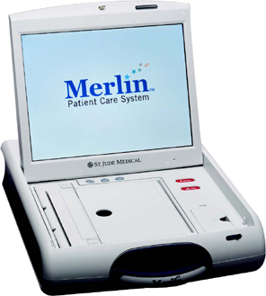
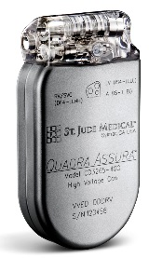
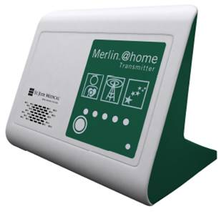

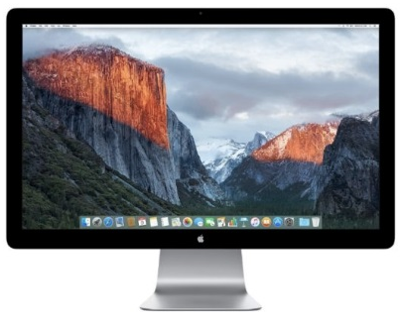
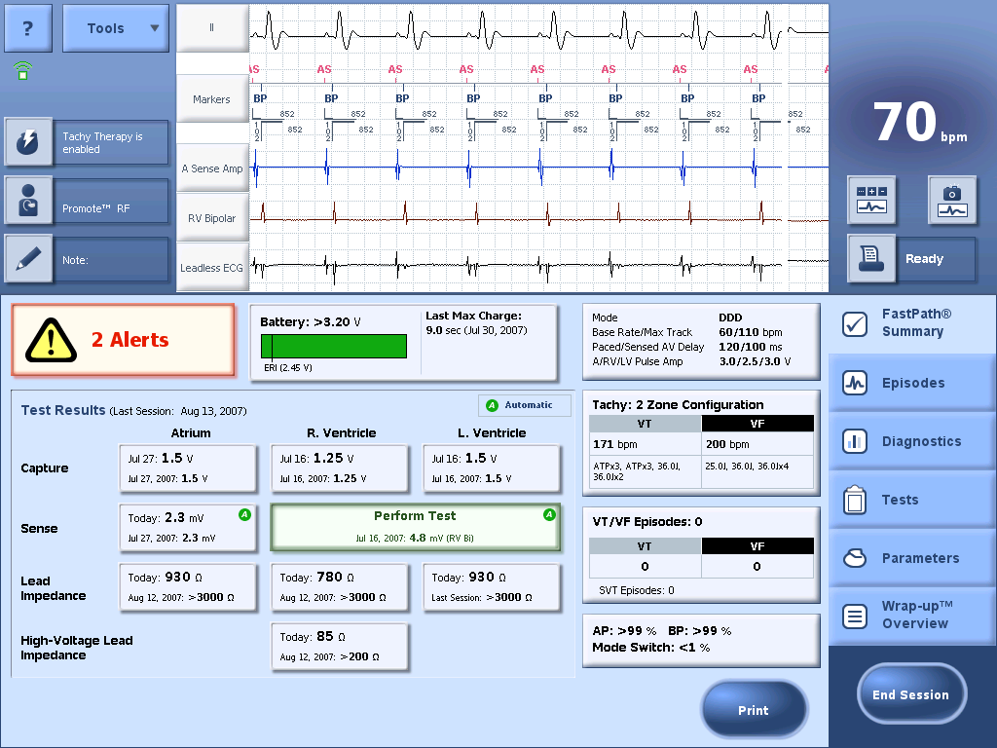
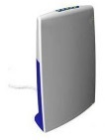
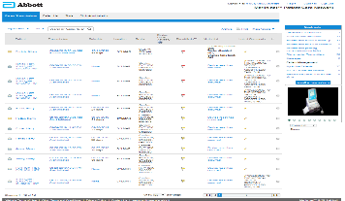

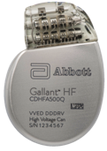
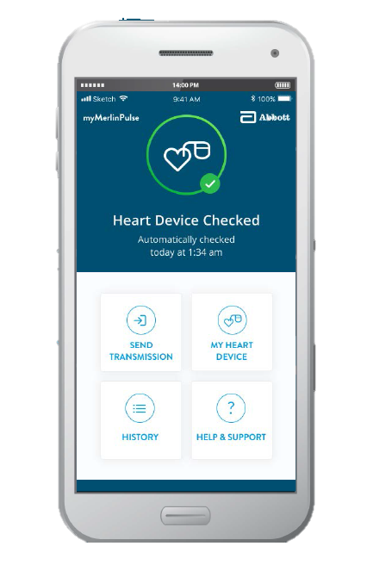


SYSTEM COMPONENTS RELATIONSHIP
PREDICATE SYSTEMS
Assura™ Device Families
IT Infrastructure
MICS RF
Inductive
MICS RF
Landline
Cellular/Wi-Fi
Merlin™ Patient Care System (PCS)
Assura™ ICD/CRT-D
Merlin@Home
Merlin.net™ MN5000
Merlin.net™ Patient Care Network
WebApp & Database
NEXT GENERATION SYSTEMS
Gallant™ and Entrant™ Device Families
IT Infrastructure
Bluetooth® Low Energy
Inductive
Bluetooth® Low Energy
Cellular
Wi-Fi
Merlin™ Patient Care System (PCS)
Gallant™ or Entrant™ ICD/CRT-D
myMerlinPulse™ Mobile App
(iOS & Android)
Merlin.net™ MN5000
Merlin.net™ Patient Care Network
WebApp & Database
15

Slide 16
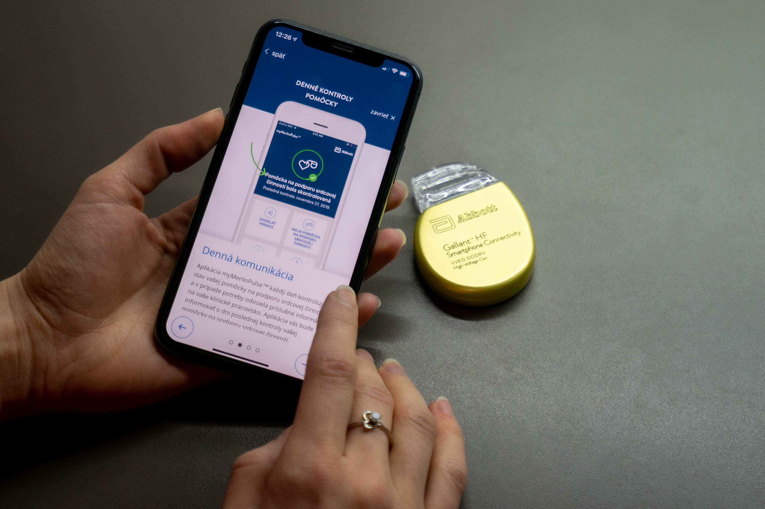
MyMerlin App limitations
Patient must be smartphone owner familiar with its operation
Basic digital skills required
16

Slide 17
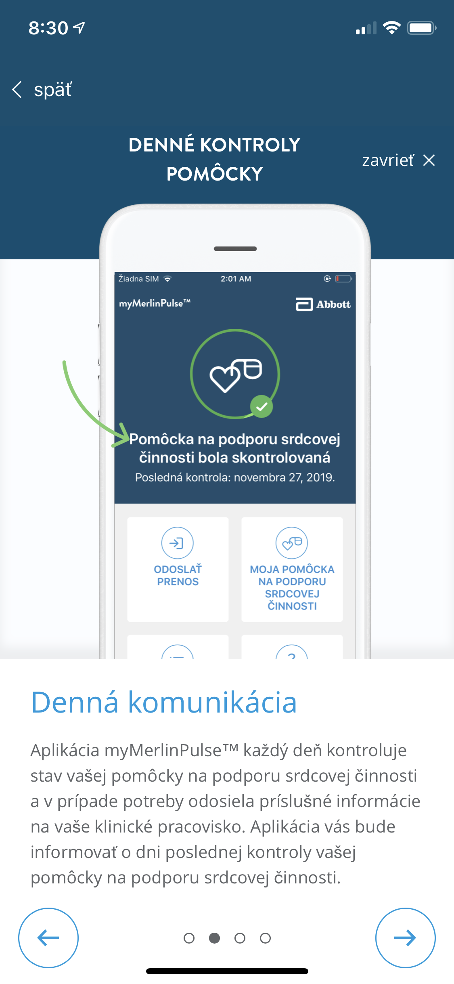
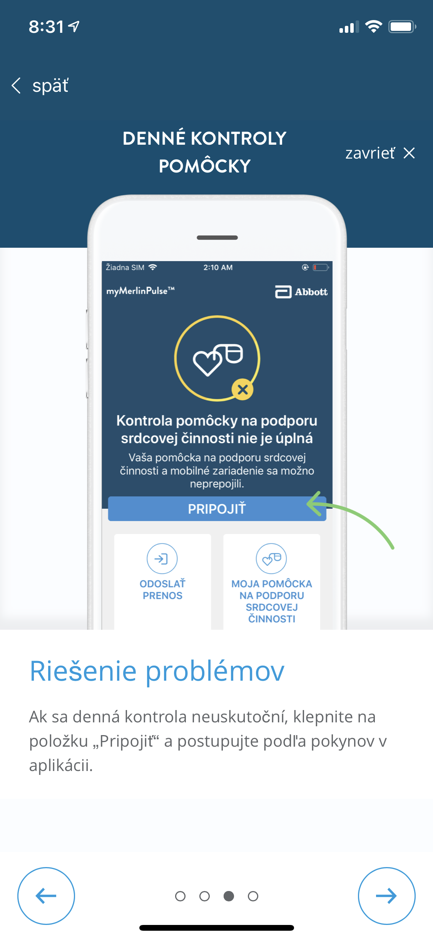
MyMerlin App benefits
  App localized in native language
  Patient friendly for manual transmissions
  Improved real-time monitoring (smartphone is usually close to patient)
  Easier to fix connectivity issues
  Improved security perception for the patient
  Patient can check
    battery status and monitoring
    transmission history

Slide 18
Náklady na vzdialené monitorovanie pacientov
(odhad USA)

Slide 19

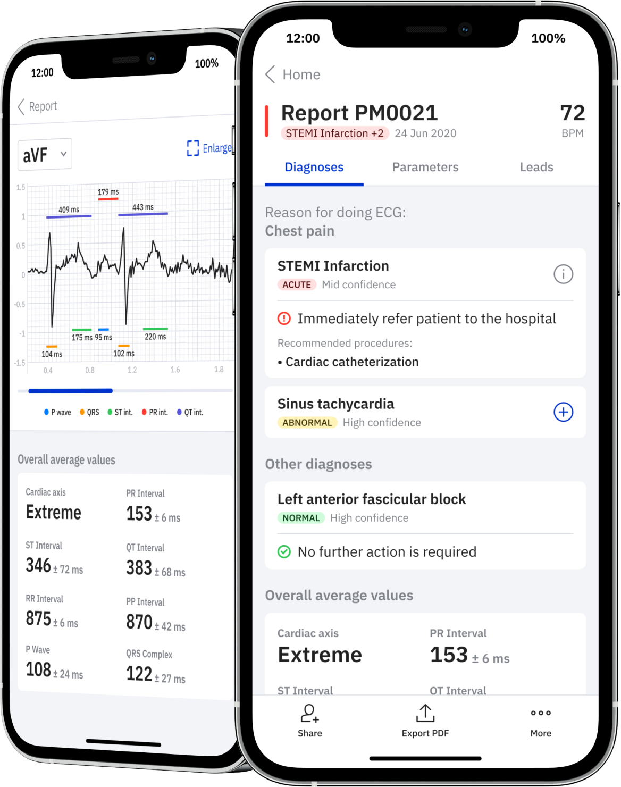
Introducing PMcardio
AI-powered clinical assistant revolutionizing CVD detection
and management in primary and emergency care
Available to any physician with a smartphone & compatible with all ECG devices and existing hospital infrastructure
Can accurately detect up to 60 diagnoses in under 4 seconds
Diagnoses tested on large datasets cross-validated by some of the world’s top cardiologists. 3 multi-centre clinical trials in 8 countries ongoing.
Certified as Medical Device in the EU (CE Mark) in Q1/22, in the US (FDA) in Q2/22
Notes:
Stemming from these clinical needs, we have developed PMcardio, an intuitive clinical assistant in the form of a smartphone application that empowers any healthcare professional with the access to an EKG with knowledge from millions of previous cases in the matter of seconds!
PMcardio can accurately detect up to 60 CVD diagnoses in less than 4 seconds
We have tested and benchmarked our diagnostic AI on the largest prospectively labeled, cross-validated dataset containing tens of thousands of EKGs
PMcardio will soon be CE certified as one of the first Class IIb Software as a medical device in the form of a smartphone application with FDA following beginning of next year
To see a live demo of PMcardio, please see the supplmentary video that is available online

Slide 20
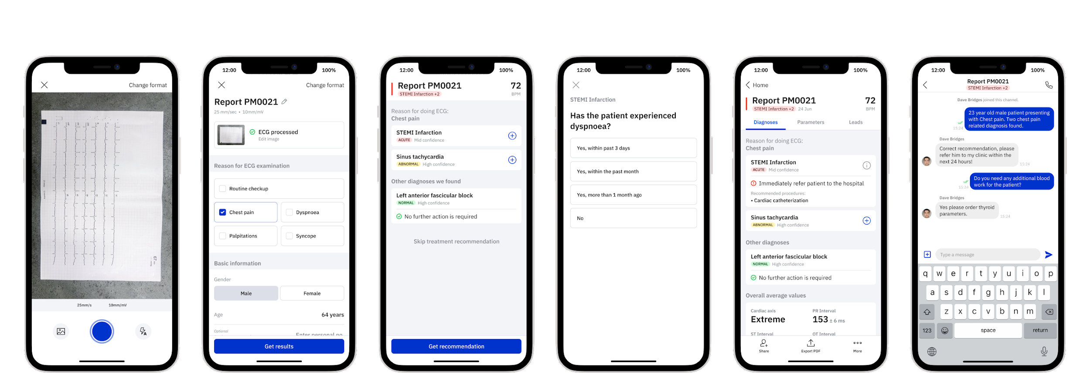

PMcardio summary
World’s first AI-powered ECG Digitization, Analysis and Treatment platform
ECG
Digitization
Data
Collection
AI
Diagnosis
Standardized
Anamnesis
Treatment
Recommedantions
Sharing &
Collaboration
Multi-user Chat
Group Calls
File Sharing
Secure Export
EMR Integration
Notes:
So let’s see how PMcardio works:
First, the user takes an image of the 12-lead EKG, we support taking pictures of both paper-form or screen-based EKGs
In the background our patent-pending digitization algorithms extract the waveforms from the image and reliably converts them into digital datapoints
Meanwhile the user enters some baseline demographics of the patient
Using deep learning PMcardio can diagnose up to 60 CVDs in less then 4 seconds
The user then fills out follow-up questions to receive a guideline-based recommendation for immediate patient management and further diagnostic procedures.
In the last step he is able to share the whole report, including the digitized ECG securely in a GDPR and HIPAA compliant chat.
So to summarize, with PMcardio, a healthcare professional is able to scan and digitize any ECG format, get a fast AI-powered interpretation, receive immediate guideline-based management recommendations and share the report with specialists in their network.

Slide 21
Demonstrating clinical effectivness
Running
Q4 2021
Coming soon
Primary care - GP trial
Emergency care - Ambulance trial
Emergency department trial
- Increase adequate referrals from primary to secondary care
- Increase availability of secondary care
- Reduce total ischemic time of ACS patients
- Decrease time to adequate patient management
- Improve triage accuarcy of CVD patients in emergency department
- Decrease time to adequate treatment
Notes:
To demonstrate the clinical effectiveness of PMcardio we have also launched several trials in the respective clinical use environments.
Following next are trials in the Ambulance and Emergency department setting.
In conclusion, we have developed a very accessible Class IIb medical device empowering all non-cardiologist healthcare professionals with a fast diagnosis of the ECG, recommendations for immediate patient management and remote consultation with specialists. PMcardio is soon to be certified in the EU and available on both Android and iOS platforms and used by thousands of physicians already. And with that being said I would like to thank you for your attention, and if there are any questions, I'm happy to answer them!

Slide 23
Eur Heart J. 2021;42(38):3979-3988. doi:10.1093/eurheartj/ehab597
Notes:
Bonnesen MP, Frodi DM, Haugan KJ, et al. Day-to-day measurement of physical activity and risk of atrial fibrillation. Eur Heart J. 2021;42(38):3979-3988. doi:10.1093/eurheartj/ehab597

Slide 24
Schierbeck S et al. Eur Heart J. 2021;ehab498. doi:10.1093/eurheartj/ehab498
Notes:
Schierbeck S, Hollenberg J, Nord A, et al. Automated external defibrillators delivered by drones to patients with suspected out-of-hospital cardiac arrest [published online ahead of print, 2021 Aug 26]. Eur Heart J. 2021;ehab498. doi:10.1093/eurheartj/ehab498
Abstract
Aims : Early defibrillation is critical for the chance of survival in out-of-hospital cardiac arrest (OHCA). Drones, used to deliver automated external defibrillators (AEDs), may shorten time to defibrillation, but this has never been evaluated in real-life emergencies. The aim of this study was to investigate the feasibility of AED delivery by drones in real-life cases of OHCA.
Methods and results : In this prospective clinical trial, three AED-equipped drones were placed within controlled airspace in Sweden, covering approximately 80 000 inhabitants (125 km2). Drones were integrated in the emergency medical services for automated deployment in beyond-visual-line-of-sight flights: (i) test flights from 1 June to 30 September 2020 and (ii) consecutive real-life suspected OHCAs. Primary outcome was the proportion of successful AED deliveries when drones were dispatched in cases of suspected OHCA. Among secondary outcomes was the proportion of cases where AED drones arrived prior to ambulance and time benefit vs. ambulance. Totally, 14 cases were eligible for dispatch during the study period in which AED drones took off in 12 alerts to suspected OHCA, with a median distance to location of 3.1 km [interquartile range (IQR) 2.8-3.4). AED delivery was feasible within 9 m (IQR 7.5-10.5) from the location and successful in 11 alerts (92%). AED drones arrived prior to ambulances in 64%, with a median time benefit of 01:52 min (IQR 01:35-04:54) when drone arrived first. In an additional 61 test flights, the AED delivery success rate was 90% (55/61).
Conclusion : In this pilot study, we have shown that AEDs can be carried by drones to real-life cases of OHCA with a successful AED delivery rate of 92%. There was a time benefit as compared to emergency medical services in cases where the drone arrived first. However, further improvements are needed to increase dispatch rate and time benefits.

Slide 25
Schierbeck S et al. Eur Heart J. 2021;ehab498. doi:10.1093/eurheartj/ehab498

Slide 26
Časová úspora pre defibriláciu 1:52 min
Schierbeck S et al. Eur Heart J. 2021;ehab498. doi:10.1093/eurheartj/ehab498

Slide 27
Digitálne zdravie v kardiológii
PROBLÉMY
RIEŠENIA
Frederix I et al. Eur J Prev Cardiol. 2019;26(11):1166-1177. doi:10.1177/2047487319832394
Notes:
Frederix I, Caiani EG, Dendale P, et al. ESC e-Cardiology Working Group Position Paper: Overcoming challenges in digital health implementation in cardiovascular medicine. Eur J Prev Cardiol. 2019;26(11):1166-1177. doi:10.1177/2047487319832394

Slide 28
Digitálne zdravie - prekážky a riešenia
Singhai A, Cowie MR. Card Fail Rev. 2021;7:e08. doi:10.15420/cfr.2020.28
Notes:
Singhal A, Cowie MR. Digital Health: Implications for Heart Failure Management. Card Fail Rev. 2021;7:e08. Published 2021 May 11. doi:10.15420/cfr.2020.28
Abstract
Digital health encompasses the use of information and communications technology and the use of advanced computing sciences in healthcare. This review covers the application of digital health in heart failure patients, focusing on teleconsultation, remote monitoring and apps and wearables, looking at how these technologies can be used to support care and improve outcomes. Interest in and use of these technologies, particularly teleconsultation, have been accelerated by the coronavirus disease 2019 pandemic. Remote monitoring of heart failure patients, to identify those patients at high risk of hospitalisation and to support clinical stability, has been studied with mixed results. Remote monitoring of pulmonary artery pressure has a consistent effect on reducing hospitalisation rates for patients with moderately severe symptoms and multiparameter monitoring shows promise for the future. Wearable devices and apps are increasingly used by patients for health and lifestyle support. Some wearable technologies have shown promise in AF detection, and others may be useful in supporting self-care and guiding prognosis, but more evidence is required to guide their optimal use. Support for patients and clinicians wishing to use these technologies is important, along with consideration of data validity and privacy and appropriate recording of decision-making.
Keywords: COVID-19; Digital health; apps; cardiology; e-health; heart failure; m-health; machine learning; telemedicine; wearable

Slide 29
Digitálne zdravie a arytmie - súhrn
Významný rozmach v súvislosti s pandémiou
Dopad na mnohé aspekty zdravotníctva a lekárskych vied, napr.:
  Zdokonalená a akcelerovaná diagnostika na báze zberu fyziologických údajov
  AI pre interpretáciu týchto údajov
  Edukácia a manažment zdravotníkov & pacientov (digitálna gramotnosť)
  Akceláracia implementácie odporúčaní
  Nové možnosti realizácie klinických štúdii, facilitácia multicentrickej koordinácie
Ale: v mnohých krajinách chaotické a odborne úbohé využívanie, funguje len na báze entuziazmu odborníkov
Neochota finančného ohodnotenie mentálneho know-how a práce zdravotníkov.
Napriek tomu tieto technológie nabrali novú dimenziu a ostanú s nami.

