Slide 1
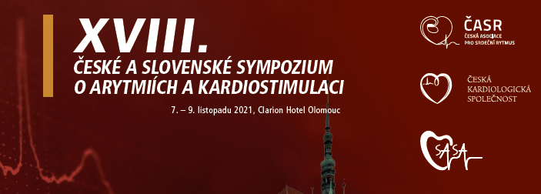
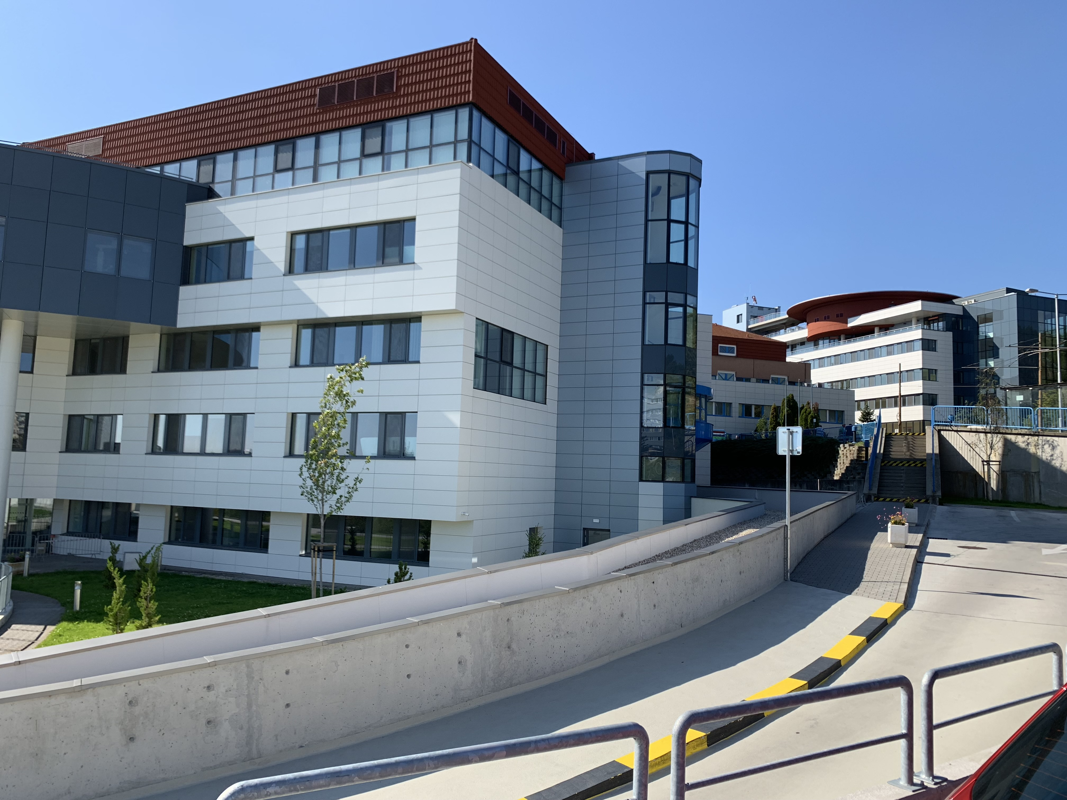
PACIENT SO SRDCOVÝM ZLYHÁVANÍM
A KOMOROVÝMI ARYTMIAMI :
TENTO PACIENT POTREBUJE LIEČBU SRDCOVÉHO ZLYHÁVANIA
ROBERT HATALA
Klinika kardiológie a angiológie
NÚSCH a.s. a LF SZU Bratislava

Slide 2
Vyhlásenie o potenciálnom konflikte záujmov autora
Forma finančného prepojenia | Spoločnosť
Participácia na klinických štúdiách/firemnom grante | Medtronic, Biotronik, Abbott, SASA
Nepeňažné plnenie (v zmysle zákona) | -
Honorované prednášky | ESC, Novartis, Medtronic, Abbott
Akcionár | nie
Konzultant/odborný poradca | Novartis
Ostatné príjmy (špecifikovať) | -
Podľa ESC a UEMS (upravené v zmysle slovenskej legislatívy)

Slide 3
Celulárne a multicelulárne arytmogénne mechanizmy pri SZ
Alvarez CK et al. J Interv Card Electrophysiol. 2019;56(3):229-247. doi:10.1007/s10840-019-00623-x
Notes:
Alvarez CK, Cronin E, Baker WL, Kluger J. Heart failure as a substrate and trigger for ventricular tachycardia. J Interv Card Electrophysiol. 2019;56(3):229-247. doi:10.1007/s10840-019-00623-x

Slide 4
Betablokátory v liečbe SZ - dopad na NKS
RRR = -31%
Al-Gobari M et al. BMC Cardiovasc Disord. 2013;13:52. doi:10.1186/1471-2261-13-52
Notes:
Al-Gobari M, El Khatib C, Pillon F, Gueyffier F. β-Blockers for the prevention of sudden cardiac death in heart failure patients: a meta-analysis of randomized controlled trials. BMC Cardiovasc Disord. 2013;13:52. Published 2013 Jul 13. doi:10.1186/1471-2261-13-52

Slide 5
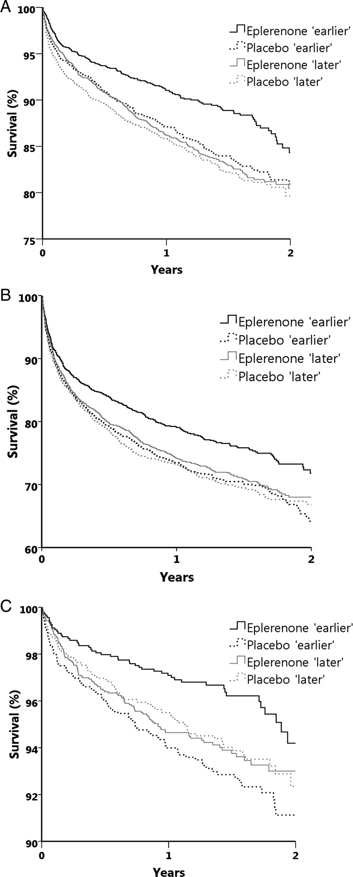
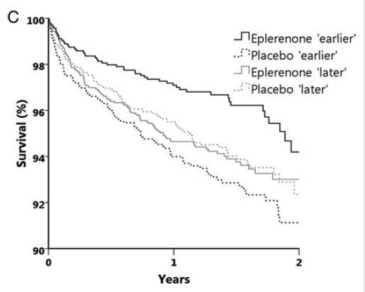
Štúdia EPHESUS - eplerenon pri SZ po IM
Kaplan–Meierova analýza prežívania:
celková mortalita (A), KV mortalita (B) a NKS (C)
Adamopoulos C et al. Eur J Heart Fail 2009;11:1099-1105
Notes:
Kaplan–Meier estimates of the rate of all-cause mortality (A), the rate of death from cardiovascular causes or cardiovascular hospitalization for cardiovascular events (B), and the rate of sudden cardiac death (C).
Aims To test the hypothesis that an earlier post-acute myocardial infarction (AMI) eplerenone initiation in patients with left ventricular systolic dysfunction (LVSD) and heart failure (HF) is associated with better long-term outcomes.
Methods and results The 6632 patients of the EPHESUS study were randomized from day 3 to 14 after the index AMI (median = 7 days), of these 3319 were assigned to eplerenone. We analysed the differential effects of time-to-eplerenone initiation vs. placebo, based on the median time to initiation of treatment (<7 days—‘earlier’, ≥7days—‘later’). Effects on outcomes were evaluated over a mean 16-month follow-up, using Cox proportional hazards regression analysis. The earlier eplerenone initiation (<7 days) reduced the risk of all-cause mortality by 31% (P = 0.001) when compared with the ‘earlier’ placebo’ and also reduced the risks of cardiovascular (CV) hospitalization/CV mortality by 24% (P < 0.0001) and sudden cardiac death (SCD) by 34% (P < 0.0001). In contrast, later eplerenone initiation (≥7 days) had no significant effect on outcomes. Interactions between time-to-randomization and treatment were significant. These associations remained substantially unchanged after risk adjustment in multivariable models.
Conclusion An earlier eplerenone administration (3–7days) post-AMI improved outcomes in patients with LVSD and HF. This benefit was not observed when eplerenone was initiated later (≥7days).

Slide 6
PARADIGM-HF (sacubitril/valsartan pri SZ)
8442 patients with chronic HF, NYHA
II–IV, with LVEF ≤ 35% (≤ 40% for the first of the 3 years of patient enrolment)
Liečba redukujúca NKS cestou “neutralizácie”
Komorového proarytmogénneho milieu pri SZ
Boriani G et al. Eur J Prev Cardiol. 2021;28(1):110-123. doi:10.1093/eurjpc/zwaa015
Notes:
Treatments to reduce sudden cardiac death by effecting the cardiac substrate or the ventricular arrhythmogenicity. ACE, angiotensinconverting
enzyme; AED, automated external defibrillator; ARB, angiotensin-receptor blocker; ARNI, angiotensin-receptor neprilysin inhibitor; ICD,
implantable cardioverter-defibrillator; MRA, mineralocorticoid receptor antagonist.
Figure 4 Data from PARADIGM-HF trial on the effect of sacubitril/
valsartan vs. enalapril in the subgroups without (n=7156) and
with defibrillator therapy back-up (with an ICD or CRTD device)
(n = 1243).62 No significant interaction was found (Pint was not significant).
CRTD, cardiac resynchronization therapy defibrillator; CV,
cardiovascular; HF, heart failure; ICD, implantable cardioverterdefibrillator.
Boriani G, De Ponti R, Guerra F, et al. Sinergy between drugs and devices in the fight against sudden cardiac death and heart failure. Eur J Prev Cardiol. 2021;28(1):110-123. doi:10.1093/eurjpc/zwaa015
Abstract
The impact of sudden cardiac death (SCD) in heart failure (HF) patients is important and prevention of SCD is a reasonable and clinically justified endpoint if associated with a reduction in all-cause mortality. According to literature, in HF with reduced ejection fraction, only three classes of agents were found effective in reducing SCD and all-cause mortality: beta-blockers, mineralcorticoid receptor antagonists and, more recently, angiotensin-receptor neprilysin-inhibitors. In the PARADIGM trial that tested sacubitril/valsartan vs. enalapril, the 20% relative risk reduction in cardiovascular deaths obtained with sacubitril/valsartan was attributable to reductions in the incidence of both SCD and death due to HF worsening and this effect can be added to the known positive effect of implantable cardioverter-defibrillators in appropriately selected patients. In order to maximize the implementation of all the available treatments, patients with HF should be included in virtuous networks with a dialogue between all the physician involved, with commitment by all these physicians for appropriate decision-making on application of pharmacological and device treatments according to available evidence, as well as commitment for drug titration before and after device implant, taking advantage from remote monitoring, and with the safety of back up device therapy when indicated. There are potential synergistic effects of drug therapy, with all the therapies acting on neuro-hormonal and sympathetic activation, but specifically with sacubitril/valsartan, and device therapy, in particular cardiac resynchronization therapy, with added incremental benefits on positive cardiac remodelling, prevention of HF progression, and prevention of ventricular tachyarrhythmias.
Keywords: Sacubitril/valsartan; Beta-blockers; Heart failure; Mineralcorticoid receptor antagonists; Mortality; Remote monitoring; Sudden cardiac death.

Slide 7
Notes:
Effects of sacubitril/valsartan vs. enalapril on a series of clinical outcomes in the PARADIGM-HF trial. Data are reported as hazard or rate
ratios and 95% confidence intervals. From Refs.56–58. CV, cardiovascular; ED, emergency department; HF, heart failure.
Boriani G, De Ponti R, Guerra F, et al. Sinergy between drugs and devices in the fight against sudden cardiac death and heart failure. Eur J Prev Cardiol. 2021;28(1):110-123. doi:10.1093/eurjpc/zwaa015
Abstract
The impact of sudden cardiac death (SCD) in heart failure (HF) patients is important and prevention of SCD is a reasonable and clinically justified endpoint if associated with a reduction in all-cause mortality. According to literature, in HF with reduced ejection fraction, only three classes of agents were found effective in reducing SCD and all-cause mortality: beta-blockers, mineralcorticoid receptor antagonists and, more recently, angiotensin-receptor neprilysin-inhibitors. In the PARADIGM trial that tested sacubitril/valsartan vs. enalapril, the 20% relative risk reduction in cardiovascular deaths obtained with sacubitril/valsartan was attributable to reductions in the incidence of both SCD and death due to HF worsening and this effect can be added to the known positive effect of implantable cardioverter-defibrillators in appropriately selected patients. In order to maximize the implementation of all the available treatments, patients with HF should be included in virtuous networks with a dialogue between all the physician involved, with commitment by all these physicians for appropriate decision-making on application of pharmacological and device treatments according to available evidence, as well as commitment for drug titration before and after device implant, taking advantage from remote monitoring, and with the safety of back up device therapy when indicated. There are potential synergistic effects of drug therapy, with all the therapies acting on neuro-hormonal and sympathetic activation, but specifically with sacubitril/valsartan, and device therapy, in particular cardiac resynchronization therapy, with added incremental benefits on positive cardiac remodelling, prevention of HF progression, and prevention of ventricular tachyarrhythmias.
Keywords: Sacubitril/valsartan; Beta-blockers; Heart failure; Mineralcorticoid receptor antagonists; Mortality; Remote monitoring; Sudden cardiac death.

Slide 8
Mechanizmy KV benefitov SGLT2 inhibítorov pri SZ
Joshi SS et al. Heart. 2021;107(13):1032-1038. doi:10.1136/heartjnl-2020-318060
Notes:
Joshi SS, Singh T, Newby DE, Singh J. Sodium-glucose co-transporter 2 inhibitor therapy: mechanisms of action in heart failure [published online ahead of print, 2021 Feb 26] [published correction appears in Heart. 2021 Nov;107(22):e15]. Heart. 2021;107(13):1032-1038. doi:10.1136/heartjnl-2020-318060

Slide 9
“Konvenčné” mechanizmy KV benefitov inhibítorov SGLT2 pri SZ
Joshi SS et al. Heart. 2021;107(13):1032-1038. doi:10.1136/heartjnl-2020-318060
Notes:
Joshi SS, Singh T, Newby DE, Singh J. Sodium-glucose co-transporter 2 inhibitor therapy: mechanisms of action in heart failure [published online ahead of print, 2021 Feb 26] [published correction appears in Heart. 2021 Nov;107(22):e15]. Heart. 2021;107(13):1032-1038. doi:10.1136/heartjnl-2020-318060

Slide 10
Nové mechanizmy KV benefitov inhibítorov SGLT2 pri SZ
Joshi SS et al. Heart. 2021;107(13):1032-1038. doi:10.1136/heartjnl-2020-318060
Notes:
Joshi SS, Singh T, Newby DE, Singh J. Sodium-glucose co-transporter 2 inhibitor therapy: mechanisms of action in heart failure [published online ahead of print, 2021 Feb 26] [published correction appears in Heart. 2021 Nov;107(22):e15]. Heart. 2021;107(13):1032-1038. doi:10.1136/heartjnl-2020-318060

Slide 11
RRR NKS pri SGLT2 inhibítoroch = -46%
Fernandez GC et al. Heart Rhythm. 2021;18(7):1098-1105. doi:10.1016/j.hrthm.2021.03.028
Notes:
Fernandes GC, Fernandes A, Cardoso R, et al. Association of SGLT2 inhibitors with arrhythmias and sudden cardiac death in patients with type 2 diabetes or heart failure: A meta-analysis of 34 randomized controlled trials. Heart Rhythm. 2021;18(7):1098-1105. doi:10.1016/j.hrthm.2021.03.028
Abstract
Background: Sodium-glucose cotransporter 2 inhibitors (SGLT2is) reduce hospitalizations and death from heart failure (HF), but their effect on arrhythmia expression has been poorly investigated.
Objective: The purpose of this study was to evaluate the association of SGLT2is with arrhythmias in patients with type 2 diabetes mellitus (T2DM) or HF.
Methods: We searched PubMed and ClinicalTrials.gov. Two independent investigators identified randomized double-blind trials that compared SGLT2is with placebo or active control for adults with T2DM or HF. Primary outcomes were incident atrial arrhythmias, ventricular arrhythmias (VAs), and sudden cardiac death (SCD).
Results: We included 34 randomized (25 placebo-controlled and 9 active-controlled) trials with 63,166 patients (35,883 SGLT2is vs 27,273 control: mean age 53-67 years; 63% male). Medications included canagliflozin, dapagliflozin, empagliflozin, or ertugliflozin. Except for 1 study of HF, all patients had T2DM. Follow-up ranged from 24 weeks to 5.7 years. The cumulative incidence of events was low: 3.6, 1.4, and 2.5 per 1000 patient-years for atrial arrhythmias, VAs and SCD, respectively. SGLT2i therapy was associated with a significant reduction in the risk of incident atrial arrhythmias (odds ratio 0.81; 95% confidence interval 0.69-0.95; P = .008) and the "SCD" component of the SCD outcome (odds ratio 0.72; 95% confidence interval 0.54-0.97; P = .03) compared with control. There was no significant difference in incident VA or the "cardiac arrest" SCD component between groups.
Conclusion: SGLT2is are associated with significantly reduced risks of incident atrial arrhythmias and SCD in patients with T2DM. Prospective trials are warranted to confirm the antiarrhythmic effect of SGLT2is and whether this is a class or drug-specific effect.

Slide 12
RRR VT pri SGLT2 inhibítoroch = -27%
43 963 pacientov
163 prípadov VT
Li HL et al. Cardiovasc Diabetol. 2021;20(1):100. doi:10.1186/s12933-021-01293-8
Notes:
Li HL, Lip GYH, Feng Q, et al. Sodium-glucose cotransporter 2 inhibitors (SGLT2i) and cardiac arrhythmias: a systematic review and meta-analysis [published correction appears in Cardiovasc Diabetol. 2021 Sep 4;20(1):177]. Cardiovasc Diabetol. 2021;20(1):100. Published 2021 May 7. doi:10.1186/s12933-021-01293-8

Slide 13
Pacienti s CRT-D mali počas 3-ročného sledovania o 45% nižšiu incidenciu AB v porovnaní s pacientami s ICD.
Dlhodobý benefit CRT-D liečby je dôsledkom zlepšenej hemodynamiky - CRT responderi majú veľmi nízku incidenciu AB.
AB treba interpretovať ako symptóm bezprostredne hroziaceho prechodu do terminálneho SZ
.
Guerra F et al. Europace. 2018;20(6):979-985. doi:10.1093/europace/eux166
Notes:
Kaplan–Meier estimates of the cumulative time free from ES according to clinical response to CRT.
Guerra F, Palmisano P, Dell'Era G, et al. Cardiac resynchronization therapy and electrical storm: results of the OBSERVational registry on long-term outcome of ICD patients (OBSERVO-ICD). Europace. 2018;20(6):979-985. doi:10.1093/europace/eux166
Abstract
Aims: Electrical storm (ES) is a condition defined as three or more episodes of ventricular fibrillation (VF) or ventricular tachycardia (VT) within 24 h, and usually coexist with advanced heart failure in patients with structural heart disease. The aim of the present study is to test whether cardiac resynchronization therapy (CRT) can be associated with a lower incidence of ES.
Methods and results: The OBSERVO-ICD (NCT02735811) is a multicentre, retrospective registry, enrolling all consecutive patients undergoing ICD or CRT-D implantation from 2010 to 2012 in five Italian high-volume arrhythmia centres. Propensity score matching was used to compare two equally sized cohorts of ICD and CRT-D patients with similar characteristics. The primary endpoint was the time free from ES. Secondary endpoints were time free from unclustered VT/VF episodes and time free from ES in CRT-D patients according to clinical or echographic response. CRT-D was associated with a 45% relative risk reduction in ES when compared with ICD (5.6% vs. 12.3%; log rank P = 0.014). CRT-responders presented lower rates of ES when compared with non-responders and negative responders according to both clinical and echographic criteria (log-rank P = 0.017 and 0.023, respectively). No ES was detected in any of the 133 full responders to CRT-D. Clinical and echographic positive responses, but not CRT-implant per se, were associated with lower estimate rates of unclustered VTs/VFs.
Conclusion: Patients with CRT had a lower incidence of ES when compared with propensity-matched ICD patients. The long-term benefit of CRT seems to be due to the improved haemodynamics, as CRT-responders performed markedly better over a long-term follow-up.

Slide 14
RFCA arytmickej búrky (AB)
s monomorfnou VT znižuje
osobitne u pacientov
s LVEF > 25% riziko rekurencie AB, avšak bez zlepšenia prežívania.
Izquierdo M et al., Europace. 2012;14(12):1734-1739. doi:10.1093/europace/eus186
Notes:
Izquierdo M, Ruiz-Granell R, Ferrero A, et al. Ablation or conservative management of electrical storm due to monomorphic ventricular tachycardia: differences in outcome. Europace. 2012;14(12):1734-1739. doi:10.1093/europace/eus186
Abstract
Aims: Electrical storm (ES) is a life-threatening condition that predicts bad prognosis. Treatment includes antiarrhythmic drugs (AAD) and catheter ablation (CA). The present study aims to retrospectively compare prognosis in terms of survival and ES recurrence in 52 consecutive patients experiencing a first ES episode.
Methods and results: Patients were admitted from 1995 to 2011 and treated for ES by conservative therapy (pharmacological, 29 patients) or by CA (23 patients), according to the physician's preference and time of occurrence, i.e. conservative treatments were more frequently administered during the first years of the study, as catheter ablation became more frequent as the years passed by. After a median follow-up of 28 months, no differences either in survival (32% vs. 29% P = 0.8) or in ES recurrence (38% in ablated vs. 57% in non-ablated patients, P = 0.29) were observed between groups. Low left ventricle ejection fraction (LVEF) was the only variable associated with ES recurrence in ablated patients. When including patients with LVEF > 25%, ES recurrence was significantly lower in ablated patients (24 months estimated risk of ES recurrence was 21% vs. 62% in ablated and non-ablated patients, respectively); however, no benefit in survival was observed.
Conclusion: Our data suggest that in most patients, especially those with an LVEF > 25%, catheter ablation following a first ES episode, decreases the risk of ES recurrence, without increasing survival.

Slide 15
Design štúdie
(retrospektívna analýza)
Martens P et al. Clin Res Cardiol. 2019; 108(10): 1074-1082.
doi:10.1007/s00392-019-01440-y

Slide 16
Dopad ARNI liečby SZ na výskyt komorových arytmií
Martens P et al. Clin Res Cardiol. 2019;108(10):1074-1082. doi:10.1007/s00392-019-01440-y
Notes:
Martens P, Nuyens D, Rivero-Ayerza M, et al. Sacubitril/valsartan reduces ventricular arrhythmias in parallel with left ventricular reverse remodeling in heart failure with reduced ejection fraction. Clin Res Cardiol. 2019;108(10):1074-1082. doi:10.1007/s00392-019-01440-y

Slide 17
Dopad ARNI liečby SZ na výskyt komorových arytmií
ARNI uptitrácia
Martens P et al. Clin Res Cardiol. 2019;108(10):1074-1082. doi:10.1007/s00392-019-01440-y
Notes:
Martens P, Nuyens D, Rivero-Ayerza M, et al. Sacubitril/valsartan reduces ventricular arrhythmias in parallel with left ventricular reverse remodeling in heart failure with reduced ejection fraction. Clin Res Cardiol. 2019;108(10):1074-1082. doi:10.1007/s00392-019-01440-y

Slide 18
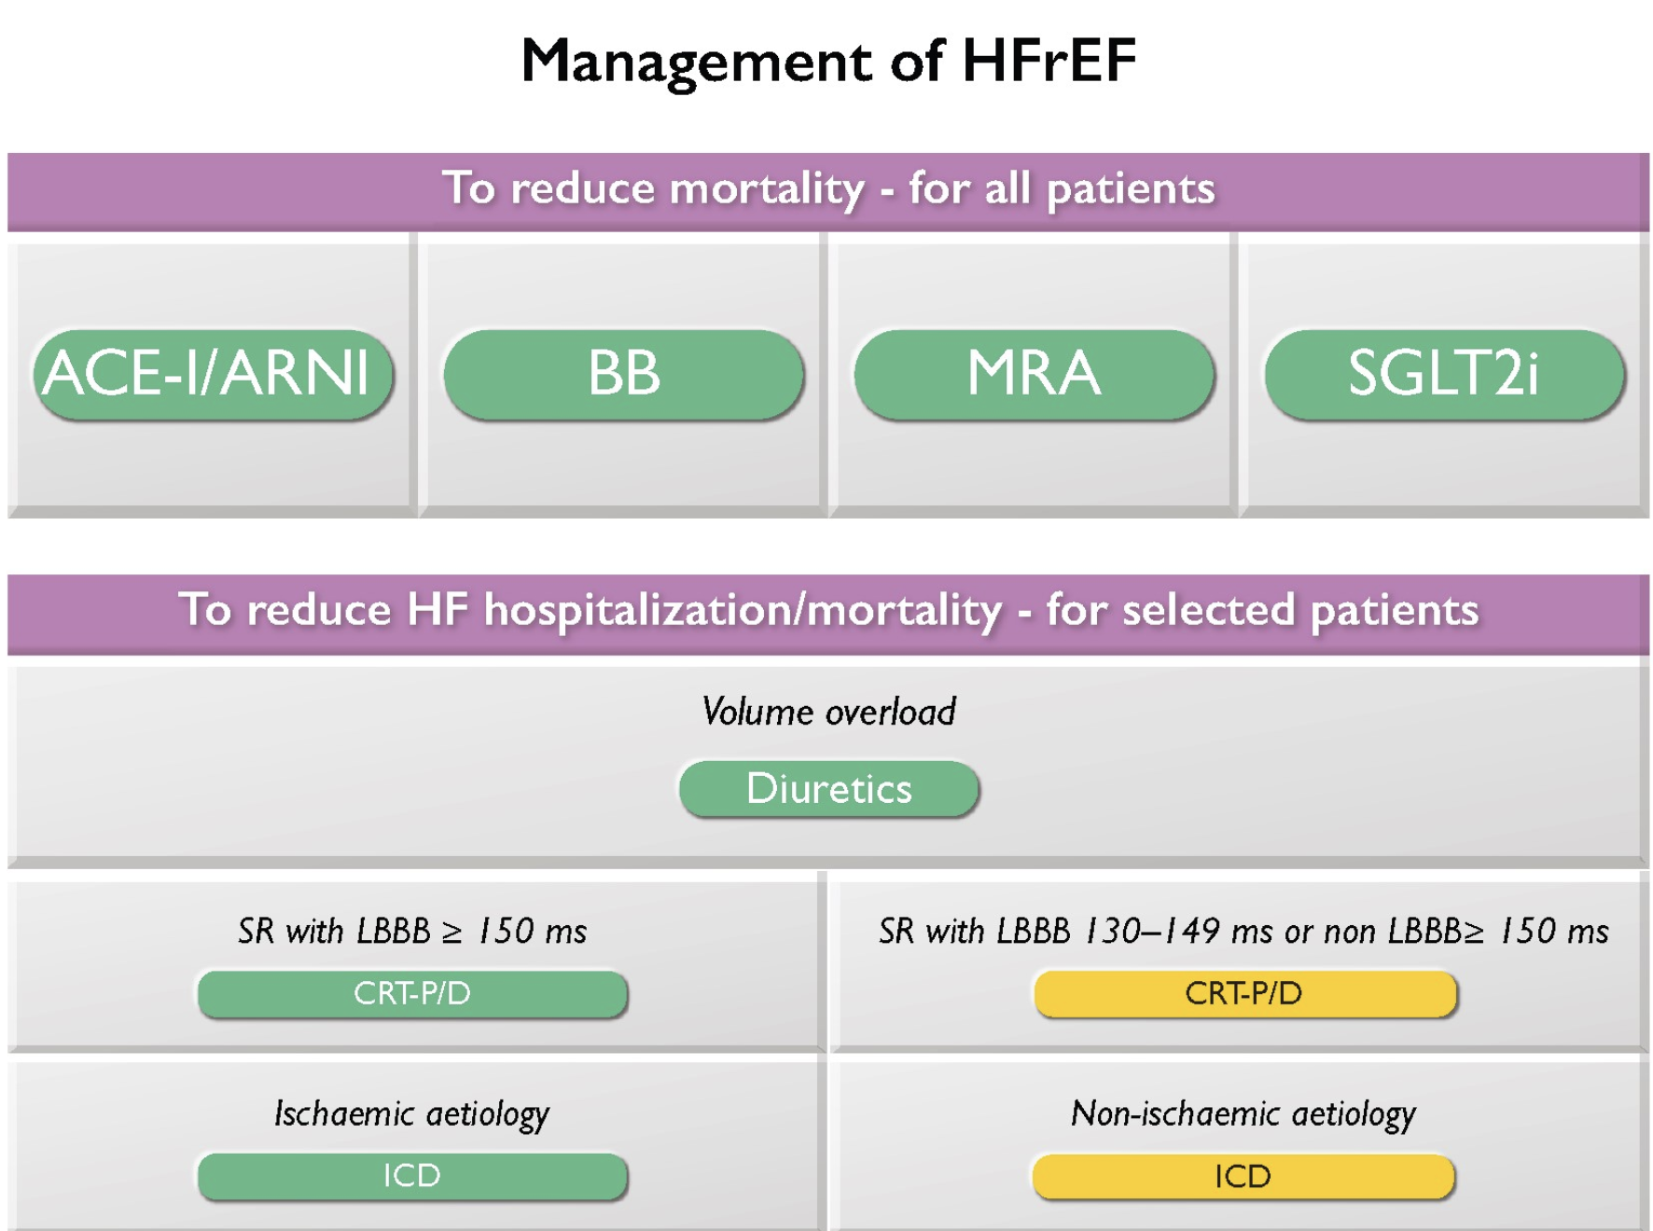
McDonagh TA et al. Eur Heart J. 2021;42(36):3599-3726. doi:10.1093/eurheartj/ehab368
Notes:
McDonagh TA, Metra M, Adamo M, et al. 2021 ESC Guidelines for the diagnosis and treatment of acute and chronic heart failure [published correction appears in Eur Heart J. 2021 Oct 14;:]. Eur Heart J. 2021;42(36):3599-3726. doi:10.1093/eurheartj/ehab368

Slide 19
Farmakologická a elektroimpulzná liečba SZ predlžuje život pacienta s komorovými arytmiami
Hlavným mechanizmom komorovej arytmogenézy pri SZ je remodelácia ĽK.
Farmakoterapia SZ a CRT predstavujú vysoko účinnú deceleráciu remodelácie, ktorá nespochybniteľne znižuje riziko malignych komorových arytmií a NKS.
Táto liečba predlžuje život a nemá v súčasnosti alternatívu.

