Slide 1
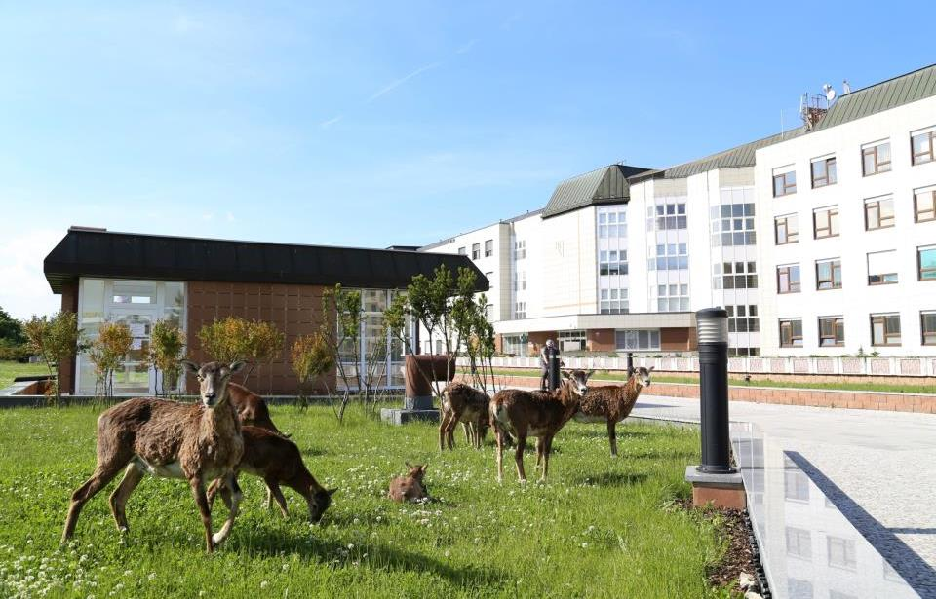
ABLATION WITH HIGH POWER SHORT DURATION
Doc. MUDr. Petr Peichl, PhD

Slide 2
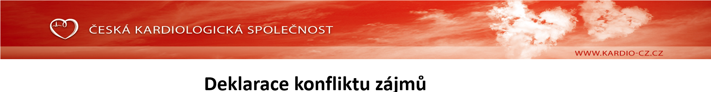
 | Nemám konflikt zájmů | Mám konflikt zájmů | Specifikace konfliktu (vyjmenujte subjekty, firmy či instituce, se kterými Vaše spolupráce může vést ke konfliktu zájmů)
Zaměstnanecký poměr | X
Vlastník / akcionář | X
Konzultant | X
Přednášková činnost |  | x
Člen poradních sborů (advisory boards) | X
Podpora výzkumu / granty | X
Jiné honoráře (např. za klinické studie či registry) | X

Slide 3
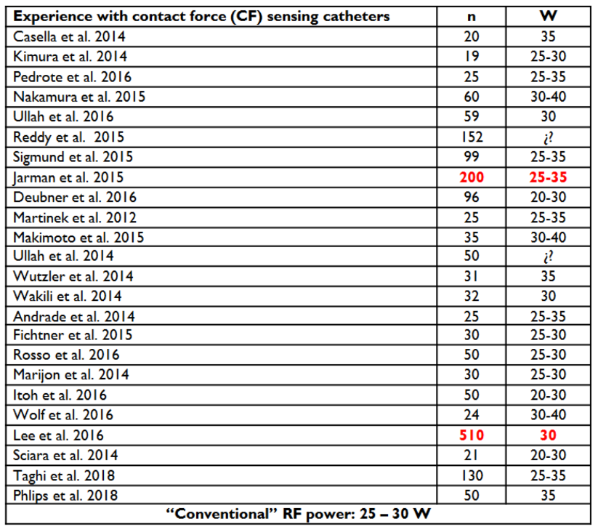
What are „conventional“ ablation settings for AF?
25-35W
Low power – long duration (LPLD)
Ablation above conventional
setting may be considered
as high power short duration (HPSD)

Slide 4
High-Power Short-Duration
using conventional cath
Navistar Thermocool Catheter
Comparison of 40W/30sec vs high power 50-80W 5sec in vitro and in vivo
Compared with 40W/30sec, 50 and 60W for 5 sec achieved transmurality and was safer
No complications for short-duration ablations of 50W-60W
Bhashkaran A Europace 2016

Slide 5
High-Power Short-Duration

Slide 6
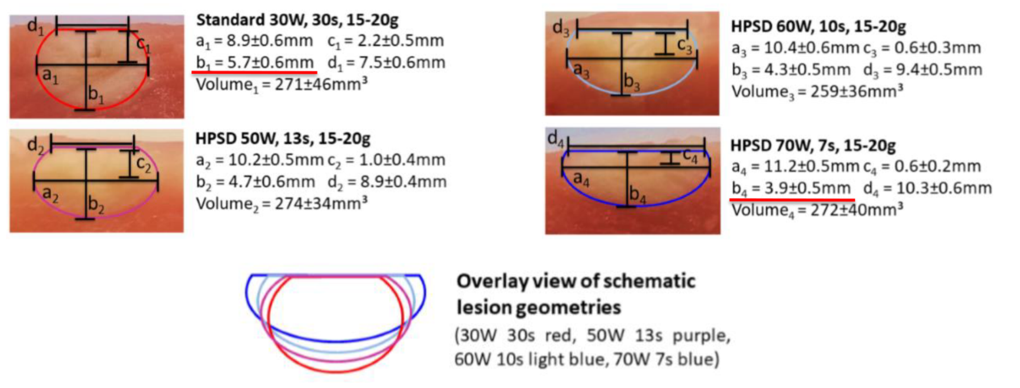
Similar volume, but different shape…
HPSD vs LPLD
Bourier JCE 2018

Slide 7
High-Power Short-Duration using conventional cath
51pts undergoing AF ablation
50W using Tacticath
  Length guided by loss of capture (mean of 11±4sec)
Procedure time
  101±20min
RF time
  14.9±4.3 min
No complications
AF free at one year 86%
Winkle RA, JICE 2017

Slide 8
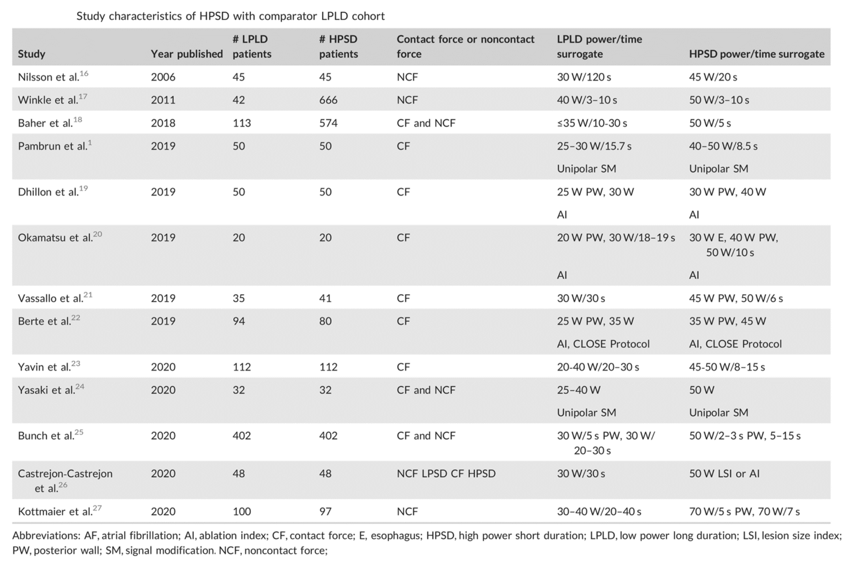
HPSD vs LPLD using conventional catheters
Studies evaluated:
CF, but also nonCF cath
Power ranges from 45W/20sec
50W/10sec
70W/5-7sec
Some studies used AI
Winkel JCE 2021
Notes:
Conventional catheters 50W-70W up to 7 sec.

Slide 9
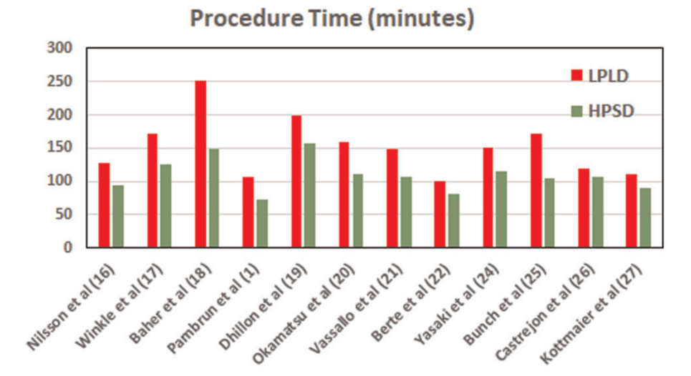
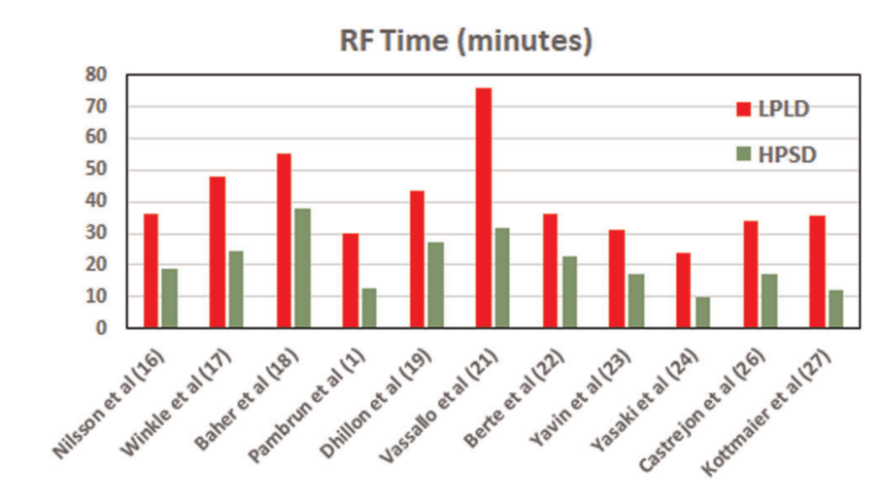
HPSD vs LPLD using conventional catheters
HPSD is faster and less RF is required
Winkel JCE 2021
Notes:
Conventional catheters 50W-70W up to 7 sec.

Slide 10
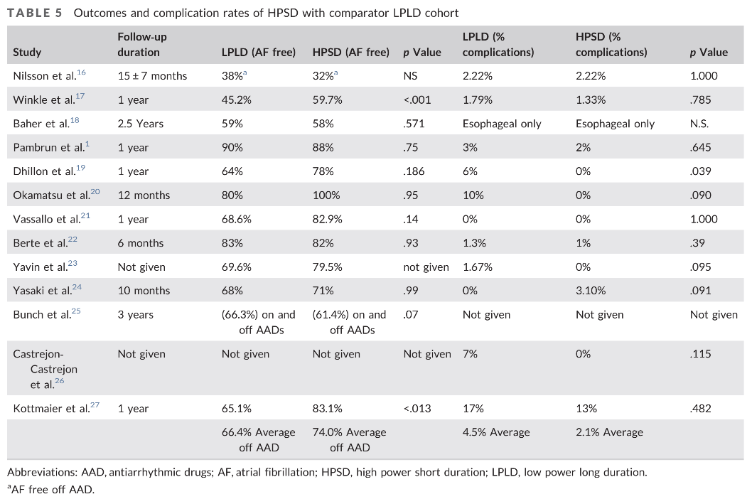
Outcome and complications HPSD vs LPLD using conventional catheters
Better outcome in some studies
Safety profile is similar to conventional ablation setting…
Winkel JCE 2021

Slide 11

High power requires better control

Slide 12
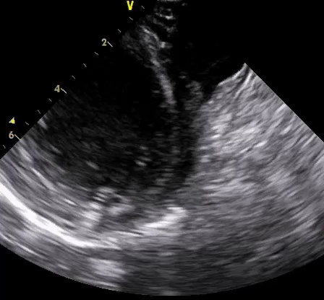
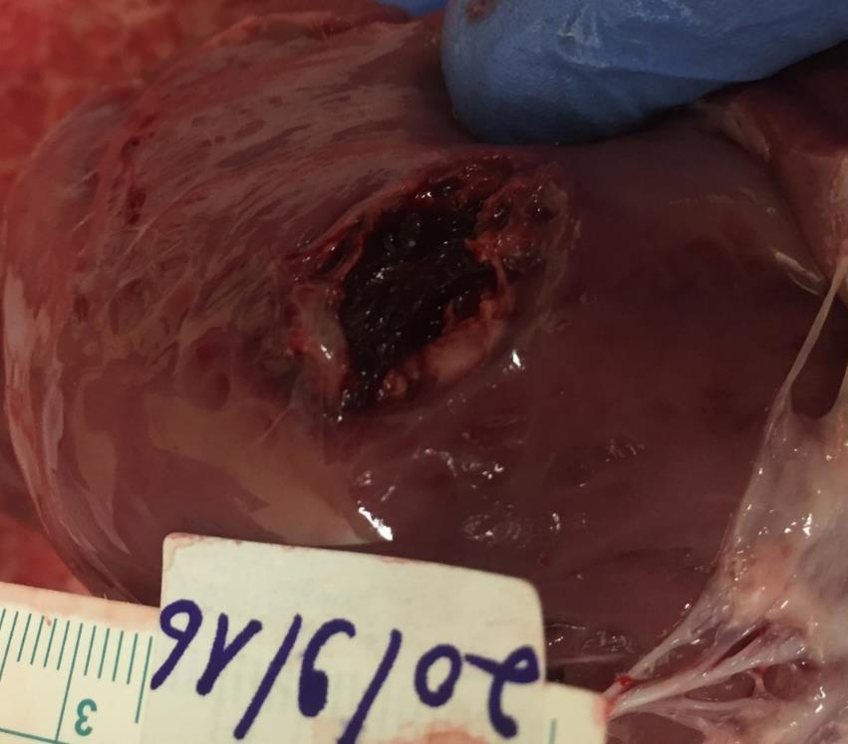
High power may have serious consequences
Lessons from animal work
ICE during „pop“ in LV apex
Gross anatomy at „pop“ site

Slide 13
To prevent tissue overheating, temperature should be measured during ablation
Measurement of temperature at the catheter-tissue interface is limited by the confounding effect of the cold irrigation fluid during ablation
Nonirrigated tip - Power 25W, T 55⁰C
Irrigated tip - Power 35W, T 43⁰C
Notes:
Novel catheter design may overcome this limitation and provide better surrogate for lesion size control

Slide 14
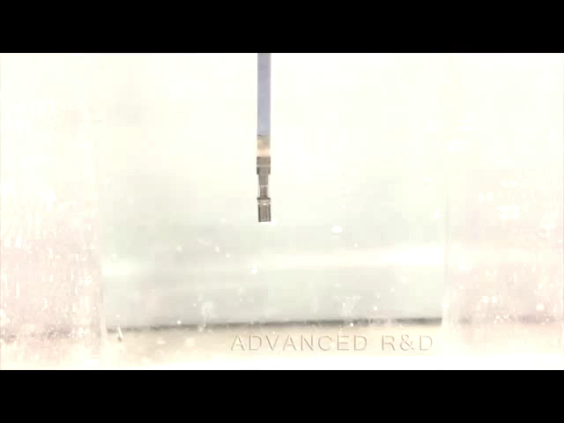
QDOT – Biosense Webster
Catheter design
Improved temperature sensing by 6 thermocouples embedded in the circumference of the tip electrode
  Distal 75µm from tip
  Proximal 3mm from tip
Improved irrigation system allowing adequate irrigation at low rates
Three microelectrodes
  Providing high-resolution electrograms
  Allow display of discrete local signals

Slide 15
vHPSD ablation using QDOT cath
Bench study
Leshem E;JACC Clinical Electrophysiology 2018

Slide 16
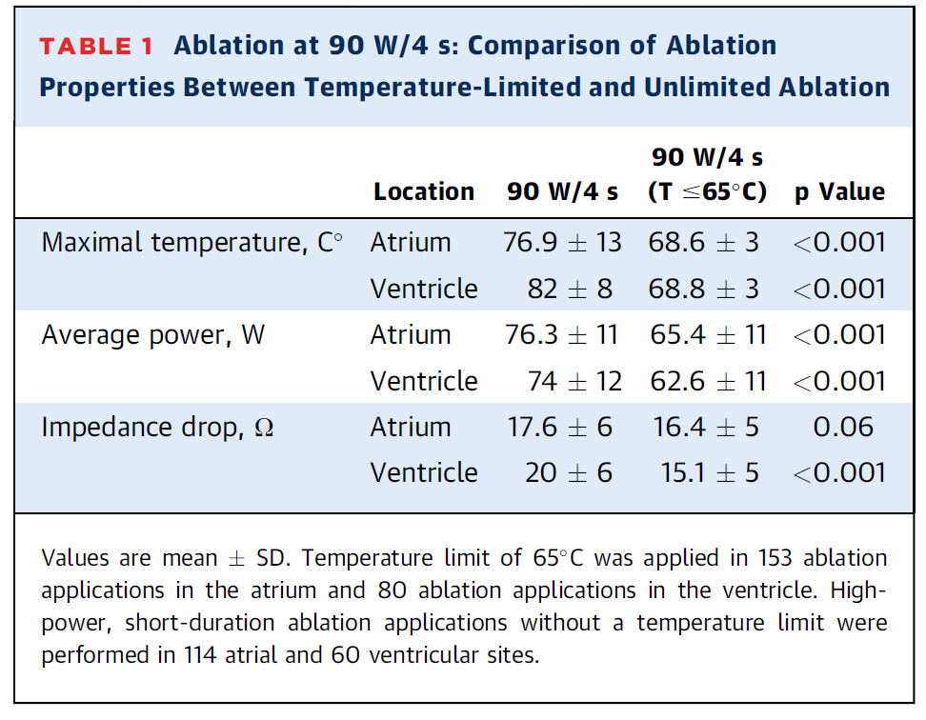
Comparison of vHPSD with/without temperature control
Ablation in beating heart
No popping with temperature limit to 65ºC
Three pops occurred (1.7%) without temperature limit
Mean temperature during pops >85ºC
Leshem E;JACC Clinical Electrophysiology 2018

Slide 17
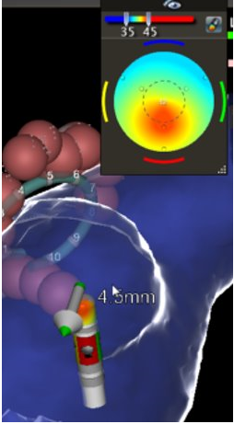
QDOT – Biosense Webster
Workflow
RF energy modulation to reach the selected target temperature (47⁰C, max 50⁰C)
QMODE Irrigation titration:
  Irrigation rate and power vary automatically between 4ml and 15ml based on tip temperature for optimized power delivery
  Power <35W irrigation 4ml/min, when temp >47⁰C irrigation increased to 15ml/min
  Power >35W irrigation 15ml, when temp <42⁰ irrigation decreased to 4ml/min
QMODE +:
  Ablation with 90W 4sec – True vHPSD
Notes:
Irrigation rate and power vary automatically between 4ml and 15ml based on tip temperature for optimized power delivery
Ensure the tip is within the allowed temperature range to avoid over-heating or over-cooling
Ablation Index standardizes the PAF procedural Workflow and allows reproducibility across multiple operators.*

Slide 18
vHSPD vs conventional ablation LPLD
Leshem E;JACC Clinical Electrophysiology 2018

Slide 19
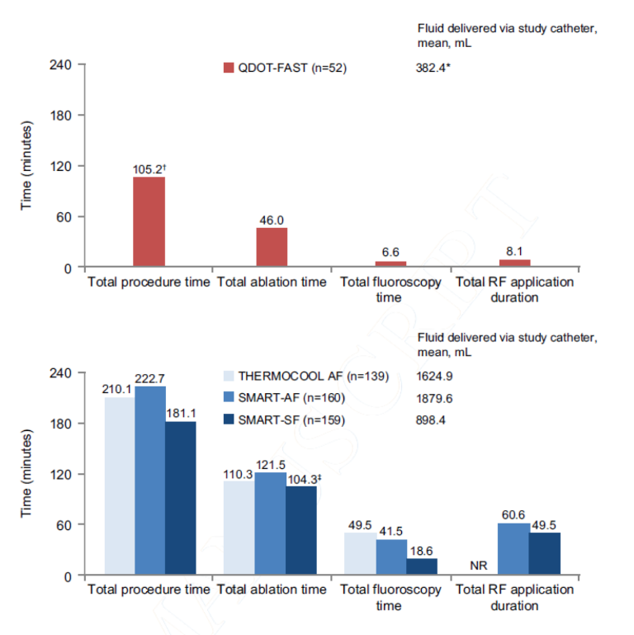
QDOT FAST Multicenter trial
52pts with PVI
90W/4sec
All veins isolated with study protocol
Procedure time 105min
One AE ulcer and hemorrhage at endoscopy
Six pts (11%) had silent cerebral lesions
Reddy V. JACC EP 2019

Slide 20
Other novel catheter tips for
HPSD

Slide 21
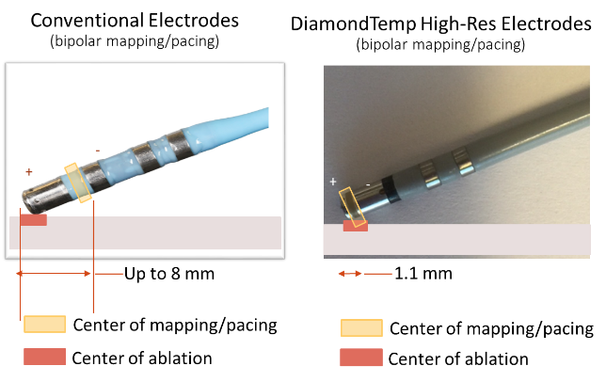
Diamond tip catheter (Medtronic)
7.5F externally irrigated (6 ports) catheter with 4.1mm tip electrode
Composite tip providing higher resolution electrograms
Tip is embedded with 2 industrial-grade diamonds allow rapid heat shunting
  (2 orders better thermal diffusivity than Ir-Pt)
Six thermocouples at the tip
Dedicated RF generator (ACT)
Iwasawa J et al. JACC 2017;70:542-53
Notes:
Tip is made of iridium –platina
Composite tip – during ablation works as one

Slide 22
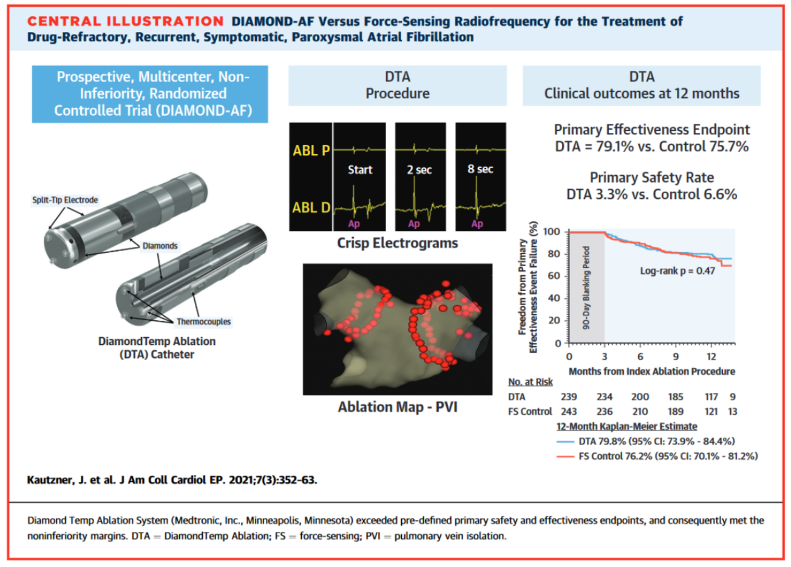
Clinical experience with Diamond tip
482pts with pAF
Randomized to PVI by:
  Diamond tip
    50W 60ºC
  Tacticath abl
    30W
Better safety profile
Shorter RF time
Noninferiority outcome

Slide 23
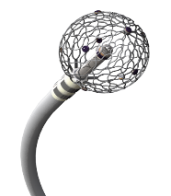
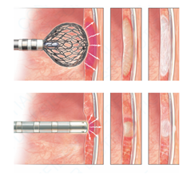
Affera Inc.
Sphere-9 is an 8F steerable ablation catheter
RF energy is delivered through a 9mm expandable irrigated tip
9 uniformly distributed temperature sensors and mini-electrodes enable high density mapping and temperature controlled energy delivery
The system also includes a proprietary ablation generator, pump and mapping system
  Radiofrequency High power– short duration lesions
    3-5 sec ablations with ~450W
  Pulse field (electroporation)
Barkagan Circ EP 2019

Slide 24
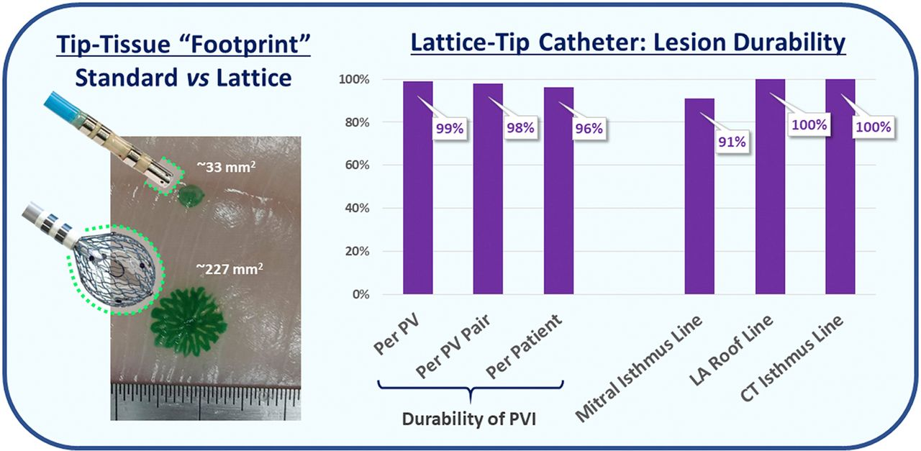
Ablation using lattice tip with HPSD provided durable lesions
Reddy..Peichl..Kautzner JACC EP 2020

Slide 25
High-Power Short-Duration
Summary
Advantages
  Faster
  Wider lesions
  Superficial (lower risk for collateral damage)
  As safe as conventional ablation
Disadvantages
  Not suitable for thick tissue
Notes:
Clearly better?
Lesion index validated for 35W
Steerable sheat does influence?
Same power ant/post
Not deep – but cumulative energy

